Slide 1
SB and DVBE Best Practices​ Webinar
Hosted by Department of General Services & Department of Veteran Affairs
August 16, 2023

Slide 2
Topics
Supplier Diversity Program
SB and DVBE Training Unit
First Policy, the Option & DVBE Exemptions
Business Outreach & Cal eProcure
SB and DVBE Emergency Registry
Statewide Advocacy Support, Economic Impact Study & New Legislation
Advocate Role and Responsibilities
CalVet DVBE Program
Leveraged Procurement Agreements
UNSPSC & Procurement Data Dashboards

Slide 3

Office of SB and DVBE Services (OSDS)
Our Core Functions:
Certification & Compliance Program Abuse
Business Outreach
Statewide Advocacy Support
SB & DVBE Training

Slide 4
Supplier Diversity Program
Mission
The state’s leader in integrating strategies and resources to advance the equitable inclusion and utilization of small and diverse businesses in California’s state procurement and contracting opportunities.

Slide 5
Supplier Diversity Program
What is Supplier Diversity?
A business strategy that:
    Ensures a diverse supplier base in the procurement of goods and services.
    Encourages a diverse range of businesses, without expressing a preference for any particular race.
    Uses race-neutral factors, such as socioeconomic status, to produce a diverse supplier pool.

Slide 6
Supplier Diversity Program
Supplier Diversity Myths
    A set-aside or affirmative action program
    The same as Diversity, Equity and Inclusion in hiring
    Is a department or company initiative

Slide 7
Supplier Diversity Program
Equity Legislation and Directives
Executive Order N-16-22 – Equity analysis considerations.
AB 1574 - Leveraging State Procurement for an Inclusive Economic Recovery Act of 2021.
AB 2019 – Mandated 25% SB goal.
SB 1442 (Liu) Authorizes focused outreach.

Slide 8
Supplier Diversity Program
Minority Owned Small Business Task Force (MOSB)
MOSB is a forum for diverse small businesses and affiliate organizations to identify ways to improve the state’s procurement process for state certified small and micro businesses.

Slide 9
Supplier Diversity Program
Minority Owned Small Business Task Force (MOSB)
Strategic Objectives:
    Unbundling contracts
    Contract/account management
    Utilizing digital technologies to automate and increase awareness of contract opportunities

Slide 10
Supplier Diversity Program
Contracting Strategies
Set SB contract participation goals as needed.
Reduce experience, reference requirements and level of inventory typically required for SB, Micros and DVBEs in solicitations.
Simplify specifications and terms.
Use the SB/DVBE Off-Ramp whenever feasible on Leveraged Procurement Agreements.
Establish an outreach program geared toward small, diverse and disabled veteran businesses.

Slide 11
Supplier Diversity Program
Target Area Contract Preference Act (TACPA)
TACPA is a tool designed to stimulate economic growth and opportunities in disadvantaged zones throughout the state. Raising awareness of its benefits will increase opportunities for California-based companies to operate eligible worksites in these disadvantaged zones and employ Californians experiencing high unemployment or poverty.

Slide 12
Supplier Diversity Program
Measuring Diversity Results Requires Metrics and Data
Spend and utilization
Number of repeat awards
Number of businesses that respond and lose/win bids
Project completion rate of businesses
Number of workshop participants = Actual suppliers
Demographics/Socioeconomic based

Slide 13

Is Supplier Diversity integrated into your department’s priorities?

Slide 14
Supplier Diversity Program
California Ethnic Media Report Key Findings:
Sector is robust and diverse.
Provides trusted community-specific information, they are a key community institution.
Provides 36 languages other than English, which are spoken in more than 15 million households.
Government agencies have underinvested in the state's ethnic media.

Slide 15
Has your department utilized ethnic media in your SB/DVBE outreach efforts?

Slide 16

Thursday, August 31 at the Kimpton Sawyer Hotel
500 J Street, Sacramento, CA 95814 from 11am to 7:30pm

Slide 17
Supplier Diversity Program
Save the Date – CA Supplier Diversity Symposium
March 14, 2024, in Sacramento
Hosted by the Statewide Coalition on Diversity Initiatives
Stakeholder Interest Survey Results

Slide 18
If invited, would you attend state or regional small business conferences at no cost to connect with more diverse suppliers?

Slide 19
Supplier Diversity Program
Web Resources
  Diversity Partner Directory
  Ethnic Media Guide
  Voluntary diversity data collection
  California SB/DVBE Atlas Tool (CalSAT)

Slide 20
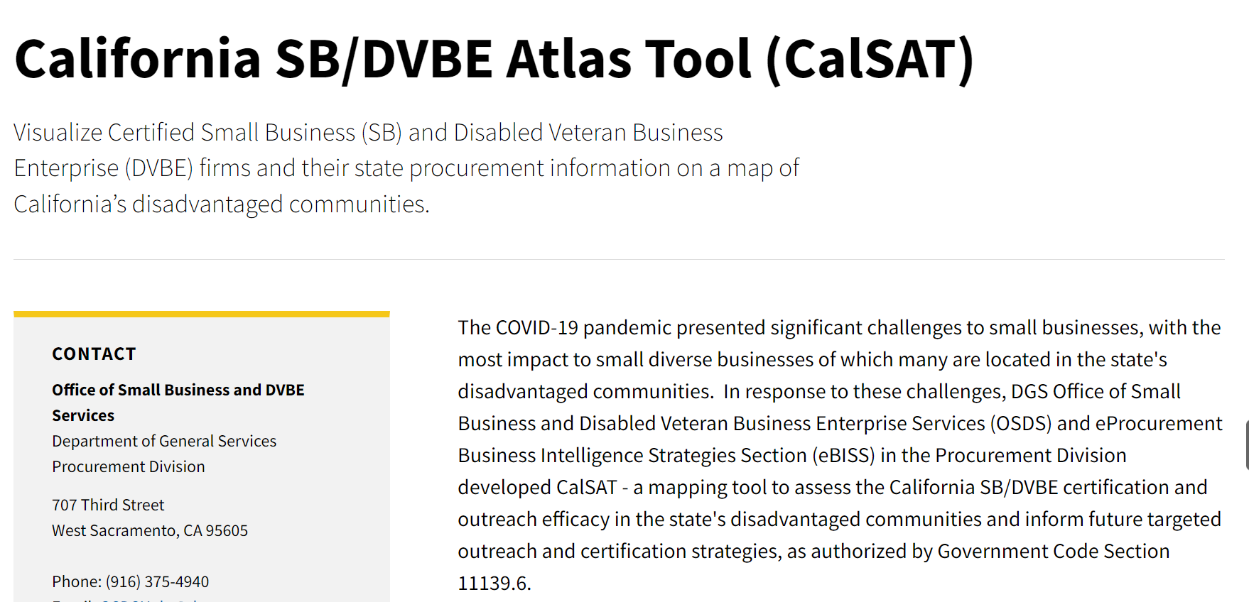
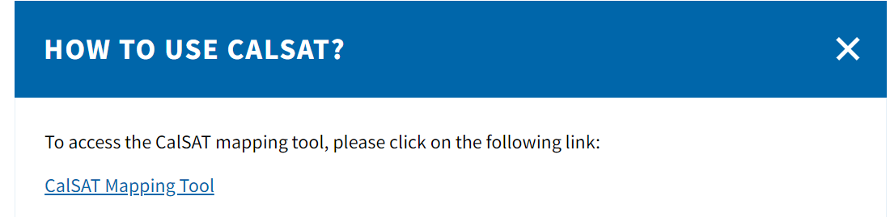
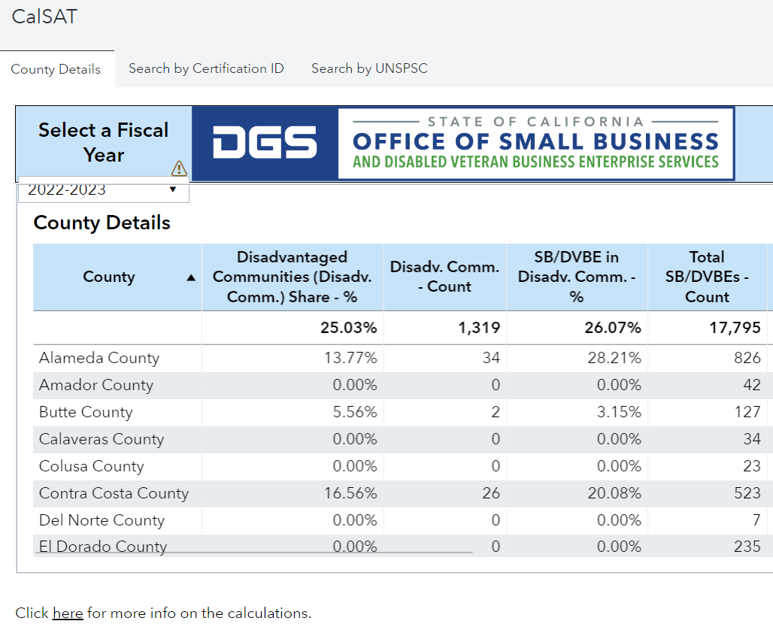
Supplier Diversity Program
How to use CalSAT?

Slide 21
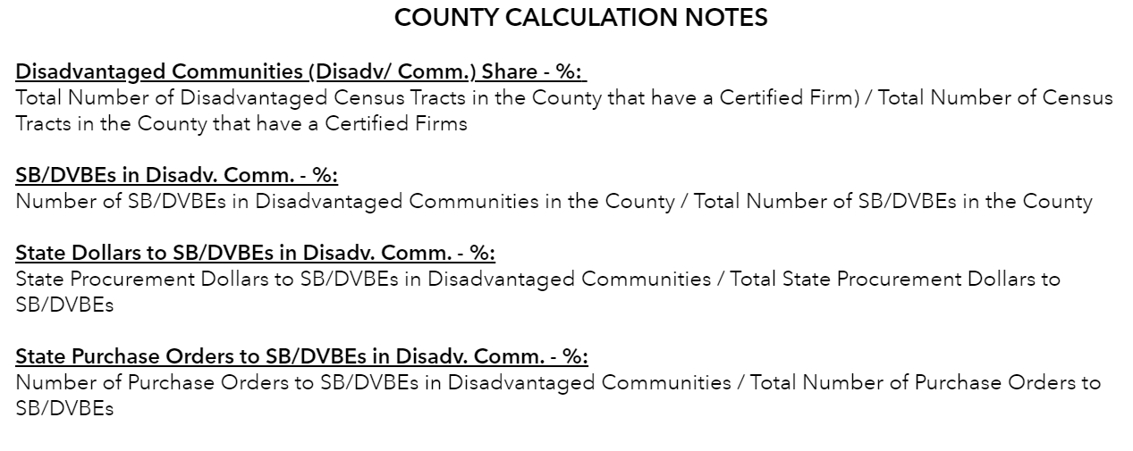
Supplier Diversity Program
How to use CalSAT?

Slide 22
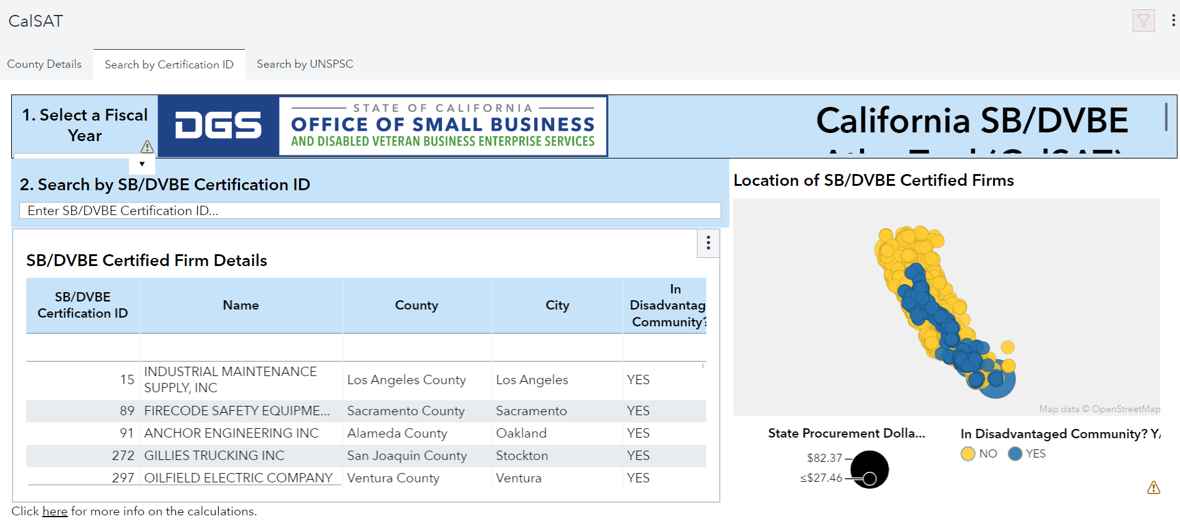
Supplier Diversity Program
How to use CalSAT?

Slide 23
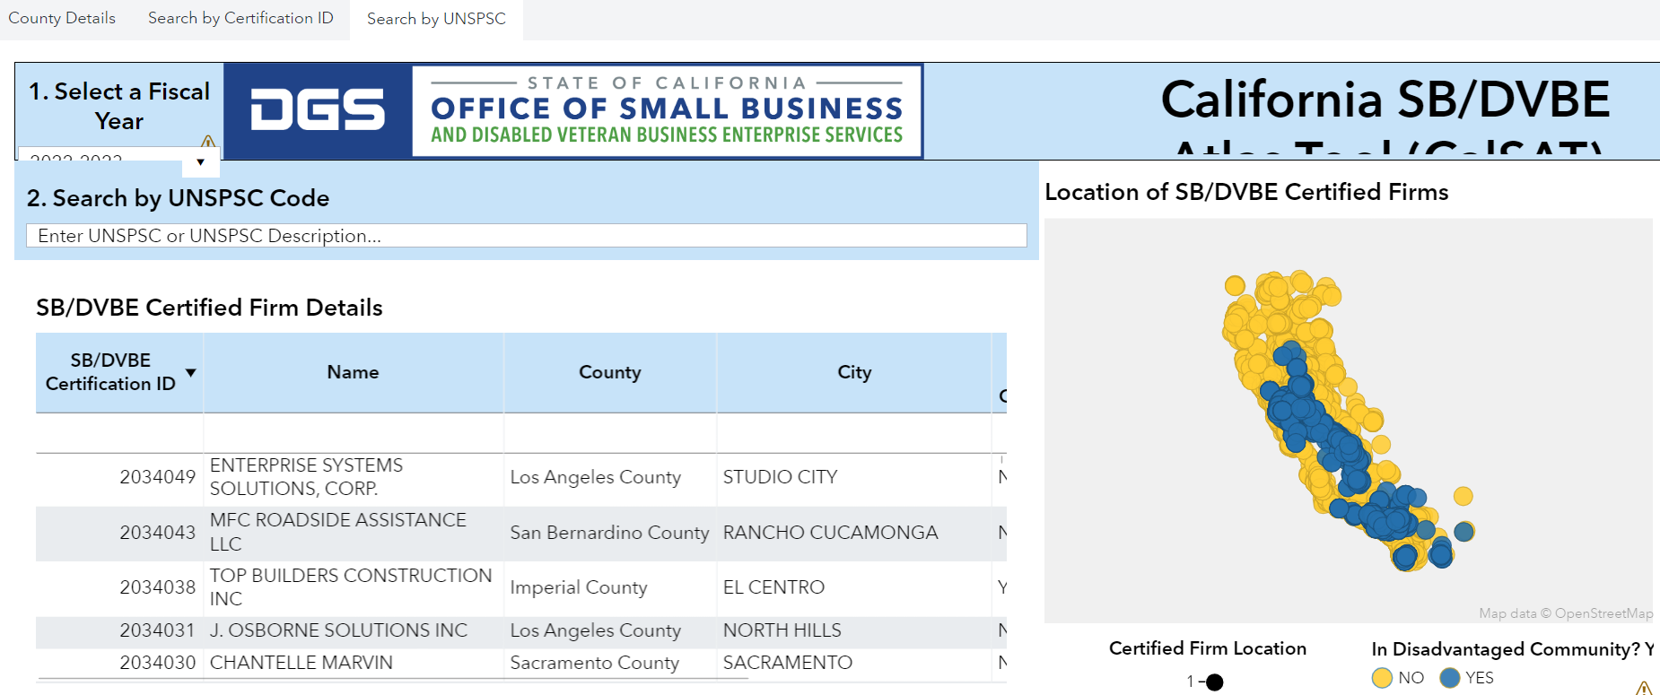
Supplier Diversity Program
How to use CalSAT?

Slide 24
Supplier Diversity Program
Visit the Website:
Statewide Supplier Diversity Program (ca.gov)
Contact:
SupplierDiversity@dgs.ca.gov

Slide 25

New SB and DVBE Training Unit
SB and DVBE trainings on navigating state contracting will launch by end of 2023
Modules include:
    Marketing
    CUF
    Prompt Payment
    LPAs
    Environmentally Preferable Purchasing and more!
More details coming soon!

Slide 26
SB and DVBE First Policy
Benefits:
Simplifies procurement – less work for you!
Acquire goods and services more quickly and efficiently
Helps you to meet the 25% and 3% mandated goals
Grow your network of SB and DVBE business contacts
Supports California’s economy

Slide 27
SB and DVBE Option
Streamlined procurement process to help increase SB and DVBE contracting participation
Benefits:
Acquire goods and services quickly and efficiently
$5,000.01 - $249,999; PW $5,000.01 -$388,000
Allows you to meet the 25% and 3% requirements
Increases opportunities to SBs and DVBEs

Slide 28
DVBE Exemption Request (STD 816)
Purpose: To waive DVBE requirement and/or incentive
Processed by each department and prepared by buyers
Review justification
Conduct independent research
Link to form STD. 816

Slide 29
Leveraging Business Outreach
Over 200 outreach events in FY ‘22 – ’23
Exhibiting, workshops, panels and matchmaking activities
Strategic partners and host organizations
Subject matter experts

Slide 30
Using Cal eProcure - Certified SB and DVBE Firm Database
Search by:
Business Name
Certification ID/Type
Business Type
UNSPSC Classification
Keywords
Services Areas/Zip Codes
Contractor’s License Classification

Slide 31
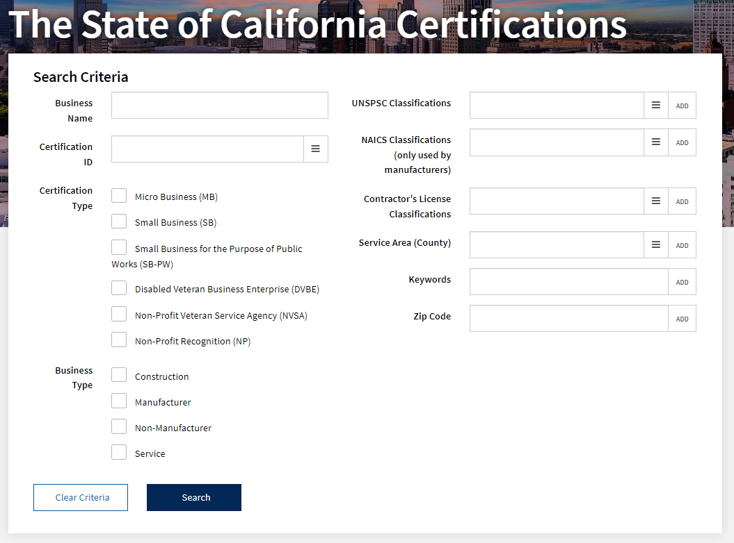

Slide 32
What is the SB/DVBE Emergency Registry?
  The registry is designed specifically to aid state departments in connecting with certified businesses who can quickly offer specialized emergency goods and services

Slide 33
SB/DVBE Emergency Registry
  Separate from Cal eProcure
  List of state certified businesses
  Used by state department buyers
  Businesses must be ready for emergency contract work
  Predetermined categories of goods and services

Slide 34
Benefits
  Expands contracting opportunities to certified firms.
  Allows state departments to quickly identify certified firms able to provide emergency goods and services.

Slide 35
Emergency Categories
  Base Camp Operations
  Buildings/Sanitation
  Communications
  Debris Removal
  Electrical
  Energy/Fuel
  Erosion Control
  Facilities
  Fencing
  Fire Protection
  Food & Beverage
  Hazardous Materials
  Information Technology
  Janitorial
  Law Enforcement/Security
  Lighting
  Logistics/Transportation
  Maintenance/Repair Medical
  Miscellaneous Services
  Miscellaneous Supplies
  Personal Care Supplies
  Portable Modular
  Respiratory Products
  Roadway Maintenance
  Temporary Labor
  Traffic Control
  Vehicle Rentals (Incl. Heavy Equipment)
  Vehicle Repair

Slide 36
SB and DVBE Emergency Registry – Buyer Access
  Buyers must register within the DGS Shared Services portal to get access to the Emergency Registry Search Portal
  In order to be granted search access buyers will need:
    Contact information: state department email, phone, department address
    Supervisor contact information

Slide 37
Resources
  SB DVBE ER State Department Webpage
  Instructional Guide for State Departments
  Questions SBDVBEEmergencyRegistry@dgs.ca.gov

Slide 38
Statewide Advocacy Support Program
We can help!
  Receive training and guidance
  Collaborate & participate in OSDS Business Outreach events https://www.dgs.ca.gov/PD/Events
  Develop outreach strategy to increase vendor pool
  Conduct market research to find SBs and DVBEs
  Adopt an SB and DVBE First Policy
  Identify best practices that help you meet SB and DVBE mandated goals

Slide 39
Statewide Advocacy Support Program
  New Advocate Directory!
  New Online Improvement Plan!
  OSDS is Growing!

Slide 40
Statewide Advocacy Support Program
  AB 2019 Survey
    The implementation of AB 2019 and AB 1574
    Launched in May
    As of 8/10, 66 responses were received
    142 departments received the survey
    Survey Link

Slide 41
Economic Impact Study of SB & DVBE Program
  The study will assess:
    The effectiveness of DGS SB and DVBE programs
    The impact of state contract dollars on SBs and DVBEs, their communities, and the state economy
  Look for a communication coming soon. For questions, email Demeshia.Swanson@dgs.ca.gov

Slide 42
Advocate Role and Responsibilities
Expectations and Tools for Success
  Understand your department’s needs
  Clarify procurement processes
  Troubleshoot prompt payment issues
  Management support is KEY
  Promote policies to meet annual goals
  Maintain consistent communication with DGS, CalVet, and peer state advocates
  Stay current on SB & DVBE program legislation

Slide 43
Advocate Role and Responsibilities
Expectations and Tools for Success
  Update desk manuals, policies and procedures, solicitation documentations and forms
  Review SB and DVBE Waiver requests carefully
  Set a 3% mandatory DVBE goal on all formal solicitations (e.g., IFB, RFP)
  Review CAR data regularly to ensure SB and DVBE prime and subcontractor information is captured correctly

Slide 44
Advocate Role and Responsibilities
Best Practices
  Build an active partnership with your department buyers
  Create a shared folder to share capabilities statements
  Prepare a template email to respond to suppliers promptly
  Create an SB and DVBE Advocate general email address.
  Designate a backup SB and DVBE Advocate
  Update contact information on the Advocate Directory

Slide 45
Advocate Role and Responsibilities
Resources
  Connect with other Advocates on the List Serve: List Serve Access
  Connect with Statewide Advocacy Support Program: Advocate@dgs.ca.gov
  Update Advocate Contact Information: SB and DVBE Advocate Update Form
  Quarterly Advocate Meetings: https://www.dgs.ca.gov/PD-Advocate-Info
  CAR Report contact: OSDSReports@dgs.ca.gov
  2023 SARA Awards: 23rd Annual State Agency Recognition Awards (ca.gov)

Slide 46
DVBE Overview
  The California Department of Veterans Affairs DVBE unit primary functions are:
  Supporting all State agencies DVBE advocates are continuously striving to meeting the 3% contracting requirement
  CalVet Advisory Council which provides California’s Disabled Veteran Business Enterprise community with a dedicated forum to advise the Secretary on program improvements to support veteran entrepreneurship
  DVBE Request for Response

Slide 47
DVBE Request for Response
  Survey housed on CalVet website
  Avenue for Veterans, Contractors, SBs, and buyers to contact DVBE unit
    Staff review all inquiries within 5 business days
    Provide information and resources
    CalVet Management review high level inquiries
    DVBE Advisory Council review concerns regarding the DVBE community
  Webpage: https://www.surveymonkey.com/r/CalVet_DVBE_Request_for_Response

Slide 48
DVBE Overview
  Quarterly SB and DVBE Advocates meeting
    Policy and Legislation updates
    Upcoming Outreach events
    Open discussions to assist Advocates struggles
  DVBE Exemption Request (STD 816) review
    CalVet will provide analysis and recommendation
  Solicitation assistance
    Review solicitations
    Search and contact firms

Slide 49
CalVet Advisory Council
  Six member council
    DVBE and veteran service organizations
  Providing California's Disabled Veteran Business Enterprise community with a dedicated forum to advise the Secretary
    This is not a policy making body
  Taskforces will take on current issues brought by members of the DVBE community
    Recommendations will be presented to the Statewide DVBE Advocate

Slide 50
CalVet Resources
  https://www.calvet.ca.gov/calvet-programs/veteran-services

Slide 51
Leveraged Procurement Agreements
  The Acquisitions branch establishes Leveraged Procurement Agreements (LPAs) for commonly purchased goods and services
  LPAs leverage the state’s buying power and simplify the procurement process for state departments and local government entities

Slide 52
Leveraged Procurement Agreements
Finding LPAs
  State Contracts Index Listing contains high level contract information for each contract, including links to the Cal eProcure LPA details page
    Located on the DGS-PD home page: https://www.dgs.ca.gov/PD

Slide 53
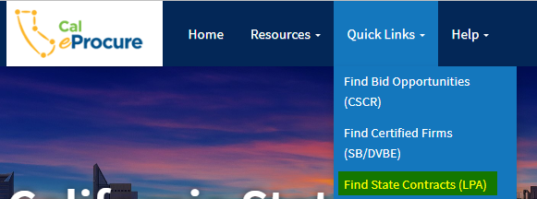
Leveraged Procurement Agreements
Finding LPAs Con’t.
  Search Cal eProcure for LPAs
    Step 1: Search Cal eProcure: https://caleprocure.ca.gov/pages/index.aspx
    Step 2: Quick Links → “Find State Contracts (LPA)”

Slide 54
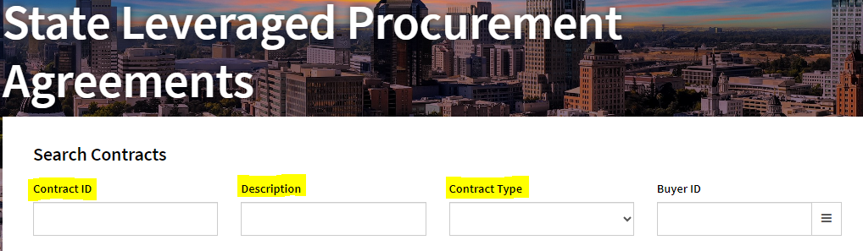
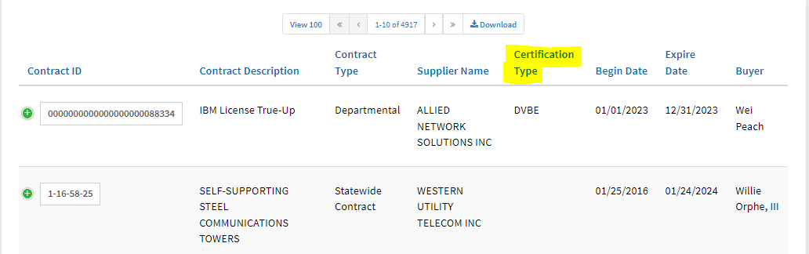
Leveraged Procurement Agreements
Finding LPAs Con’t.
    Step 3: Search by Contract ID, Description, or Contract Type
    Step 4: Sort by Certification Type

Slide 55
Statewide Contracts
  Offers non-IT goods and IT goods and services
  Established through a competitive bidding process
  Reduces the need for individual departments to conduct repetitive bids for like products
  Most are mandatory for state departments and available for use by local government entities
  Solicitations include SB preference and DVBE incentives to increase participation
  SB and DVBE off-ramp provision may be included

Slide 56
LPA Contact Information
  Contract Search and State Contracts Index Listing
  DGS Leveraged Procurement Agreements webpage:
    https://www.dgs.ca.gov/PD-LPA

Slide 57
California Multiple Award Schedules (CMAS)
  Streamlined procurement process based on pricing from federal GSA schedules and other multiple award contracts where pricing has been deemed fair, reasonable and competitive
  Suppliers do not need their own GSA schedule or base contract. They may piggyback on another company’s schedule/contract
  Non-IT commodities, non-IT services, and IT goods and services may be offered through CMAS

Slide 58
CMAS Awarded to SB and DVBE Suppliers
49.96% of all CMAS awarded to SBs
5.36% of all CMAS awarded to DVBEs
As of 3/08/2022

Slide 59
Advantages for SB and DVBE
  State agencies must consider offers from SBs and DVBEs
  Contracts to SBs are exempt from the DGS administrative fee. (DGS bills state agencies for CMAS transactions.)
  CMAS waives the incentive fee for SBs. Typically, CMAS charges a fee to suppliers for local government (counties, cities, K-12 schools, community colleges, etc.).

Slide 60
CMAS Portal
  Live on February 1, 2021
  Improved the CMAS application process. Current processing time is averaging 3-5 days.
  Eco friendly! Eliminated all paper from the process.
  Eliminated many of the typical deficiencies in the paper applications.
  Payments may be made by credit/debit or electronic check.
  Quarterly reports can be submitted through the portal
  Multiple company users may be added to the portal; different users may have different roles and permissions.

Slide 62
CMAS Contact Information
Visit the Website:
California Multiple Award Schedules
CMAS Search Portal Link:
https://cmassearch.azurewebsites.net/
Contact: CMAS@dgs.ca.gov

Slide 63
Master Agreements
  Master Agreements (MAs) are competitively bid contracts available to any agency that expends public funds
  Prequalified list of vendors
  Simplifies the purchasing process for the end user
  Offers both IT and Non-IT MAs
  Agencies may be required to conduct Request for Offers (RFOs) from awarded suppliers
  Small Business and DVBE Resellers are available!

Slide 64
Master Agreements Contact Information
Visit the Website:
Master Agreements
Contact:
Masters@dgs.ca.gov

Slide 65
Software Licensing Program (SLP)
  The SLP was established in January 1994
  Software discounts are negotiated with major software publishers then passed on to the state
  Reduces the need for individual departments to conduct separate acquisitions for proprietary software licenses and software upgrades.

Slide 66
Software Licensing Program (SLP)
  Available Categories
    Software, Maintenance
    Support
    SaaS/Cloud
    Implementation Services
    Installation
    Training
    IaaS/PaaS
  Not Available
    Standalone Hardware, Consulting, Standalone Training and Standalone Installation Services

Slide 67
Software Licensing Program (SLP)
  Departments must solicit from a minimum of three (3) contractors.
  Award is based upon lowest cost or best value, determined by departments
  Small Business and DVBE resellers are available

Slide 68
Software Licensing Program (SLP) Contact Information
Visit the website:
Software Licensing Program (ca.gov)
Contact: SLP@dgs.ca.gov

Slide 69
Cooperative Agreements
  DGS-PD partners with purchasing consortiums, such as the National Association of State Procurement Officials (NASPO), to establish cooperative agreements for California state and local agencies to use
  Cooperative agreements are based on master agreements established by a lead entity, which are written, solicited and executed under that lead entity’s procurement rules
  Offers Non-IT commodities, Non-IT services and IT goods and services

Slide 70
Cooperative Agreements Contact Information
Visit the Website:
Cooperative Agreements
Contact:
PDCooperatives@dgs.ca.gov

Slide 71
Procurement/Intake & Analysis Unit
  UNSPSC (United Nations Standard Products and Services Code)
  Procurement Data Dashboards

Slide 72
Procurement/Intake & Analysis Unit
UNSPSC (United Nations Standard Products and Services Code)
Where to find information regarding UNSPSC
          https://www.dgs.ca.gov/PD-UNSPSC
          Go to www.dgs.ca.gov and the type in “UNSPSC” in search bar
        Understanding the UNSPSC coding
          For help, contact helpUNSPSC@dgs.ca.gov
UNSPSC Replacement Search Dashboard
          Removed unused codes
          Added more context to codes
          Consolidated codes

Slide 73
Procurement/Intake & Analysis Unit
  Certified SB and DVBE Spend Comparison Dashboard
  Where to find the dashboard:
    https://www.dgs.ca.gov/PD/Resources/Page-Content/Procurement-Division-Resources-List-Folder/Intake-and-Analysis-Unit-Dashboards?search=dashboard
    Or go to www.dgs.ca.gov and type in “DASHBOARD” in the search bar
  Understanding the SB and DVBE Spend Dashboard
    The dashboard was created to provide a visual tool to show how much money was spent with certified vendors compared to non-certified vendors

Slide 74
Procurement/Intake & Analysis Unit
Certified SB and DVBE Spend Comparison Dashboard
  Certified SB and DVBE Spend Dashboard
    Shows the total spend on each UNSPSC code
    Provides the purchase order frequencies
    Visually shows how much is spent over time

Slide 75
Procurement/Intake & Analysis Unit
Certified SB and DVBE Spend Comparison Dashboard
  How to use the dashboard:
    Enter the desired fiscal year. You may select “Clear Filter” to show all (3) years of data
    Enter the applicable UNSPSC description (e.g. PAPER or FISH)
    Hit enter after the selections have been made
    Double click on the line that is applicable
    The results will show the total spend under: “Certified Vendors” and “Non-Certified Vendors”
    Double click on vendor’s name to show further detail
    The results will show the total spend from each State Department

Slide 76
Procurement/Intake & Analysis Unit Contact Information
eProcurement & Business Intelligence Strategies Section (eBISS)
Department of General Services
https://www.dgs.ca.gov/PD-UNSPSC
https://www.dgs.ca.gov/PD-Dashboards
IAU@dgs.ca.gov
HelpUNSPSC@dgs.ca.gov

Slide 77
Contact Information
Statewide Advocacy Support Program
Office of Small Business and DVBE Services
California Department of General Services
Advocate@dgs.ca.gov

Slide 78
Thank You
for Participating
Notes:
Thank you!

