Slide 1
Disabled Veteran Business Enterprise (DVBE) Subcontracting Report
❖
Presented By: Mamta Srivastava
Office of Small Business and Disabled Veteran Business Enterprise Services
(OSDS)
DS) 2/16/2023
1

Slide 2
Introduction
Mamta Srivastava – Reports Coordinator
Carl Josephson - Compliance and Quality Assurance Manager
Leslie Fritz - Training and Development Specialist
Marc Anderson - Supervisor (Contracts Management Unit)
2
Office of Small Business and Disabled Veteran Business Enterprise Services (OSDS)
2/16/2023

Slide 3
Training Outline
Background
Website Resources
Statutes & Regulations
2021 Legislation Impacting the Report
DVBE Reporting Requirements
DVBE Reporting Forms
TRAINING OUTLINE

Slide 4
DVBE SUBCONTRACTING REPORT WEBPAGE
Go To https://www.dgs.ca.gov/
Search for “DVBE Subcontracting Report”
Click on File a DVBE Subcontracting Report
Information Available:
Steps in Reporting Process
Report Forms and Instructions
Training and FAQs

Slide 5
Reports Forms and Instructions
Prime Contractor's Certification - DVBE Subcontractor Report (STD 817), Formerly DGS PD 810P
State Department’s Contractor DVBE Subcontracting Consolidation Report (DGS PD 810D)
Training and FAQ
DVBE Subcontracting Training PPT
DVBE Subcontracting FAQs
DVBE SUBCONTRACTING REPORT RESOURCES

Slide 6
STATUTORY AND REGULATORY REQUIREMENTS
Military and Veterans Code Section 999.5(d),
999.55 and 999.7
Government Code Section 14841
Code of Regulations Section 1896.78(e)
Consolidated State Contracting Manual (SCM) Volume 2 Chapter 12, Section 1203.1 Link
BB. No. P-05-21 - SUBJECT: New DVBE
Contracting and Reporting Requirements

Slide 7
SCM Volume 2 Chapter 12 Pt 1
Include the applicable DVBE Program Requirements in the solicitation (verbal or written) whenever the solicitation includes the DVBE participation requirements.
Include contract language and specific payment provisions to describe the requirements including the Prime Contractor’s Certification-DVBE Subcontracting Report
The completed STD 817 is required to be submitted by the prime contractor to the contract manager.
Withhold $10,000, or full payment if less than $10,000, from a prime contractor’s final payment pending receipt of a complete and accurate STD 817. Do not withhold more than $10,000 for the purposes of ensuring compliance with the STD 817 certification requirement.
Receive and review STD 817 for completeness and accuracy.

Slide 8
SCM Volume 2 Chapter 12 Pt 2
Authorize payment of the withhold upon review and determination that the STD 817 received is accurate and complete.
If the STD 817 is received but is found by the department to be incomplete or inaccurate, or if the STD 817 is not received by the final invoice, the department must send the prime contractor a cure notice allowing at least 15 calendar days, but not more than 30 calendar days to meet the certification requirements. The notice must inform the prime contractor of the consequence of a permanent deduction if the prime refuses to comply.
Permanently deduct the withheld amount when the prime contractor refuses to comply with the STD 817 requirement after given opportunity to cure.
The state department receiving the goods or services must retain in the procurement file all records related to the Prime Contractors' Certification- DVBE Contract Report (STD 817) submittal.

Slide 9
2021 Legislation Impacting the Report Pt 1
AB 230 (Brough, Chapter 676, Statutes of 2019) amended Section 999.5 of the Military and Veterans Code and Sections 14839 and 14841 of the Government Code and added Section 10230 to the Public Contract Code.
AB 1365 (Veterans Affairs Committee, Chapter 689, Statutes of 2019) added Section 999.55 to the Military and Veterans Code.

Slide 10
2021 Legislation Impacting the Report Pt 2
SB 588 (Archuleta, Chapter 80, Statutes of 2020) added Section
999.7 to the Military and Veterans Code.
Important !
All departments must submit their Form DGS PD 810D to OSDS, even if they did not receive STD. 817 from prime contractors.
DVBE Subcontracting Reports becomes an important compliance tool for departments and OSDS to identify prime contractors not meeting DVBE requirements and commitments!
On or before January 1, 2024, the Legislative Analyst Office shall complete a comprehensive assessment of the DVBE program and submit a report to the Legislature (MVC 999.7).

Slide 11
PRIME CONTRACTOR'S CERTIFICATION - DVBE SUBCONTRACTOR REPORT (STD 817), FORMERLY DGS PD 810P

Slide 12
PRIME CONTRACTOR'S CERTIFICATION - DVBE SUBCONTRACTOR REPORT (STD 817)
DGS PD 810P expanded to include requirements and renumbered to name (STD 817)
Applicable to all contracts and POs with DVBE Subcontractors, awarded or amended on or after January 1st, 2021.
Contract language should include DVBE Program Requirements.
STD 817 must be fully completed by prime contractor.
Due upon completion of contract and POs, where completion of contract may vary with each department.
Departments to
Withhold $10,000, or full payment if less than 10,000, from a prime contractor’s final payment pending receipt of a complete and accurate STD 817.
Receive and review STD 817 for completeness and accuracy.

Slide 13
PRIME CONTRACTOR'S CERTIFICATION - DVBE SUBCONTRACTOR REPORT (STD 817) Cont.
Provide cure notice and allow 15-30 days to cure.
If prime contractors does comply, there is no withhold.
Permanently deduct the withheld amount if prime contractor does not comply.
Retain in the procurement file all records (supporting documents) related to the Prime Contractor’s Certification – DVBE Contract Report (STD 817) submittal for a minimum of 6 years from date of receipt. (Per AB 1365)
Upon request, prime contractors are required to provide proof of payment to the DVBE subcontractors. (Per AB 230)
Captures DVBE subcontracting information.
ONLY one contract per form.
Includes all DVBE subcontractors that performed work on this contract.
Multi-Year Contracts due at the end of the contract (not every year).

Slide 14
PRIME CONTRACTOR'S CERTIFICATION - DVBE SUBCONTRACTOR REPORT (STD 817)- Cont.
STD 817, Formerly DGS PD 810P includes the following columns:
Date Last Payment Received
Date STD 817 Received (by the department)
Total Contract Commitment Percentage to DVBE
Percentage Paid to DVBE (F/Contract Received Amount)
Comment section can be used to explain the difference between the DVBE commitment and what was the actual percentage and amount paid to DVBE.

Slide 15
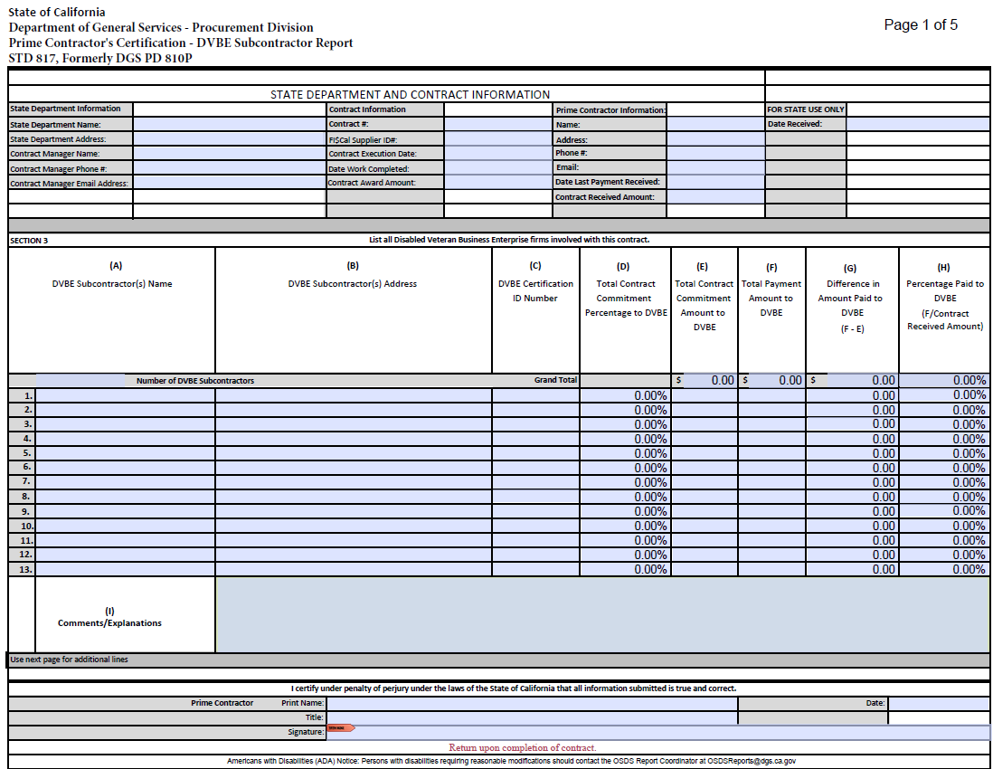
PRIME CONTRACTOR'S CERTIFICATION - DVBE SUBCONTRACTOR REPORT (STD 817) Form

Slide 16
Leveraged Procurement Agreements with DVBE subcontractors- Departments
LPAs that require a department Request For Offer (RFO)
California Multiple Award Schedules (CMAS), Master Service Agreements (MSA), Cooperative Agreements, and Software Licensing Program(SLP)
Statewide contracts for big ticket items- requiring build out for heavy equipment, such as fire trucks, helicopters, etc.
Note: Follow the user instructions. The departments are to follow the withholding requirements per MVC §999.7 and SCM Volume 2 → Socioeconomic Programs →Prime Contractor’s Certification on DVBE Subcontractors and Payment Withhold

Slide 17
Leveraged Procurement Agreements with DVBE subcontractors- Department of General Services (DGS)
All other Statewide contracts
How will DGS ensure compliance with MVC 999.7.
PD captures DVBE subcontracting information throughout the term of the contract
DGS will use the information to provide an opportunity to cure, if needed.
Note: See SCM Volume 2, Chapter 12, Section 1203.1 for more information about alternative mechanisms when utilizing LPAs for the reporting SB 588 withholds.

Slide 18
STATE DEPARTMENT’S CONTRACTOR DVBE SUBCONTRACTING CONSOLIDATION REPORT (DGS PD 810D)

Slide 19
STATE DEPARTMENT’S CONTRACTOR DVBE SUBCONTRACTING CONSOLIDATION REPORT (DGS PD 810D) Pt 1
The report is due annually to OSDS on November 1st
Compiles information from all contracts/PO with DVBE requirements completed in the fiscal year, even the ones where a Prime Contractors’ Report (STD 817) was not received.
Include contracts issued by DGS or any other department on behalf of your department.
Exceptions: For statewide commodities contracts, Prime contractors report that information to DGS.

Slide 20
STATE DEPARTMENT’S CONTRACTOR DVBE SUBCONTRACTING CONSOLIDATION REPORT (DGS PD 810D) Pt 2
Each line represents ONE prime contractor’s report.
Additional lines are available on separate tabs.
On the upper right field, enter the total Number of Contracts/PO with DVBE requirements completed during the fiscal year.
No longer limited to the STD 817 received from prime contractors
Include one line for each STD 817 sent to the prime contractor if received or not.
All contracts/PO with DVBE requirements must be reported.
Supports electronic signature.
Email to OSDSReports@dgs.ca.gov

Slide 21
STATE DEPARTMENT’S CONTRACTOR DVBE SUBCONTRACTING CONSOLIDATION REPORT (DGS PD 810D) Pt 3
DGS PD 810D includes the following columns:
Prime Contractor FI$Cal Supplier ID
Withhold Amount for STD 817 (see requirements in MVC § 999.7)
Date STD 817 Received from the prime contractors
Permanent Deduction Amount for STD 817 Noncompliance
Comment section can be used to explain the difference between the DVBE commitment and what was the actual percentage and amount paid to DVBE.

Slide 22
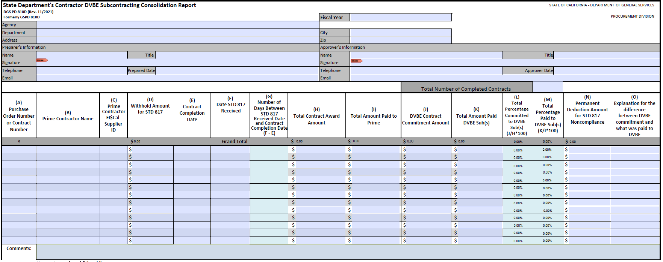
STATE DEPARTMENT’S REPORT DGS PD 810D

Slide 23
Reporting Required
All Agencies/Departments must report.
Includes all contracts with DVBE commitments awarded no earlier than July 1, 2014, and completed during the fiscal year 2022-2023.
If you did not receive any STD 817 from prime contractors, fill out the information for the contracts and POs with DVBE commitment completed during the fiscal year.
Permanently deduct the withheld amount when the prime contractor refuses to comply with the STD 817 requirement after given an opportunity to cure.
If no contracts/POs with DVBE subcontractors were completed during the fiscal year, enter 0 in the number of contracts completed field and enter in comment section “Nothing to report”.
REPORTING REQUIRED!

Slide 24
Email OSDSReports@dgs.ca.gov
DUE DATE NOVEMBER 1st
Note: Do NOT include the Prime Contractor’s DVBE subcontracting reports (STD 817) with this report.
SAVE these reports in your records!

Slide 25
For questions on the DVBE Program Requirements email: SB.DVBEcompliance@dgs.ca.gov
Contact Information:
For reporting questions email: OSDSReports@dgs.ca.gov
25

Slide 26
THANK YOU!
Questions?
26

