Slide 1
Consolidated Annual Report training- Form 810 – Intake Pages
For departments that do not transact in the Financial information system for California (FI$Cal)

Slide 2
Welcome and Introductions
Nancy Huth OSDS Manager
Mamta Srivastava OSDS Research Specialist
Christopher Calceta OSDS Certification

Slide 3
Who is today’s audience?
CAR reports preparer and approvers from departments that are not transacting in FI$Cal, including voluntary reporting departments (i.e., California State Universities) and deferred or exempt departments from FI$Cal

Slide 4
Agenda
Consolidated Annual Report (CAR) background
Changes in CAR Submission Process for Non-FI$Cal depts.
Form 810 Intake Pages in FI$Cal
Cover Letter
Improvement Plan
Resources
Who to contact for questions?

Slide 5
Consolidated Annual Report (CAR) Background
The Public Contract Code 10111 requires state departments to report annually, the SB/DVBE participation on all its state contracts, purchase orders, and Cal-Card purchases, to ensure that the 25 percent of their annual contracting dollars award to Certified Small Businesses (SB) and 3 percent to certified Disabled Veteran Business Enterprises (DVBE) participation goals are met.
Link for CAR training webpage:
File Consolidated Annual Report for State Contracting

Slide 6
Changes in CAR Submission Process for Non-FI$Cal depts.
Previous CAR submission by:
Paper or emails.
New CAR submission process:
Required to submit an online report. (No more paper submissions)

Slide 7
Pros of new CAR submission process
Departments can enter and make corrections to their reporting data.
Streamline the statewide reporting process for analyzing SB and DVBE participation percentages.

Slide 8
Form 810 Intake pages
New! Form 810 Intake page functionality has been implemented in FI$Cal system for deferred or exempt departments providing them the ability to submit their CAR report online by logging into FI$Cal .
The Form 810-Intake pages consist of the following electronic CAR data entry forms:
Form 810 Contract Activity for the Contracting Activity Report (Form DGS PD 810)
Form 810C Consulting Services for the Consulting Services Report (Form DGS PD 810C)

Slide 9
Form 810 Intake Pages (cont.)
Form 810S SB/DVBE Options for the SB Option, DVBE Option and DVBE Incentive (Form DGS PD 810S)
Form 810A I-Bond Report for the SB Participation in Infrastructure Bond Acts of 2006 (Form DGS PD 810A)
Note: The entry point for the Ethnicity, Race, Gender and Sexual Orientation (ERGSO) (DGS PD 810E) was developed and launched July 2019. As such there is no change to the reporting process for the ERGSO data collected.

Slide 10
To access the Form 810 Intake Pages
In order to access the CAR Intake pages in FI$Cal each department needs to have at least one user that is mapped to the SCPRS Processor role.
For security purposes, all system access and role mapping must be done between the department/CSU and FI$Cal. OSDS is not able to assist with this process.
For more information regarding FI$Cal access : https://fiscal.ca.gov/user-support/fiscal-service-center/end-user-access/
Questions should be directed to the FI$Cal Service Center: FiscalServiceCenter@fiscal.ca.gov

Slide 11
To access the Form 810 Intake Pages (cont.)
SCPRS processors may access FI$Cal by using the FI$Cal webpage: www. Fiscal.ca.gov
After logging in into FI$Cal, to access the Form 810 Intake Pages you will need:
Business unit number of your department

Slide 12
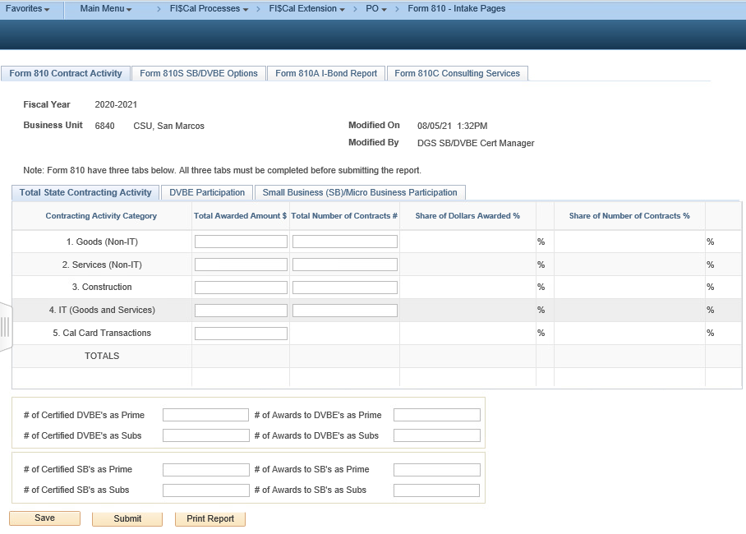
Where are the Form 810 Intake pages located in the system?
To access the intake pages, use the following navigation: Main Menu > FI$Cal Processes > FI$Cal Extension > PO > Form 810 - Intake Pages

Slide 13
How to use the Form 810 – Intake Pages?
See a live demo after this presentation!

Slide 14
Cover Letter
Non-FI$Cal Departments are required to submit a Cover Letter.
Includes an analysis of trends and any anomalies in the SB/MB or DVBE participation.
Email to us at: osdsreports@dgs.ca.gov
Note: See the CAR training for more info:
CAR Reporting Training for FI$Cal/SCPRS Users

Slide 15
Improvement Plans
Now collected via SurveyMonkey
If your department misses one or both goals, an Improvement Plan must be submitted.
The old GSPD 824 form will not be accepted as a completed Improvement Plan.
The SurveyMonkey link will be posted here under Forms: File Consolidated Annual Report for State Contracting (ca.gov)

Slide 16
Resources on DGS Website
CAR Reporting Training for FI$Cal/SCPRS Users
FI$Cal/SCPRS User's Guide to CAR Reporting
Instructions to fill out the Form 810 Intake Pages are here:
https://www.dgs.ca.gov/PD/Services/Page-Content/Procurement-Division-Services-List-Folder/File-a-Consolidated-Annual-Report

Slide 17
Who to contact for questions?
Email at:
OSDSReports@dgs.ca.gov

Slide 18
QUESTIONS

Slide 19
Thank you!

