Slide 1
Contracting Activity Report (Form 810) Training – Capturing and reporting in FI$Cal transactions with California Office of Emergency Services (CalOES) Mission Task or Statewide Incident IDs
Presented By: Mamta Srivastava

Slide 2
Welcome and Introductions
Nancy Huth OSDS Manager
Mamta Srivastava OSDS Research Specialist
Christopher Calceta OSDS Certification

Slide 3
Who is today’s audience?
Small Business (SB) and Disabled Veterans Business Enterprises (DVBE) Advocates
Staff involved in or responsible for procurement activities such as conducting acquisitions and/or data entry in FI$Cal.

Slide 4
Agenda
New FI$Cal functionality for capturing in Contracting Activity Report - Form 810 transactions with Cal OES Mission Task or Statewide Incident IDs.
A live demonstration of how to run and validate the Contracting Activity Report using the new FI$Cal functionality.
Resources
Questions and Answers

Slide 5
Objectives
By the end of the training, you should know..
What are the new functionalities in FI$Cal?
Why is this new functionality needed?
How to run and validate the Contracting Activity Report by using the new functionality?
Who to contact with questions?

Slide 6
Why capturing Cal OES Mission Task or Statewide Incident IDs transactions in Form 810?
Departments can identify and analyze their SB/DVBE participation by carving out and reporting transactions with Cal OES Mission Task or Statewide Incident Ids.
Departments can identify such transactions on which they were not able to locate SB and/or DVBEs and ask the Office of Small and Disabled Veteran Business Enterprise (OSDS) for help to find certified firms.
This data may be used to support California Small and Disabled Veteran Business Enterprise (SB/DVBE) contracting participation goals.

Slide 7
Why capturing Cal OES Mission Task or Statewide Incident IDs transactions in Form 810? Part 2
Why capturing Cal OES Mission Task or Statewide Incident IDs transactions in Form 810?
Departments that were not being able to meet the SB/DVBE participation goal because of the mission task or statewide Incident transactions will use this functionality to inform their analysis in their Improvement plan and the Cover letter.
OSDS will be able to run statewide reports and analyze availability of SB/DVBE for mission-tasked transactions
Important! The new functionality is for CAR purposes only and does not replace any other required tracking/reporting as instructed by the Department of Finance (DOF) and/or Cal OES.

Slide 8
What are the new functionalities in FI$Cal?
Four optional data fields have been added to the Procurement Contract, Purchase Order (including Amendments/Change Orders), P-Card, and SCPRS modules to allow the identification of mission tasked and statewide incident related transactions in the Contracting Activity Report Form 810 section:
Mission Task ID – Enter the assigned mission task ID by Cal OES (e.g., M23030 T27201).
Mission Task Description –Enter the description when a Mission Task ID is entered.
Statewide Incident ID – Use the look-up tool to select a statewide incident ID.
Statewide Incident Description - Will auto-populate upon selection of a statewide incident ID.
Note: This functionality is also limited to manual entry only and has NOT been
updated for any of the interface options (i.e., Requisition, Contracts, PO,
and SCPRS).

Slide 9
What are the new functionalities in FI$Cal? Part 2
What are the new functionalities in FI$Cal? (cont.)
If one of the emergency acquisition methods has been chosen for the transaction, the following soft warning will appear when saving. This message will not prevent the transaction from being saved.
Note: Job aid is available on FI$Cal website: FISCal.464 Completing CAR Reportable Section

Slide 10
What are the new functionalities in FI$Cal? (cont.)
The Form 810 Reports Run Control Page has been updated to include a “Statewide Incidents” section and a check box labeled “Exclude Mission Tasks.”
The Data Validation Query (DVQ) format has been updated to include the following: Mission Task ID, Mission Task Description, Statewide Incident ID, and Statewide Incident Description.

Slide 11
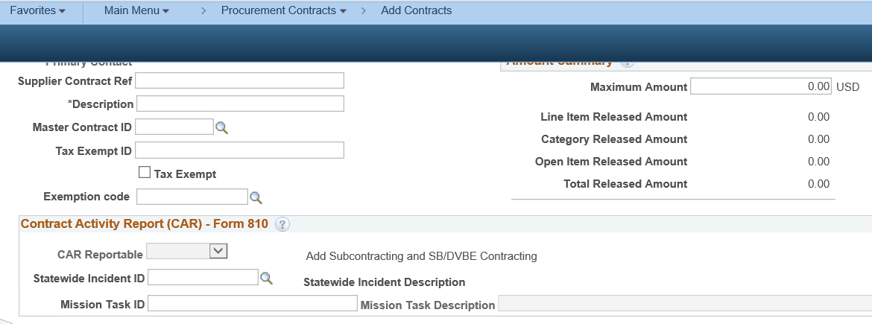
Where are the new fields displayed in the system?

Slide 12
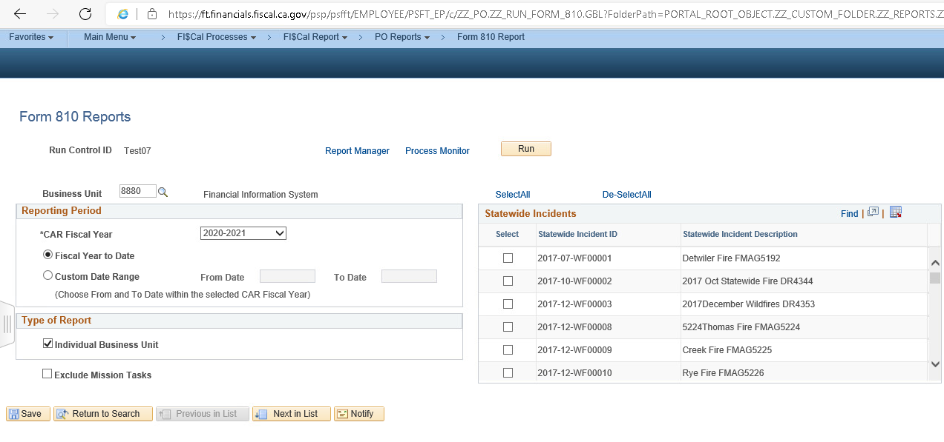
How do you run the Contracting Activity Report (CAR) – Form 810?
Navigation to access the Form 810 Reports page:
Main Menu>FI$Cal Process> FI$Cal Report>PO Report> Form 810 Report

Slide 13
How do you run CAR– Form 810 report with the new functionality? (Cont.)
From the Departmental Run Control page, you will be able to filter and run the following Form 810 reports:
To run the Standard Form 810 Report, follow the usual steps, no changes and additional action is required.
To run a Form 810-report that only captures transactions with Cal OES Mission task ID and Statewide Incident IDs:
SELECT Statewide Incidents ID and
SKIP (do not check) the Exclude Mission Tasks Check Box.
Note: This reporting functionality has been implemented for departments to analyze their SB/DVBE participation with and without California Office of Emergency Services related transactions. It is not an additional reporting requirement for departments to submit to OSDS.

Slide 14
How do you run the CAR – Form 810 report with new functionality? (Cont.)
III. To run the Form 810 report capturing all transactions except the CalOES mission task and statewide Incidents
SKIP (do not select) any statewide Incident IDs and
CHECK the Exclude Mission Tasks Check Box
Tip! This report could help departments and OSDS analyze and determine if the SB or DVBE participation goal would have been met absent any of the OES mission-tasked and/or Statewide Incident-related transactions.
Note: There is no change in other CAR reports (Form 810 S, form 810 C, Form 810 A,
and Form E).

Slide 15
Using the DVQ with the new functionality
The Parameters selected on the run control page do not change the layout of the Data Validation Query report.
The DVQ will include four columns displaying data entered in the 4 fields:
Mission Task ID
Mission Task Description
Statewide Incident ID, and
Statewide Incident Description
The DVQ can be used periodically to review and correct
transactions and data entered into the new fields –
See a live demo after this presentation!

Slide 16
Resources
FI$Cal/SCPRS User's Guide to CAR Reporting (July 2021)
FI$Cal Job Aid 464 Completing CAR Reportable Section
Upcoming on OSDS website at :File Consolidated Annual Report for State Contracting (ca.gov)
FAQ
Data Validation Query Job Aid
Run Control Page Job Aid

Slide 17
Who to contact with questions?
Email at: OSDSReports@dgs.ca.gov

Slide 18
A live demonstration of how to run and validate the FI$Cal Contracting Activity Report – From 810 using new functionalities.

Slide 19
Questions and answers

Slide 20
Closing

