Slide 1
Fiscal Year (FY) 2020-21
Consolidated Annual Report
Training for All Departments

Slide 2
Welcome and Introductions
  Nancy Huth OSDS Manager
  Mamta Srivastava OSDS Research Specialist
  Christopher Calceta OSDS Certification

Slide 3
Agenda
  Introductions and Objectives
  Background
  Upcoming FI$Cal Changes
  Reports Requirements
  Process, timelines, extensions
              Questions and Answers
              How to run/validate the reports
              Who to contact

Slide 4
Objectives
By the end of the training, you should know…
Why and which reports are required
Upcoming FI$Cal Changes
How data is captured/reported
What to do if you need to revise the data
Who to contact with questions
How to run your reports

Slide 5
SB & DVBE Program Authority
  REPORTING IS MANDATORY
  SB and DVBE Program Statutes:
  SB - Government Code 14835
  DVBE - Military and Veterans Code 999
  Consolidated Annual Report (CAR) Statutes:
  Public Contract Code (PCC) §10111 - all reports
  Government Code Section 14838.1(f) - I-Bond report 810A
Notes:
5

Slide 6
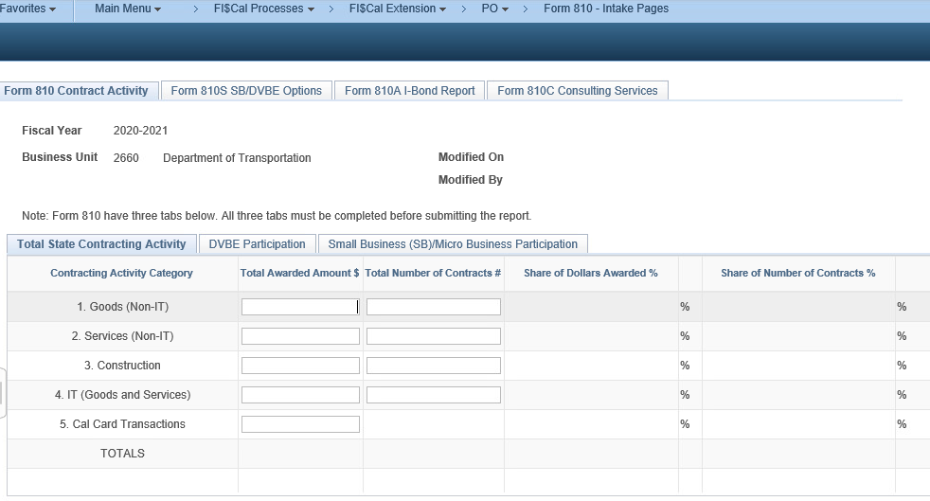
Upcoming FI$Cal Changes
Online Intake Pages
Non-FI$Cal Users will be able to enter their CAR data into the FI$Cal system.

Slide 7
Upcoming FI$Cal Changes (Cont.)
Online ERGSO report
Prime contractors will be able to fill out this voluntary confidential survey online.
Office of Emergency Services (OES) Mission Task Fields on Contract, PO, SCPRS, and PCard. (FI$Cal Users)
The next slide will show you a mockup and has not been finalized.

Slide 8
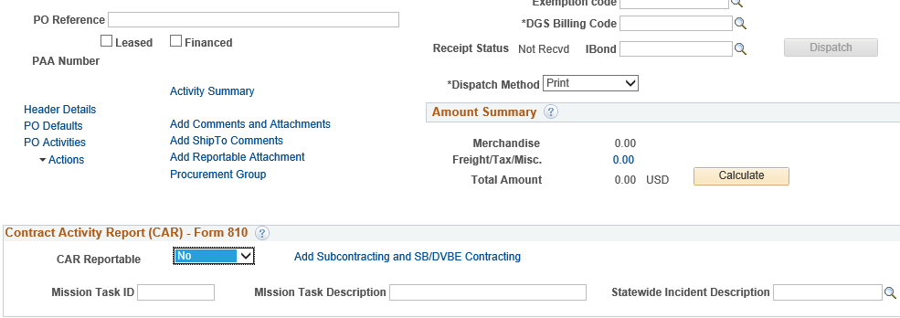
For CAR Purposes Only – FI$Cal Users
Capturing emergency SB/DVBE dollars
For CAR purpose only, in addition to and not to be confused with reporting of statewide incidents using projects and chartfields for DOF !

Slide 9
Reporting Structure
Mandatory reporting departments
  All Agencies/Departments under DGS purchasing authority
  If exempt must send justification with legal basis to OSDS
Voluntary reporting departments - elected to report
  Universities
  Offices not under the governor’s jurisdiction and not under DGS purchasing authority

Slide 10
DVBE Program Audit 2018-114
Audit recommendations/requirements:
Increase accuracy
  Develop/strengthen second departmental review for accuracy
  Conduct sample data verification of the high dollar contracts
  Verify reported data against procurement records/data validation query
  Ensure consistency
    Awards vs. expenditures
    Multiyear contract reported fully in the award year (front loaded)
Implementation in FI$Cal and SCPRS ensures:
Eliminates departments labor and paper submittals, as it is fully ran by OSDS for all FI$Cal departments
Meets audits recommendations
Increases consistency (award vs. expenditures, multi-year contracts front loading)
Increased accuracy, reduces room for human errors
Accompanied by appropriate level of review and approval

Slide 11
Consolidated Annual Report
Consolidated Annual Report
DGS PD 810: DVBE and SB/MB Contracting Activity Report
  Improvement plans required if SB/DVBE goal(s) not met
DGS PD 810S:DVBE and SB/MB Option & DVBE Incentive Report
DGS PD 810A: Infrastructure Bond Report
  Improvement Plan required if SB goal is not met
DGS PD 810C: Consulting Services Report
DGS PD 810E: Ethnicity, Race, Gender and Sexual Orientation Report (ERGSO)
Hyperlink: Consolidated Annual Report Forms and Instructions
Notes:
11

Slide 12
Report on Form 810 Part 1
Report on Form 810:
Count SB/DVBE prime contractors’ participation at 100%!
All purchase orders and contracts service orders, including emergency contracts.
All contracts issued by DGS or any other department on your behalf.
All amendments, alterations, change orders, and extensions that change the total amount by more than $1.00
All contracts/POs issued pursuant to delegation of authority or under a Leveraged Procurement Agreement (LPA)
All Cal-Card purchases, even if less than $100.
Report only State funds to the extend possible, including in mixed funded contracts
Notes:
12

Slide 13
Report on Form 810 Part 2
Report on Form 810 (cont.):
Count SB/DVBE prime contractors’ participation at 100%!
Award Amounts Only
Multiyear contract in full in the award year (frontloaded)
Report only State funds including those in mixed funded contracts
    For FI$Cal users, enter the state funding percentage
    For all others, contact OSDS if you cannot separate the state funds from federal funds
Notes:
13

Slide 14
Not CAR Reportable
For Not CAR Reportable –
  100% federally funded
  Federal government (including grants)
  Any state or local government
  Prison Industry Authority
  Interagency Agreements
  Joint Powers Agreements
  California State Universities (CSU)
  Universities of California (UC)
  Note: FI$Cal users see the Help Text
Notes:
14

Slide 15
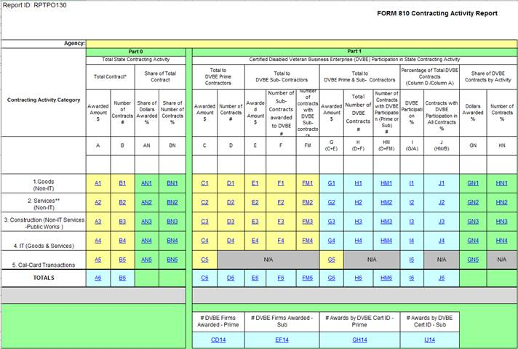
Form 810 – Contracting Activity Report Part 1
Form 810 - Contracting Activity Report
CAR Categories
DVBE Participation
Total awards
Column I displays the DVBE participation achieved!
Notes:
15

Slide 16
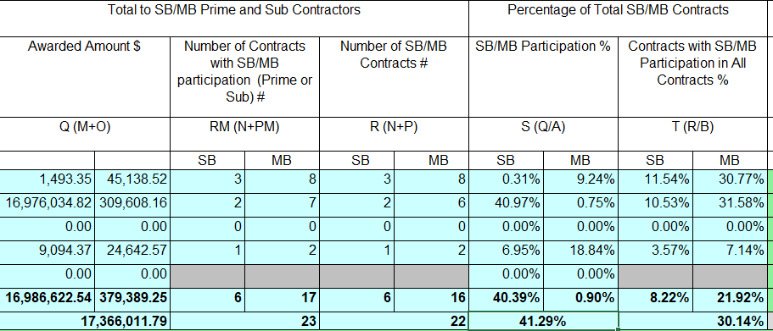
Form 810 – Contracting Activity Report Part 2
Form 810 - Contracting Activity Report (Cont.)
SB Participation
Column S displays the SB participation achieved!
Notes:
16

Slide 17

CAR – Reportable Section – FI$Cal Part 1
CAR - Reportable Section- FI$Cal
In all modules: Contracts, PO, SCPRS
Select “Yes” on the drop-down menu on CAR Reportable
When subcontracting page opens:
  Verify if prime contractor and its certification (if applicable) is auto-populated correctly
  Add SB/DVBE subcontractors on the page
Notes:
17

Slide 18
CAR – Reportable Section – FI$Cal Part 2
CAR - Reportable Section (Cont.)
3. Enter the percentage of State funds, if known
  If unavailable, leave blank and the system will pull 100%.
  DVBE Incentive Exempt box. See Slide-27
  Percent of State Fund and DVBE exemption check box only appears when CAR reportable field is selected as “Yes”.
  If the selection is “No”, the state funds and DVBE Exempt fields are not displayed.
Notes:
18

Slide 19
For all FI$Cal Reports
FI$Cal/SCPRS:- All CAR Reportable transactions in the following (cascade) order:
CONTRACTS, then
POs with no associated contracts, LPA POs, then
Cal Card transactions not reported

Slide 20
How are Transactions Captured in FI$Cal?
How transactions captured in FI$Cal?
Transaction Type | Contract | PO | SCPRS
New Transactions | FY - Contract start date Status - Approved | FY -PO dispatch date Looks for Dispatch | FY – PO Date Status -Approved
New Transactions Jul. 1 – Aug. 1 or by extension date | FY - Contract start date* Status - Approved | FY – PO Dispatch and PO date* Look at dispatch date | FY - PO Date Status – Approved
Amendments and Change orders | FY – selected in FY field of the Reason Code Page Status-Approved | FY – selected in FY field on the Reason Code Page Look at dispatch date | FY – selected in FY field on the Reason Code Page Status - Approved
Cal Card transactions:
FI$Cal – reconciled and approved P-Card transactions not reported under a PO
SCPRS – P-Card Data Summary Entry Page – one time data entry of sum of transaction not reported in SCPRS + <$2,500
Notes:
20

Slide 21
Form 810 – Reporting Categories
Form 810 - Reporting Categories
4 CAR reporting categories correspond to FI$Cal Acquisition Types
Category | Acquisition Type | Acquisition Sub-type
Non-IT Goods | Non-IT Goods | All
Non-IT Services | Non-IT Services | All except Public Works
Construction | Non-IT Services | Public Works
IT (Goods, Services) | IT Goods or IT Services | All
Note: Acq Subtype is a required field when Non-IT Services Acq Type is selected
Count SB-PW under SB participation only on Public Works contracts/projects!
Remember to select Public Works or the SB 605 related public works
Acquisition Sub-type to be able to count SB+PW.
Notes:
21

Slide 22
SB/DVBE Subcontracting Page Part 1
SB/DVBE Subcontracting Page
In all modules: Contracts, PO, P-Card and SCPRS data entry pages
Required! - Key feature of the CAR report
Multiple purpose:
  Verifies and saves certification information at award time
  Provides % for SB/DVBE participation calculations
  Pre-populates prime contractor information
Access at later time:
Click on “Add Subcontracting and SB/DVBE Contracting” link
If the firm expires in the meantime, it cannot be captured
If a certified firm does not display on this page, report defect to OSDS
and cc FSC!
Notes:
22

Slide 23
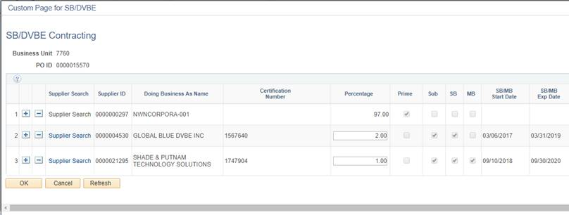
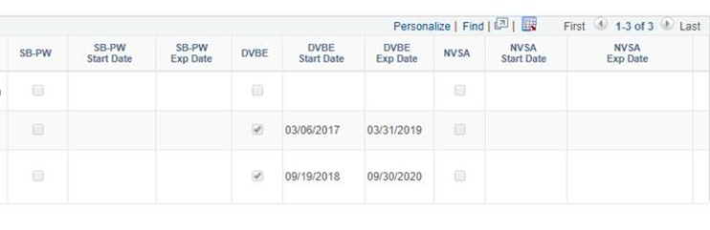
SB/DVBE Contracting Page Part 2
SB/DVBE Subcontracting Page
Add subcontractors
Enter subcontractor percentage
New SB_PW certification type
NVSA
Notes:
23

Slide 24
Certification Types and SB/DVBE Participation Goals
Certification Types and
SB/DVBE Participation Goals
Certification Type Criteria | DVBE | SB | MB SB designation | SB-PW New! | NVSA Nonprofit
Counts toward participation | DVBE goal | SB goal | SB goal | SB goal on public works transactions only | SB goal
SB(Micro), then
SB, then
SB-PW (PW sub-types only)
SB and DVBE counted on both goals

Slide 25
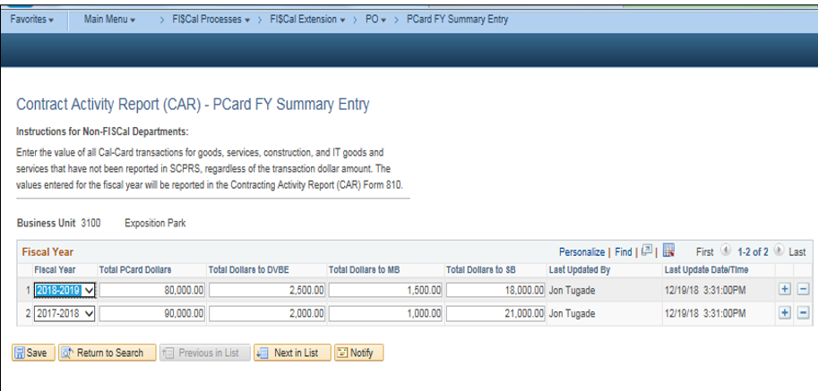
SCPRS – P-Card FY Summary Entry Page
SCPRS-
P-Card FY Summary Entry Page
One row per fiscal year!
Notes:
25

Slide 26
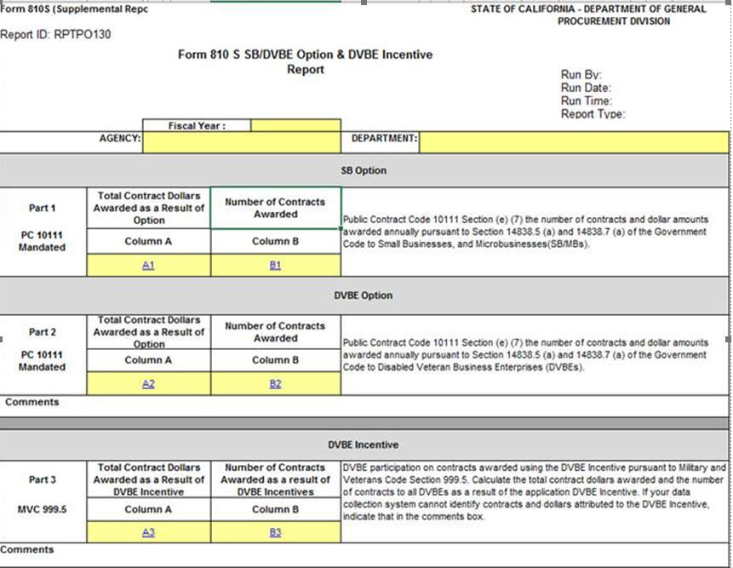
Form 810S –
SB/DVBE Option and DVBE Incentive
Acquisition Method:
SB Option
Public Works SB Option
Acquisition Method:
DVBE Option
Public Works DVBE Option
DVBE Incentive Waiver Checkbox left unchecked
Or
Contracts awarded as a result of DVBE Incentive
Notes:
26

Slide 27
Form 810S: SB and DVBE Option –
Part 1 and Part 2
Under SB/DVBE Option, the suppliers (prime) should be certified!
SB or DVBE Option
  If the contract is $5,000.01 to $249,999.99
Public Works SB or DVBE Option:
  If the contract is $5,000.01 up to $333,000

Slide 28

Form 810S: DVBE Incentive - Part 3
Military and Veterans Code section 999.5(a) applies to all competitive solicitations, unless a DVBE exemption is approved.
BB. No. P-08-20 - SUBJECT: DVBE Incentive Exemption Regulation Update & DVBE Exemption Request Form (STD 816)
For FI$Cal departments:
Select the Check if exempt from DVBE Incentive box only if :
Have an approved DVBE Incentive Exemption (outside Fi$Cal),or
The Acquisition Method is SB or DVBE Option or other non-competitive

Slide 29
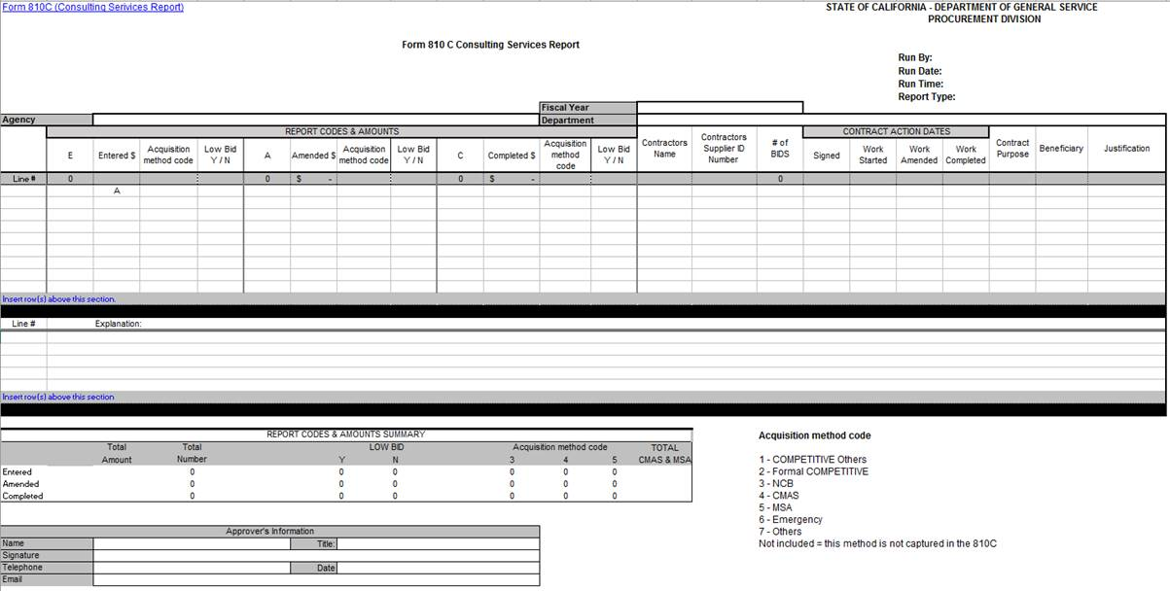
Form 810C Consulting Services Report
Contractors List
Explanation Section
Codes

Slide 30
Form 810C – Consulting Services Report Part 2
Form 810C – Consulting Services Report
Public Contract Code 10111 and 10335.5
"Consulting services contract," means services that do all of the following:
  Consulting Services Contracts are those that are defined for services of an advisory nature.
  The final product is a transmittal of information in either written or verbal form.
  The product may be answers to questions, the design of systems or plans, workshops, seminars, retreats or conferences.
  All “Consulting Services Contracts” must be reported unless excluded.

Slide 31
Form 810C - Consulting Services Report
Not captured on Form 810C:
Contracts/agreements between a state agency or department and the federal government
Contracts/agreements with local agencies to subvene federal funds for which No matching State funds are required
Contracts to develop, maintain, administer or use licensing or proficiency examinations
Architectural and Engineering (A&E) per Chapter 10 (commencing with 4525) of Division 5 of Title 1 of the Government Code
For FI$Cal departments:
No need for additional data entry
Exclusions are already addressed
Check for the errors for correction caused by amendments to provide written explanation
The system will pull all the data needed from the Consulting Services Justification box
PO Reporters and SCPRS Processors can run the report

Slide 32
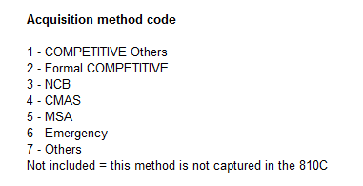
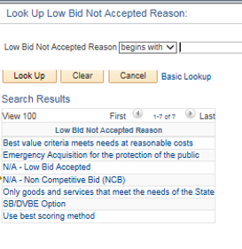
Form 810C Details
Form 810C Details (Cont.)
Acquisition method code. For NCBs the system will capture the selection in the Explanation Section.
Reasons for not accepting low bid based on the selection below. If Lowest Bid not accepted, the system would display the reason selected in the Explanation Section.

Slide 33
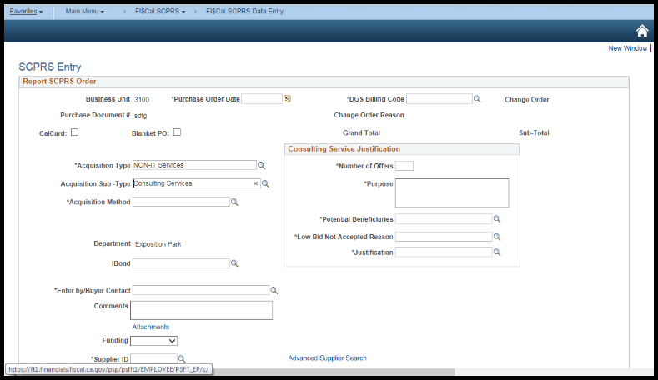
Form 810C: FI$Cal Departments
Consulting Services Justification

Slide 34
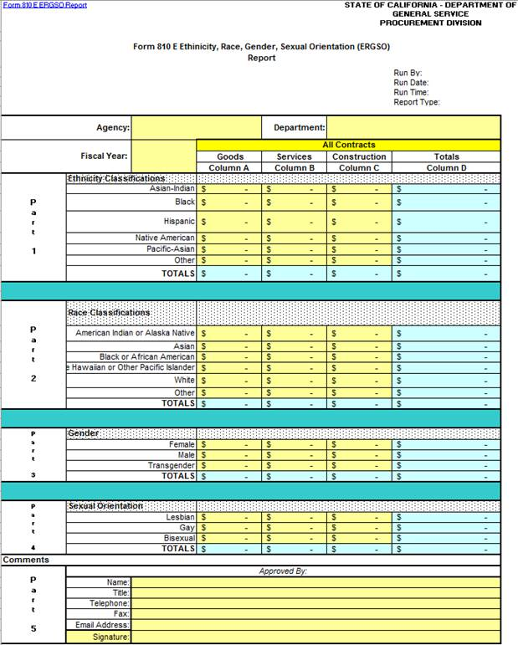
Form 810E – ERGSO Report Part 1
Form 810E: ERGSO Report
Notes:
34

Slide 35
Form 810E – ERGSO Report Part 2
Form 810E: ERGSO Report
Public Contract Code Section 10111
Includes voluntarily provided contract dollars by business owners on:
  Ethnicity
  Race
  Gender
  Sexual orientation
Information received on Voluntary Statistical Data Sheets (VSDS)
Do not save VSDS in procurement files, save all of them separately!
For FI$Cal Departments:
Buyers enter VSDS data entered on the ERGSO Data Entry Page
The system will aggregate the data for department/state

Slide 36
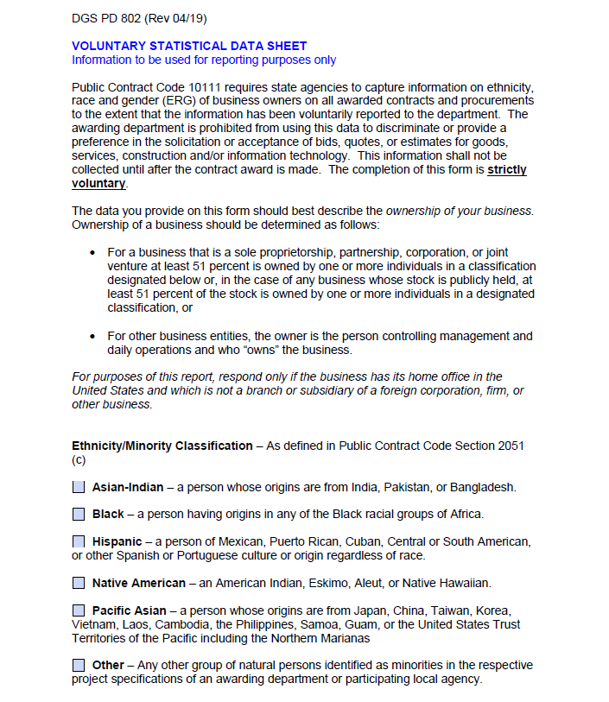
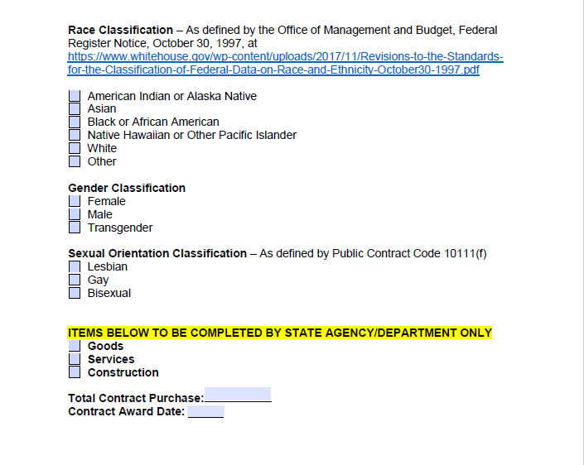
Voluntary Statistical Data Sheet (VSDS)
Voluntary Statistical Data Sheet (VSDS)
Notes:
36

Slide 37
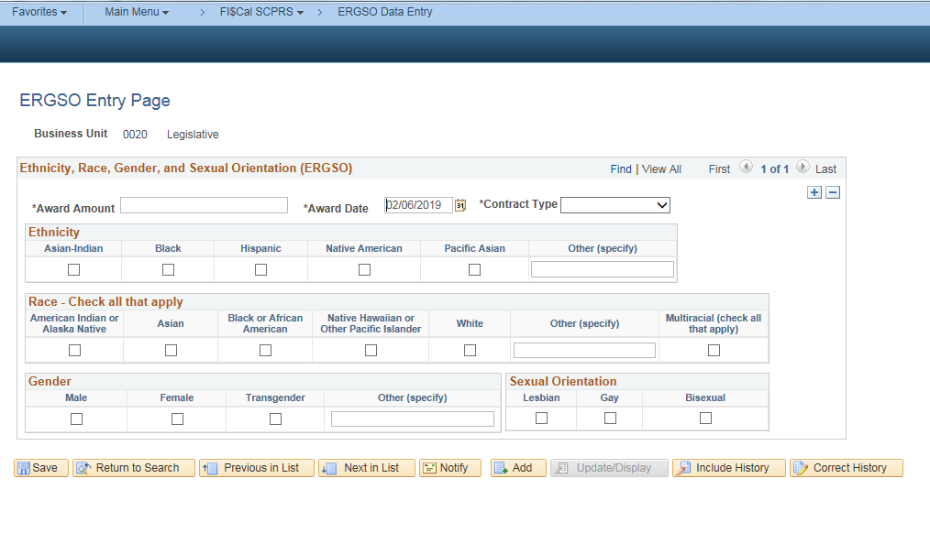
FI$Cal and SCPRS – ERGSO Data Entry
FI$Cal and SCPRS - ERGSO Data Entry
Fi$Cal Buyers and SCPRS Processors can entry VSDS data on this page
Enter data for another VSDS

Slide 38
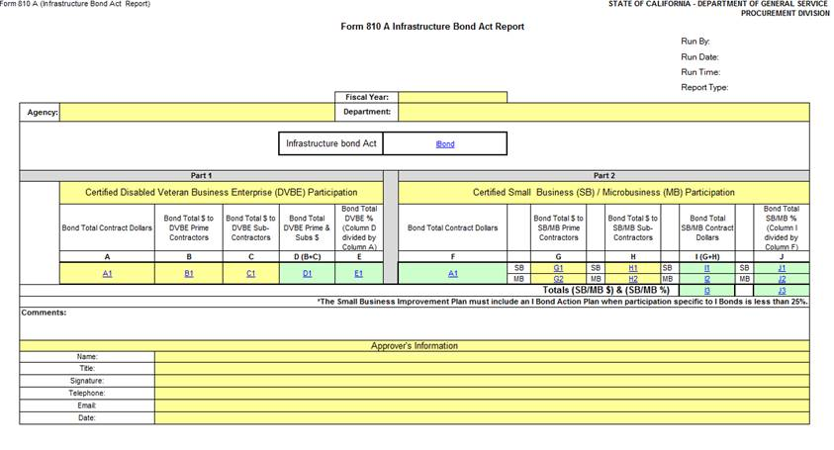
Form 810A I-Bond Activity Report Part 1
Form 810A I-Bond Activity Report
I-Bond Name
DVBE Participation
SB Participation
Notes:
38

Slide 39
Form 810A I-Bond Activity Report 2
Infrastructure Bond Acts of 2006
The Highway Safety Traffic Reduction, Air Quality and Port Security Bond Act.
The Housing and Emergency Shelter Trust Fund Act.
The Kindergarten-University Public Education Facilities Bond Act.
The Disaster Preparedness and Flood Prevention Bond Act.
The Safe Drinking Water, Water Quality and Supply, Flood Control, River and Coastal Protection Bond Act.

Slide 40
Form 810A I-Bond Activity Report 3
Government Code 14838.1 (f)
  25 percent Small Business participation goal in all contracts financed with the proceeds of the infrastructure related bond acts of 2006
  An Improvement Plan is required when the SB participation goal for I-Bond contracts is not met

Slide 41
CAR for FI$Cal Users Resources
CAR FAQs for FI$Cal & SCPRS Users (May 2020)
CAR Reporting Training for FI$Cal ,PPT(April 2019)
FI$Cal/SCPRS User's Guide to CAR Reporting (May 2019)
Running the CAR Reports (Form 810 Reports) in FI$Cal Job Aid (May 2019)
Running and Using a Department's Data Validation Query Job Aid (May 2019)

Slide 42
Important!
OSDS and all reporting departments to SAVE all reports for their own records!
In FI$Cal, all BU reports will display who ran the report, the date/time stamp, and type of report.

Slide 43
Cover Letter
Non-FI$Cal Departments are required to submit a Cover Letter.
FI$Cal departments submit to OSDS only if:
Reporting for multiple BUs
Submitting an Improvement Plan because your department did not meet its goal(s)
If you need to revise your report
Include:
If multiple BUs, specify what BUs are included in the report
An analysis of trends and any anomalies in the SB/MB or DVBE participation.
Review of progress on all prior year Improvement Plan items enacted and their effect on current participation goals.

Slide 44
Improvement Plan(s)
Improvement Plan(s)
FY___ Department/Division/Office
Summary of reportable, non-reportable, and other contracts
Explain why your SB and/or DVBE participation goal was not achieved.
Plan to improve contracting opportunities for SB/DVBE
Improvement Summary
Other comments/challenges
Contact Information
Hyperlink to fillable form:
SB/DVBE Participation Improvement Plan (PDF)
Notes:
44

Slide 45
Contact OSDS
CAR Report Questions:
OSDSReports@dgs.ca.gov
(916) 375-4940
Mamta Srivastava, OSDS Research Specialist
Mamta.srivastava@dgs.ca.gov
(916) 883-3578
Improvement Plan Questions:
Brooke Droege, Outreach Manager
Brooke.droege@dgs.ca.gov
(916) 375-4394
For reports requirements, forms, and instructions, please go to:
https://www.dgs.ca.gov/PD/Services/Page-Content/Procurement-Division-Services-List-Folder/File-a-Consolidated-Annual-Report
Notes:
45

Slide 46
Important CAR Reporting Deadlines
In May, OSDS conducted 5 training sessions for FI$Cal/SCPRS departments
May 4 OSDS conducts CAR training for FI$Cal departments
May 11 OSDS conducts CAR training for FI$Cal departments
May 18 OSDS conducts CAR training for FI$Cal departments
May 20 OSDS conducts CAR training for all departments
May 24 OSDS conducts CAR training for all departments
June 1 - 30 OSDS sends reminders about upcoming reporting
July 1 - 31 BUs run their draft reports, verify against queries/own records
July 31 Last day to request extension from OSDS

Slide 47
Important CAR Reporting Deadlines (Cont.)
August 1 | CAR Report DUE DATE (Changed to October 31st for FY 2020-21 only)
August 2 | OSDS runs and saves all reports, except extensions
August 2 or 3 | BUs run their own final reports and SAVE FOR THEIR RECORDS
Post extension | BUs to run their own report
October 15 | No revisions or extension past this date
January 1, 2022 | OSDS publishes the report

Slide 48
Other Information
For Paper submittal (limited to few departments):
Preferred!
Email to OSDSReports@dgs.ca.gov in PDF and Excel.
By mail (not recommended this year)
May 24, 2021, OFFICE OF SMALL BUSINESS AND DVBE SERVICES, DGS
Notes:
48

Slide 49
Report Verification/ Validation
FI$Cal Departments : Can use Data Validation Query :
Data extract of all approved transactions entered into FI$Cal
Support documentation for Forms 810, 810S and 810A
Shows data entered on the subcontracting page
Runs automatically when you run Form 810
Can be run for the entire fiscal year, YTD, or with custom dates
Job-aid /instructions available
Available to departments using SCPRS

Slide 50
How do I revise my report?
Post August 2 –
  Contact OSDS immediately to inform of needed revision
  OSDS will unlock the BU to allow for changes
  BU makes all the needed transaction(s) changes in FI$Cal
  BU runs its own departmental report
  BU obtains official approval to submit revisions to OSDS
  BU adds signed cover letter explaining the change
  BU emails PDF to OSDS
  OSDS runs statewide report to include revised reports
Post October 15 –
  Revisions may not be included in the published report
.
OSDS and all BUs to SAVE all reports for their own records!

Slide 51
Last Minute Tips
  Keep in touch with OSDS at OSDSReports@dgs.ca.gov
  Run your report and verify data on a sample basis monthly, or at least quarterly
  Reconcile the reports with your transactions
  Develop/strengthen secondary review and approval process
  Go back and correct during the fiscal year to the extent possible
  Specify fiscal year on Change Orders or amendments
  Report defects to OSDSReports@dgs.ca.gov and cc FSC

Slide 52
Questions?
Questions?
THANK YOU!
Next…
“How to run your reports”
(All Form 810s)
“How to validate the 810 report”
Step-by-Step / Job Aid

Slide 53
Reporting Structure Overall
  What can be run in FI$Cal:
  By Business Unit (BU) –
  Individual Departmental (BU) Reports
  Data Validation Query
By OSDS -
Individual Departmental (BU) Reports
  Statewide and agencies aggregates
  Publishable Summary - mandatory, voluntary, statewide
  Statewide Validation Query

Slide 54
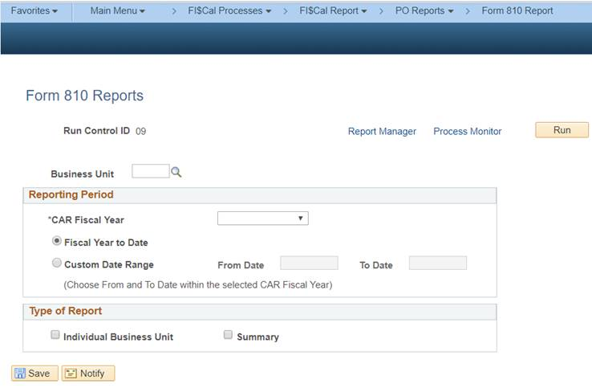
Form 810 Report - Run Control Page

Slide 55
Form 810 Report – Data Validation Query
Verify the CAR report data on a monthly basis or at least quarterly by using the Data Validation Query report.
Running and Using a Department's Data Validation Query Job Aid (May 2019)

Slide 56
Final Thoughts
Questions?
THANK YOU!

