Slide 1


Training for FI$Cal Users
Consolidated Annual Report
FISCAL YEAR 2022-23
Presented by
Mamta Srivastava
Reports Coordinator

Slide 2

Welcome and Introductions
Mamta Srivastava Reports Coordinator
Demeshia Swanson OSDS Outreach Program Manager
Araceli Mohseni OSDS Advocacy Support Manager

Slide 3
Agenda
  Objectives
  Background
  FI$Cal Updates
  Reports Requirements
  Process, timelines, extensions
              Questions and Answers
              How to run/validate the reports
              Who to contact

Slide 4
Objectives
By the end of the training, you should know…
Why and which reports are required
What’s new reporting requirement
What’s new in FI$Cal
How data is captured/reported
    What to do if you need to revise the data
Who to contact with questions
How to run your reports

Slide 5
SB & DVBE Program Authority
  REPORTING IS MANDATORY
  SB and DVBE Program Statutes:
  SB - Government Code (GC) §14835
  DVBE - Military and Veterans Code (MVC) §999
  Consolidated Annual Report (CAR) Statutes:
  Public Contract Code (PCC) §10111 - all reports
  Government Code (GC) §14838.1- I-Bond and,
  New! Infrastructure Investment and Jobs Act (IIJA) report 810A
Notes:
5

Slide 6
New Legislation
AB 2974(Chapter 600, Statute of 2022)
Effective January 1, 2023, all state agencies awarding new contracts over $500,000 financed, in whole or part, with IIJA federal funds, shall stablish a 25% Small Business (SB) procurement participation goal on those contracts.
https://leginfo.legislature.ca.gov/faces/billNavClient.xhtml?bill_id=202120220AB2974

Slide 7
New Legislation(Cont.)
AB 2019(Chapter 730, Statute of 2022)
Codifies 25 percent SB participation goal.
Requires the state to conduct a statewide procurement disparity study by January 2025.
Allows for remedial actions to be taken such as removal of delegated contract authority or restrictions on contracting activity for agencies that don’t meet SB/DVBE goals in three out of five years.
BB. No. P-12-22 - SUBJECT: Economic Equity for Small Business (SB) and Disabled Veteran Business Enterprise (DVBE) Firms and Diversity Among State Contractors

Slide 8
DVBE Program Audit 2018-114
Audit recommendations/requirements:
Increase accuracy
  Develop/strengthen second departmental review for accuracy
  Conduct sample data verification of the high dollar contracts
  Verify reported data against procurement records/data validation query
  Ensure consistency
    Awards vs. expenditures
    Multiyear contract reported fully in the award year (front loaded)
Implementation in FI$Cal and SCPRS ensures:
  Eliminates departments intensive labor and paper submittals, as it is fully run by OSDS for all FI$Cal departments
Meets audits recommendations
Increases consistency (award vs. expenditures, multi-year contracts front loading)
Increased accuracy, reduces room for human errors
Accompanied by appropriate level of review and approval

Slide 9
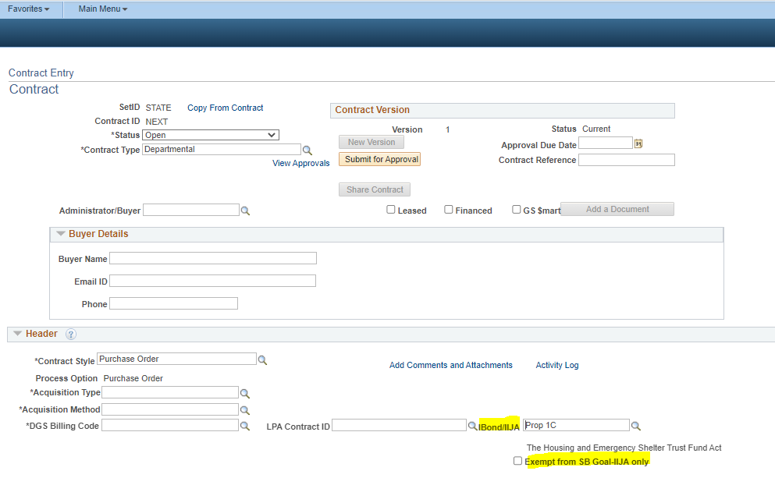
FI$Cal Updates
FI$Cal Updates
Enhanced CAR reporting to capture IIJA Fields on Contract, PO, SCPRS, and Pcard and report on the former I-Bond form .
  Check the “Exempt from SB Goal-IIJA only” check box if IIJA fund is exempt from SB goal.
Notes : As required by law, for each of these checked exemptions, an exemption should be submitted to OSDS. OSDS and PD are in the process of vetting the exemption form with the applicable departments.

Slide 10
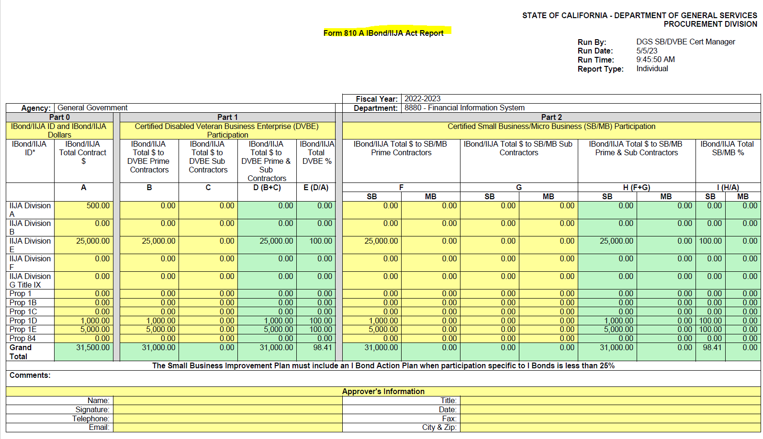
FI$Cal Updates (Part 2)
FI$Cal Updates (Cont.)
New IBond/IIJA Act Report

Slide 11
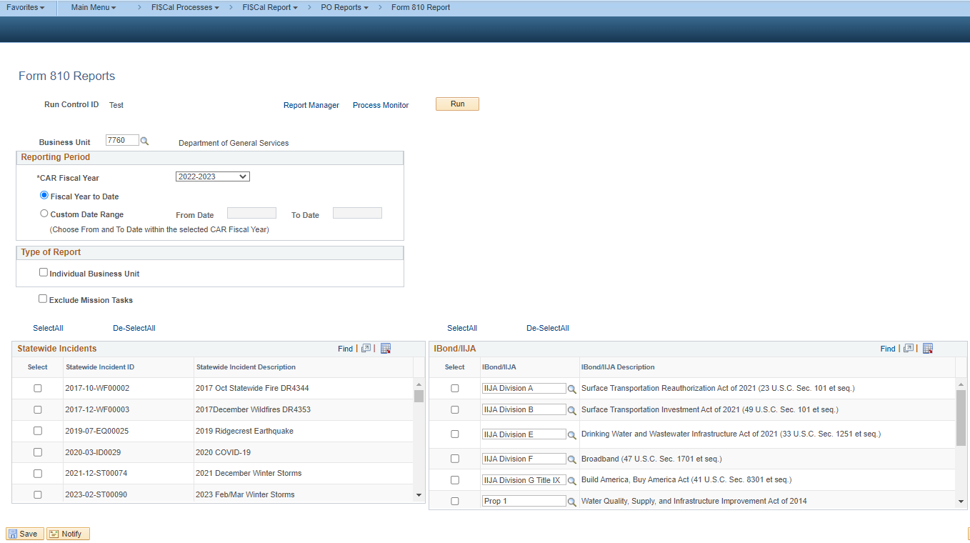
FI$Cal Updates (Part 3)
FI$Cal Updates (Cont.)
Enhanced Departmental run control page to capture Infrastructure Investment and Jobs Act (IIJA).

Slide 12
FI$Cal Updates (Part 4)
FI$Cal Updates (Cont.)
Two separate Data Validation Query (DVQ) Reports:
  Form 810 CAR - Data Validation with 3 new columns:
    IBond/IIJA Number
    IBond/IIJA Description
    Exempt from SB Goal-IIJA only
  Form 810 A IBond_IIJA - Data Validation Query

Slide 13
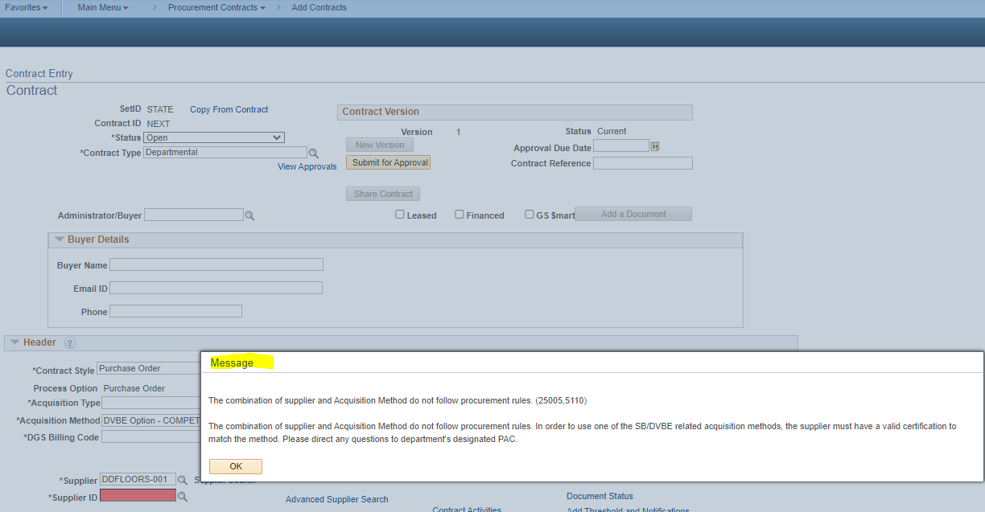
FI$Cal Updates (Part 5)
FI$Cal Updates(Cont.)
Validation for SB/DVBE, ensuring the appropriate certification is used on the SB Option or on the DVBE Option in Contract, PO, SCPRS, and Pcard.

Slide 14
Reporting Structure
Mandatory reporting departments
  All Agencies/Departments under DGS purchasing authority
  If exempt must send justification with legal basis to OSDS and keep for your records
Voluntary reporting departments - electing to report
  Universities
  Offices not under the governor’s jurisdiction and not under DGS purchasing authority

Slide 15
Consolidated Annual Report
DGS PD 810: DVBE and SB/Micro Contracting Activity Report
  Improvement plans required if SB/DVBE goal(s) not met
DGS PD 810S: SB Option, DVBE Option & DVBE Incentive Report
DGS PD 810A: Infrastructure Bond/ Infrastructure Investment and
Jobs Act Report
Improvement Plan required if SB goal is not met
DGS PD 810C: Consulting Services Report
DGS PD 810E: Ethnicity, Race, Gender and Sexual Orientation Report (ERGSO)
Hyperlink: Consolidated Annual Report
Notes:
15

Slide 16
Data Validation Query (DVQ)
Use Data Validation Query to :
Review approved transactions created into FI$Cal and SCPRS
Monitor monthly SB and DVBE goal attainment
Support documentation for Forms 810, 810S and 810A
Show data entered on the subcontracting page
DVQ :
Run automatically when you run Form 810
Run for the entire fiscal year, YTD, or with custom dates
Job-aid/instructions available
Available to departments using SCPRS

Slide 17
For Not CAR Reportable
  100% federally funded
  Federal government (including grants)
  Any state or local government
  Prison Industry Authority
  Interagency Agreements
  Joint Powers Agreements
  California State Universities (CSU)
  Universities of California (UC)
  Note: For more detail see Help Text near CAR reportable section.
Notes:
17

Slide 18
CAR Form 810:
Count SB/DVBE prime contractors’ participation at 100%!
All purchase orders and contracts service orders, including emergency contracts.
All contracts issued by DGS or any other department on your behalf.
All amendments, alterations, change orders, and extensions that change the total amount by more than $1.00.
All contracts/POs issued pursuant to delegation of authority or under a Leveraged Procurement Agreement (LPA).
All P-Card purchases, even if less than $100.
Report only State funds to the extend possible, including in mixed funded contracts.
Notes:
18

Slide 19
For all Reports
FI$Cal/SCPRS:- All CAR Reportable transactions in the following (cascade) order:
CONTRACTS, then
POs with no associated contracts, LPA POs, then
Cal Card transactions not reported

Slide 20
How are Transactions Captured in FI$Cal?
How transactions captured in FI$Cal?
Transaction Type | Contract | PO | SCPRS
New Transactions | FY - Contract start date Status - Approved | FY -PO dispatch date Looks for Dispatch | FY – PO Date Status -Approved
New Transactions Jul. 1 – Oct. 1 or by extension date | FY - Contract start date* Status - Approved | FY – PO Dispatch and PO date* Look at dispatch date | FY - PO Date Status – Approved
Amendments and Change orders | FY – selected in FY field of the Reason Code Page Status-Approved | FY – selected in FY field on the Reason Code Page Look at dispatch date | FY – selected in FY field on the Reason Code Page Status - Approved
P-Card transactions:
FI$Cal – reconciled and approved P-Card transactions not reported under a PO
SCPRS – P-Card Data Summary Entry Page – one time data entry of sum of transaction not reported in SCPRS + <$2,500
Notes:
20

Slide 21
Form 810 - Reporting Categories
4 CAR reporting categories correspond to FI$Cal Acquisition Types
Category | Acquisition Type | Acquisition Sub-type
Non-IT Goods | Non-IT Goods | All
Non-IT Services | Non-IT Services | All except Public Works
Construction | Non-IT Services | Public Works
IT (Goods, Services) | IT Goods or IT Services | All
Note: Acq Subtype is a required field when Non-IT Services Acq Type is selected
Count SB-PW under SB participation only on Public Works contracts/projects!
Remember to select Public Works or the SB 605 related public works
Acquisition Sub-type to be able to count SB+PW.
Notes:
21

Slide 22
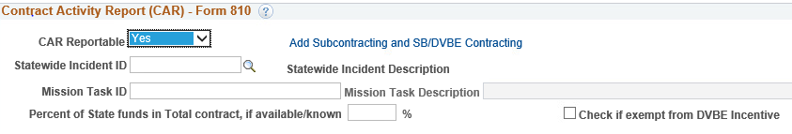
CAR - Reportable Section
In all modules: Contracts, PO, SCPRS
Select “Yes” on the drop-down menu on CAR Reportable
  A pop-up window will ask about any SB/DVBE subcontractors
When subcontracting page opens:
  Verify prime contractor and its certification (if applicable) is auto-populated correctly
  Add SB/DVBE subcontractors on the page
Notes:
22

Slide 23
CAR - Reportable Section (Cont.)
3. Enter the percentage of State funds, if known.
    If fully state funded, enter 100 or leave blank
    If % is unknown, leave blank and the system will pull 100%.
  DVBE Incentive Exempt box. See Slide-31
  Percent of State Fund and DVBE exemption check box only appears when CAR reportable field is selected as “Yes”.
  If the selection is “No”, the % state funds box and DVBE Exempt fields will not display.
  Enter the OES mission Fields, If available.
Notes:
23

Slide 24
SB/DVBE Subcontracting Page
In all modules: Contracts, PO, P-Card and SCPRS data entry pages
Required! - Key feature of the CAR report
Multiple purpose:
  Verifies and saves certification information at award time
  Provides % for SB/DVBE participation calculations
  Pre-populates prime contractor information
Access at later time:
  Click on “Add Subcontracting and SB/DVBE Contracting” link
  If the firm expires in the meantime, it cannot be captured
  If a certified firm does not display on this page, report defect to OSDS and cc FSC!
Notes:
24

Slide 25
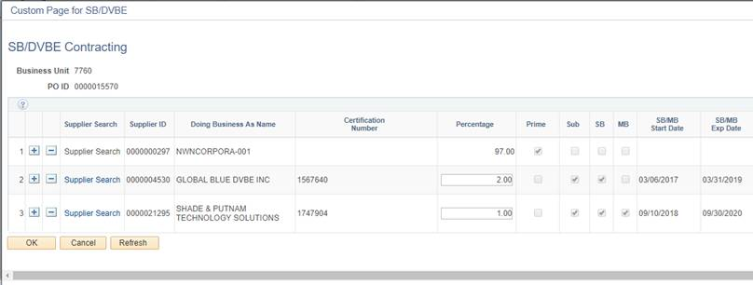
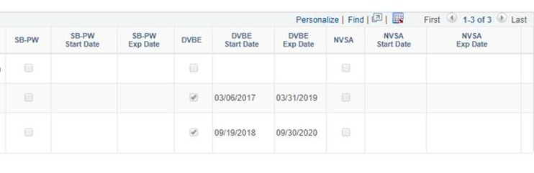
SB/DVBE Subcontracting Page (Part 2)
Add subcontractors
Enter subcontractor percentage
SB_PW certification type
NVSA
Notes:
25

Slide 26
Certification Types and SB/DVBE Participation Goals
Certification Types and
SB/DVBE Participation Goals
Certification Type Criteria | DVBE | SB | Micro SB designation | SB-PW | NVSA Nonprofit
Counts toward participation | DVBE goal | SB goal | SB goal | SB goal on public works transactions only | SB goal
SB(Micro), then
SB, then
SB-PW (PW sub-types only)
SB and DVBE counted on both goals
Helpful Links to find Certified Firms:
SB/DVBE Emergency Registry
CaleProcure

Slide 27
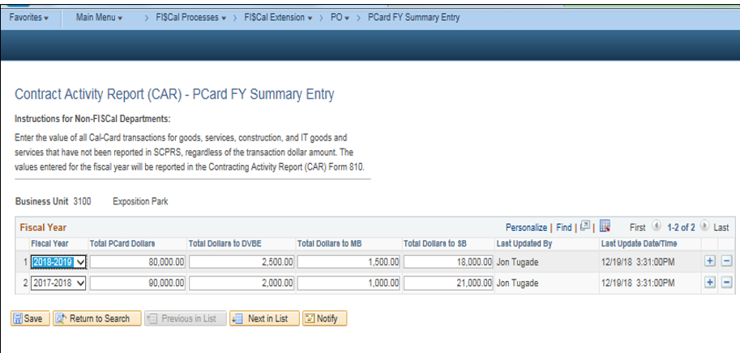
SCPRS- P-Card/Cal-Card FY Summary Entry Page
One row per fiscal year!
Notes:
27

Slide 28
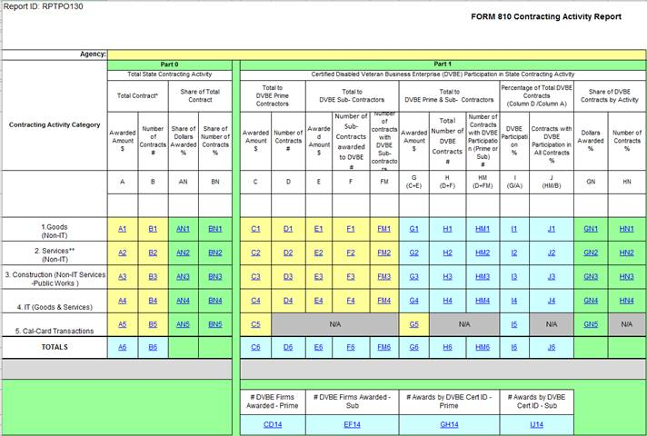
Form 810 – Contracting Activity Report Part 1
Form 810 - Contracting Activity Report
CAR Categories
DVBE Participation
Total awards
Column I displays the DVBE participation achieved!
Notes:
28

Slide 29
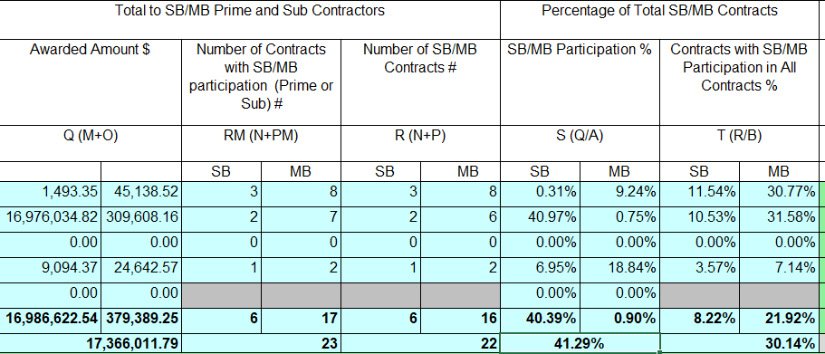
Form 810 – Contracting Activity Report Part 2
Form 810 - Contracting Activity Report (Cont.)
SB Participation
Column S displays the SB participation achieved!
Notes:
29

Slide 30
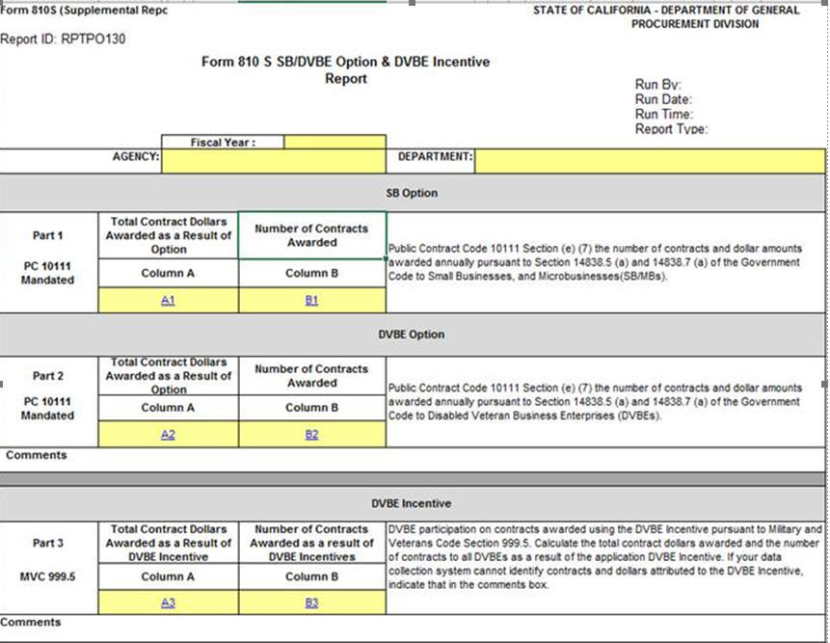
Form 810S –
SB/DVBE Option and DVBE Incentive
Acquisition Method:
SB Option
Public Works SB Option
Acquisition Method:
DVBE Option
Public Works DVBE Option
DVBE Incentive Waiver Checkbox left unchecked
Or
Contracts awarded as a result of DVBE Incentive
Notes:
30

Slide 31
Form 810S: SB and DVBE Option – Part 1 and Part 2
Under SB/DVBE Option, the suppliers (prime) should be certified!
SB or DVBE Option
  If the contract is $5,000.01 to $249,999.99
Public Works SB or DVBE Option:
  If the contract is $5,000.01 up to $388,000
  BB. No. P-01-22 - SUBJECT: SB and DVBE Option Acquisition Methods – Dollar Threshold Increase for Public Works Contracts
Government Code (GC) Section 14838.5(a)

Slide 32

Form 810S: DVBE Incentive - Part 3
Military and Veterans Code section 999.5(a) applies to all competitive solicitations, unless a DVBE exemption is approved.
BB. No. P-08-20 - SUBJECT: DVBE Incentive Exemption Regulation Update & DVBE Exemption Request Form (STD 816)
For FI$Cal departments:
Select the Check if exempt from DVBE Incentive box only if :
Have an approved DVBE Incentive Exemption (outside Fi$Cal), or
The Acquisition Method is SB or DVBE Option or other non- competitive

Slide 33
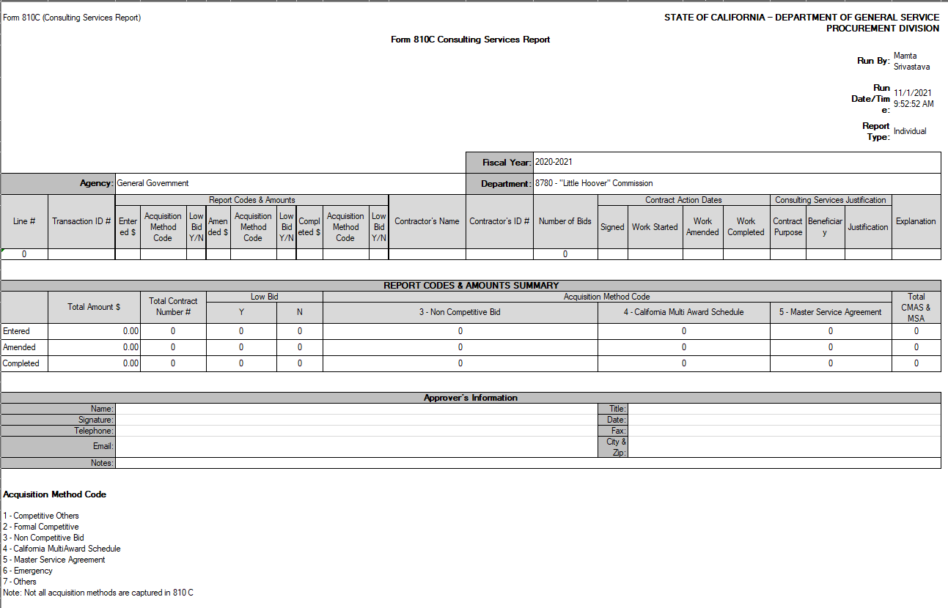
Form 810C: Consulting Services Report
Contractors List
Explanation Section
Codes

Slide 34
Form 810C: Consulting Services Report – Part 2
Public Contract Code §§10111 and 10335.5
"Consulting services contract," means services that do all of the following:
  Consulting Services Contracts are those that are defined for services of an advisory nature.
  The final product is a transmittal of information in either written or verbal form.
  The product may be answers to questions, the design of systems or plans, workshops, seminars, retreats or conferences.
  All “Consulting Services Contracts” must be reported unless excluded.

Slide 35
Form 810C: Consulting Services Report – Part 3
Not captured on Form 810C:
Contracts/agreements between a state agency or department and the federal government
Contracts/agreements with local agencies to subvene federal funds for which No matching State funds are required
Contracts to develop, maintain, administer or use licensing or proficiency examinations
Architectural and Engineering (A&E) per Chapter 10 (commencing with 4525) of Division 5 of Title 1 of the Government Code
For FI$Cal departments:
No need for additional data entry
Exclusions are already addressed
Check for the errors for correction caused by amendments to provide written explanation
The system will pull all the data needed from the Consulting Services Justification box
PO Reporters and SCPRS Processors can run the report

Slide 36
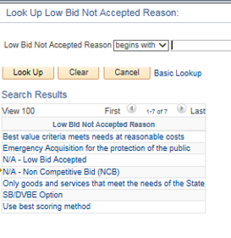
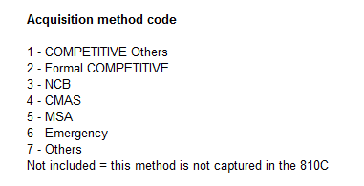
Form 810C Details (Cont.)
Acquisition method code. For NCBs the system will capture the selection in the Explanation Section.
Reasons for not accepting low bid based on the selection below. If Lowest Bid not accepted, the system would display the reason selected in the Explanation Section.

Slide 37
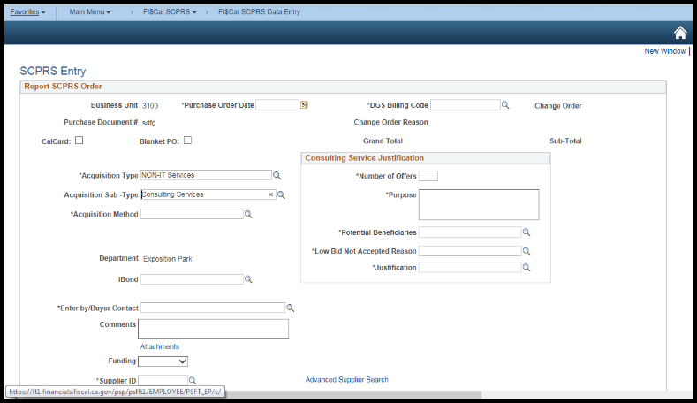
Form 810C: FI$Cal Departments
Consulting Services Justification

Slide 38
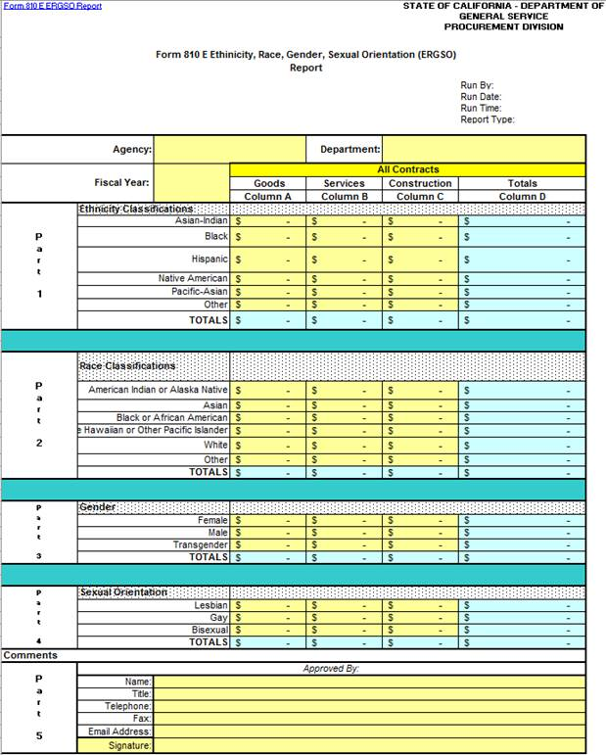
Form 810E: ERGSO Report
Form 810E: ERGSO Report
Notes:
38

Slide 39
Form 810E: ERGSO Report – Part 2
Public Contract Code §10111
Includes voluntarily provided contract dollars by business owners on:
  Ethnicity
  Race
  Gender
  Sexual orientation
Information received on Voluntary Statistical Data Sheets (VSDS)
Do not save VSDS in procurement files, save all of them separately!
For FI$Cal Departments:
Buyers enter VSDS data on the ERGSO Data Entry Page
The system will aggregate the data for department/state

Slide 40
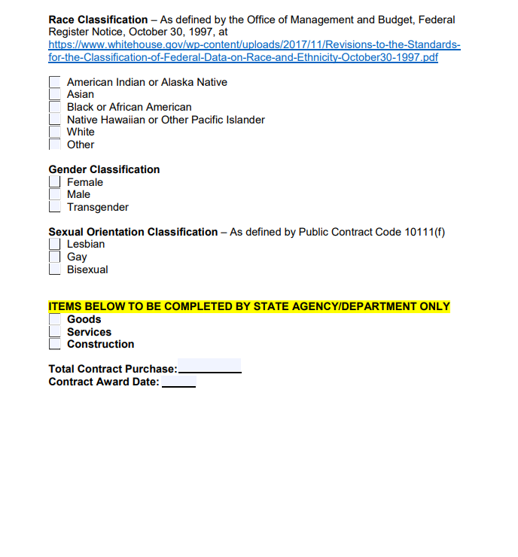
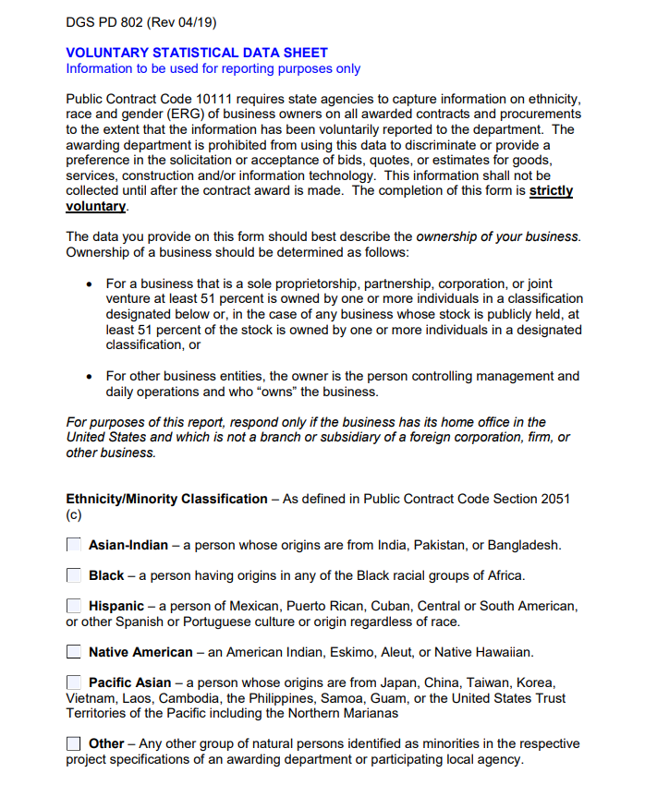

Voluntary Statistical Data Sheet (VSDS)
Voluntary Statistical Data Sheet (VSDS)
✓
✓
✓
$2,000
7/8/16
Notes:
40

Slide 41
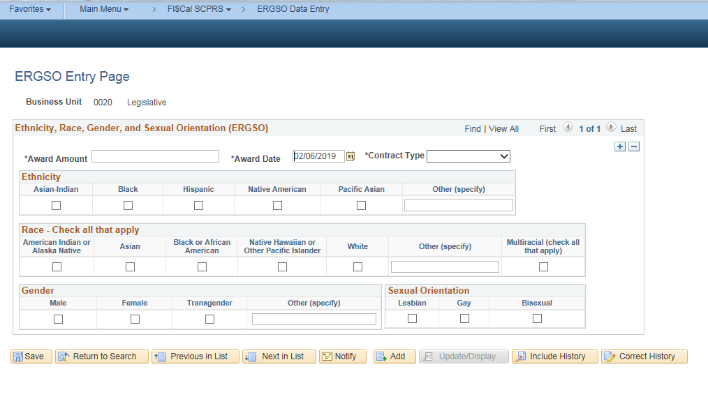
FI$Cal and SCPRS - ERGSO Data Entry
Fi$Cal Buyers and SCPRS Processors can enter VSDS data on this page
Enter data for another VSDS

Slide 42
Form 810A: I-Bond/IIJA Activity Report
Form 810A: I-Bond/IIJA Activity Report
DVBE Participation
SB Participation
Notes:
42

Slide 43
Form 810A: I-Bond/IIJA Activity Report – Part 2
Infrastructure Bond Acts of 2006
The Highway Safety Traffic Reduction, Air Quality and Port Security Bond Act.
The Housing and Emergency Shelter Trust Fund Act.
The Kindergarten-University Public Education Facilities Bond Act.
The Disaster Preparedness and Flood Prevention Bond Act.
The Safe Drinking Water, Water Quality and Supply, Flood Control, River and Coastal Protection Bond Act.
Government Code §14838.1 (d)
  25 percent Small Business participation goal in all contracts financed with the proceeds of the infrastructure related bond acts of 2006
  An Improvement Plan is required when the SB participation goal for I-Bond contracts is not met

Slide 44
Form 810A: I-Bond/IIJA Activity Report – Part 3
Infrastructure Investment and Jobs Acts (IIJA) of 2023:
The Surface Transportation Reauthorization Act.
The Surface Transportation Investment Act.
The Drinking Water and Wastewater Infrastructure Act.
Broadband.
The Build America, Buy America Act.

Slide 45
Form 810A: I-Bond/IIJA Activity Report – Part 4
Government Code §14838.1 (e)
New contracts over $500,000 financed in whole or part with the proceeds of the Infrastructure Investment and Jobs Act (IIJA)
  25 percent Small Business participation goal
  Unless an exemption determination is made
  An Improvement Plan is required when the 25 % SB participation goal for IIJA contracts is not met
  Updated report will be available 06/01/23
  Liaison must publish upcoming such contracts and send OSDS the links.

Slide 46
Form 810A: I-Bond/IIJA Activity Report – Part 5
Make determinations/exemptions of the IIJA funded contracts that are exempted from the 25% SB participation goal.
Report each instance in which a IIJA exemption determination is made to DGS, Office of Small Business and Disabled Veteran Business Enterprise Services (OSDS) at OSDSReports@dgs.ca.gov
Report annually to DGS in the Consolidated Annual Report (CAR) statistics comparing the SB and microbusiness (Micro) participation dollars for contracts funded by IIJA federal dollars to the total contract dollars for contracts funded by federal dollars.

Slide 47
CAR for FI$Cal Users Resources
Consolidated Annual Report Training – Form 810 – Intake Pages
Consolidated Annual Report – Frequently Asked Questions
FI$Cal/SCPRS User's Guide to CAR Reporting
CalOES Mission Task & Statewide Incident IDs Training
Running the CAR Reports (Form 810 Reports) in FI$Cal Job Aid
Running and Using a Department's Data Validation Query Job Aid
Intake Page Job Aid
ERGSO Entry Page Job Aid

Slide 48
Important!
The Departments need to follow the following procedure to submit the report:
FI$Cal Departments: The OSDS will pull the report directly from the system after the CAR due date. No need to email the reports to the OSDS.
Note: Contact OSDS at least two weeks before the due date for correction incase of error in system report. If for any reason if you need to submit via intake page, please let us know so we can remove your business unit (BU) from the configuration.
  OSDS and all reporting departments SAVE all reports ran on the due date or closest to the due date for their own records!
In FI$Cal, all BU reports will display who ran the report, the date/time stamp, and type of report.
Non- FI$Cal departments: submit reports via Intake pages.

Slide 49
Cover Letter
FI$Cal departments submit to OSDS only if:
Reporting for multiple BUs.
Submitting an Improvement Plan because your department did not meet one or both goal(s).
You find a discrepancy in the system report and need to make correction.
Include:
If multiple BUs, specify what BUs are included in the report.
An analysis of trends and any anomalies in the SB/MB or DVBE participation.
Review of progress on all prior year Improvement Plan items enacted and their effect on current participation goals.
Send to OSDSReports@DGS.ca.gov

Slide 50
Improvement Plans
Araceli Mohseni
SB & DVBE Advocacy Support Manager
Office of Small Business and DVBE Services
DGS Procurement Division
Araceli.Mohseni@dgs.ca.gov
(279) 946-7908

Slide 51
Improvement Plans 2
New online Improvement plan portal (live in September)
Required when department misses one or both goals
Avoid Deficiency Notice, use new portal
Run the report on monthly basis

Slide 52
Improvement Plans 3
Questions are being reformatted
Departments can add comments in open-text boxes
Communications will announce the new portal
Advocacy Support Unit is here to help!
Email advocate@dgs.ca.gov

Slide 53
Important CAR Reporting Deadlines
In 2023, OSDS conducted 4 training sessions for FI$Cal/SCPRS departments
May 30 OSDS conducts CAR training for FI$Cal departments
May 31 OSDS conducts CAR training for FI$Cal departments
June 5 OSDS conducts CAR training for Non-FI$Cal departments
June 7 OSDS conducts CAR training for Non-FI$Cal departments
June 1 - 30 OSDS sends reminders about upcoming reporting
July 1 - 31 BUs run their draft reports, verify against queries/own records
July 31 Last day to request extension from OSDS
October 1 due date
Note - Due to the statewide data compilation complexities, extensions beyond October 15 cannot be approved.

Slide 54
Important CAR Reporting Deadlines (Cont.)
October 1 | CAR Report + Improvement Plans DUE DATE
October 2 | OSDS runs and saves all reports, except extensions
October 1 or 2 | BUs run their own final reports and SAVE FOR THEIR RECORDS
Post extension | BUs to run their own report
October 15 | No revisions or extension past this date
January – February | DGS sends Purchasing Authority deficiency letters to departments not reporting/not submitting improvement plans
January -March | OSDS publishes the report

Slide 55
Last Minute Tips
  Keep in touch with OSDS at OSDSReports@dgs.ca.gov
  Run your report and verify data on a sample basis monthly, or at least quarterly
  Reconcile the reports with your transactions
  Develop/strengthen secondary review and approval process
  Go back and correct during the fiscal year to the extent possible
  Specify the fiscal year on all Change Orders or amendments
  Report defects to OSDSReports@dgs.ca.gov and cc FSC
  Submit an Improvement Plan if not meeting one/both goals

Slide 56
Contact OSDS
OSDSReports@dgs.ca.gov
(916) 375-4940
Mamta Srivastava, OSDS Research Specialist
Mamta.srivastava@dgs.ca.gov
(279) 946-8202
CAR Report Questions:
Improvement Plan Questions:
Araceli Mohseni, Advocacy Support Manager
araceli.mohseni@dgs.ca.gov
(279) 946-7908
Notes:
56

Slide 57
Step-by-Step/Job Aid
Next…
“How to run your reports”
(All Form 810s) + DVQ
“How to validate the 810 report”
Step-by-Step / Job Aid

Slide 58
Questions
Questions?
THANK YOU!

