Slide 1

Town Hall: Conferma for Travelers
September 25, 2025
Notes:
Thank you for joining us today. My name is Paola Bredberg Clark, I’m the Training and Program Improvement analyst at the Statewide Travel Program. We have a lot of information to share with you, so let’s get started.

Slide 2


Housekeeping
Presentation on Conferma
PowerPoint, Q&A, and recording will be shared after the meeting
Unrelated topics will not be addressed
Notes:
Let’s begin with a few housekeeping items.
Today’s Town Hall is set up as a 30-minute presentation on Conferma and then a 30-minute live Q&A.
A copy of the PowerPoint, recording of this presentation, and the Q&A will be shared with you via email after this meeting. Feel free to share with any colleagues that were unable to attend.
We will not be answering questions about topics that are unrelated to Conferma.

Slide 3
Topics
Conferma Mobile App Overview
Conferma App Demonstration
Registration Process
Common Conferma Questions
Notes:
Our agenda for this morning is full of information from Conferma, so I will hand it off to them now.

Slide 4


Slide 5
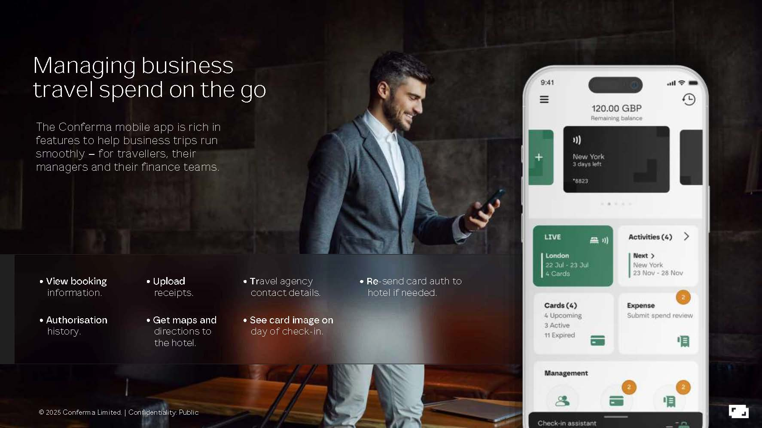

Slide 6
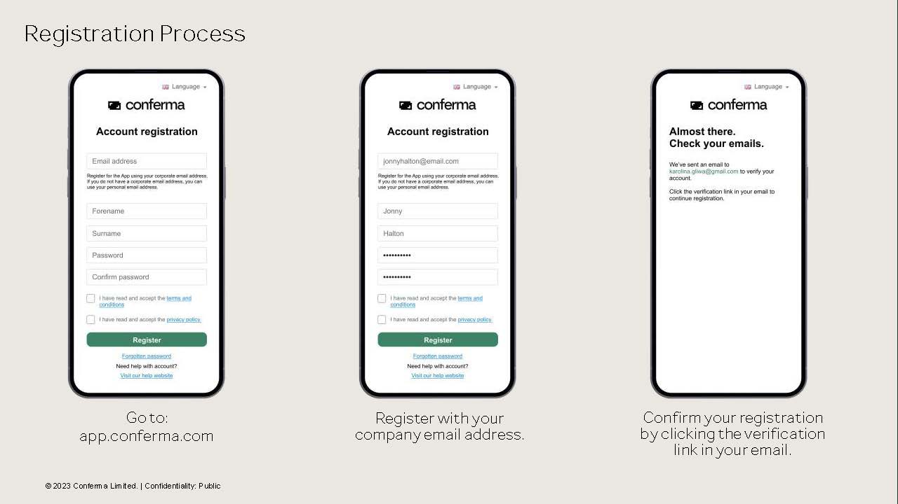

Slide 7
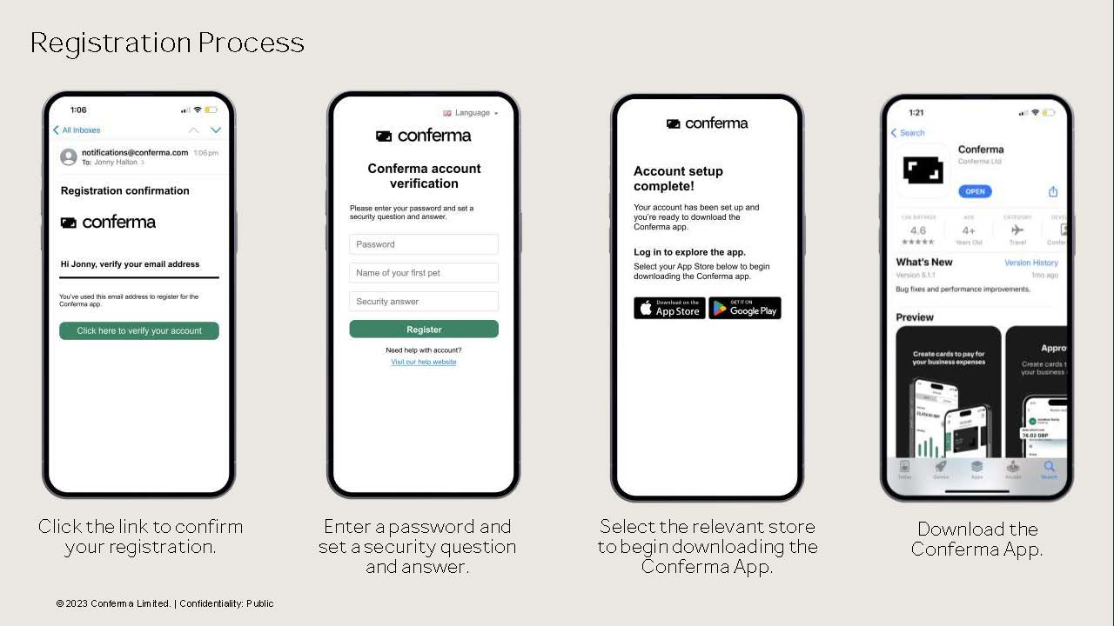

Slide 8
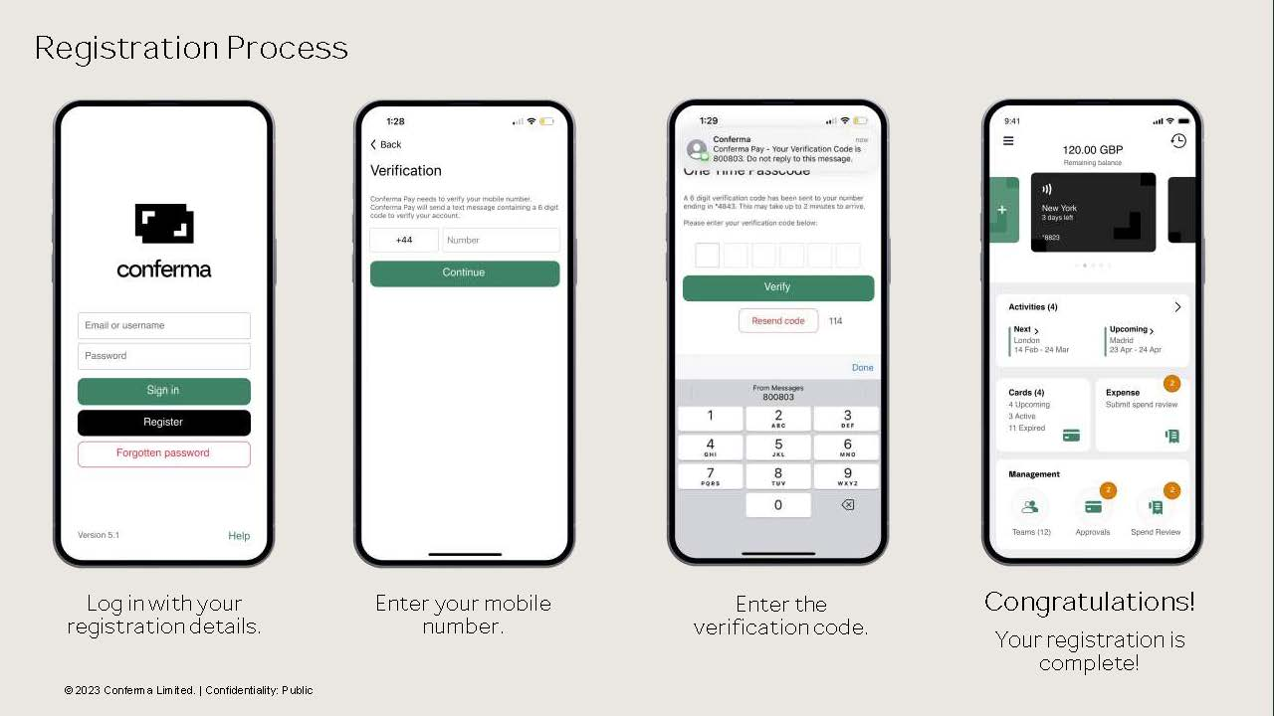

Slide 9
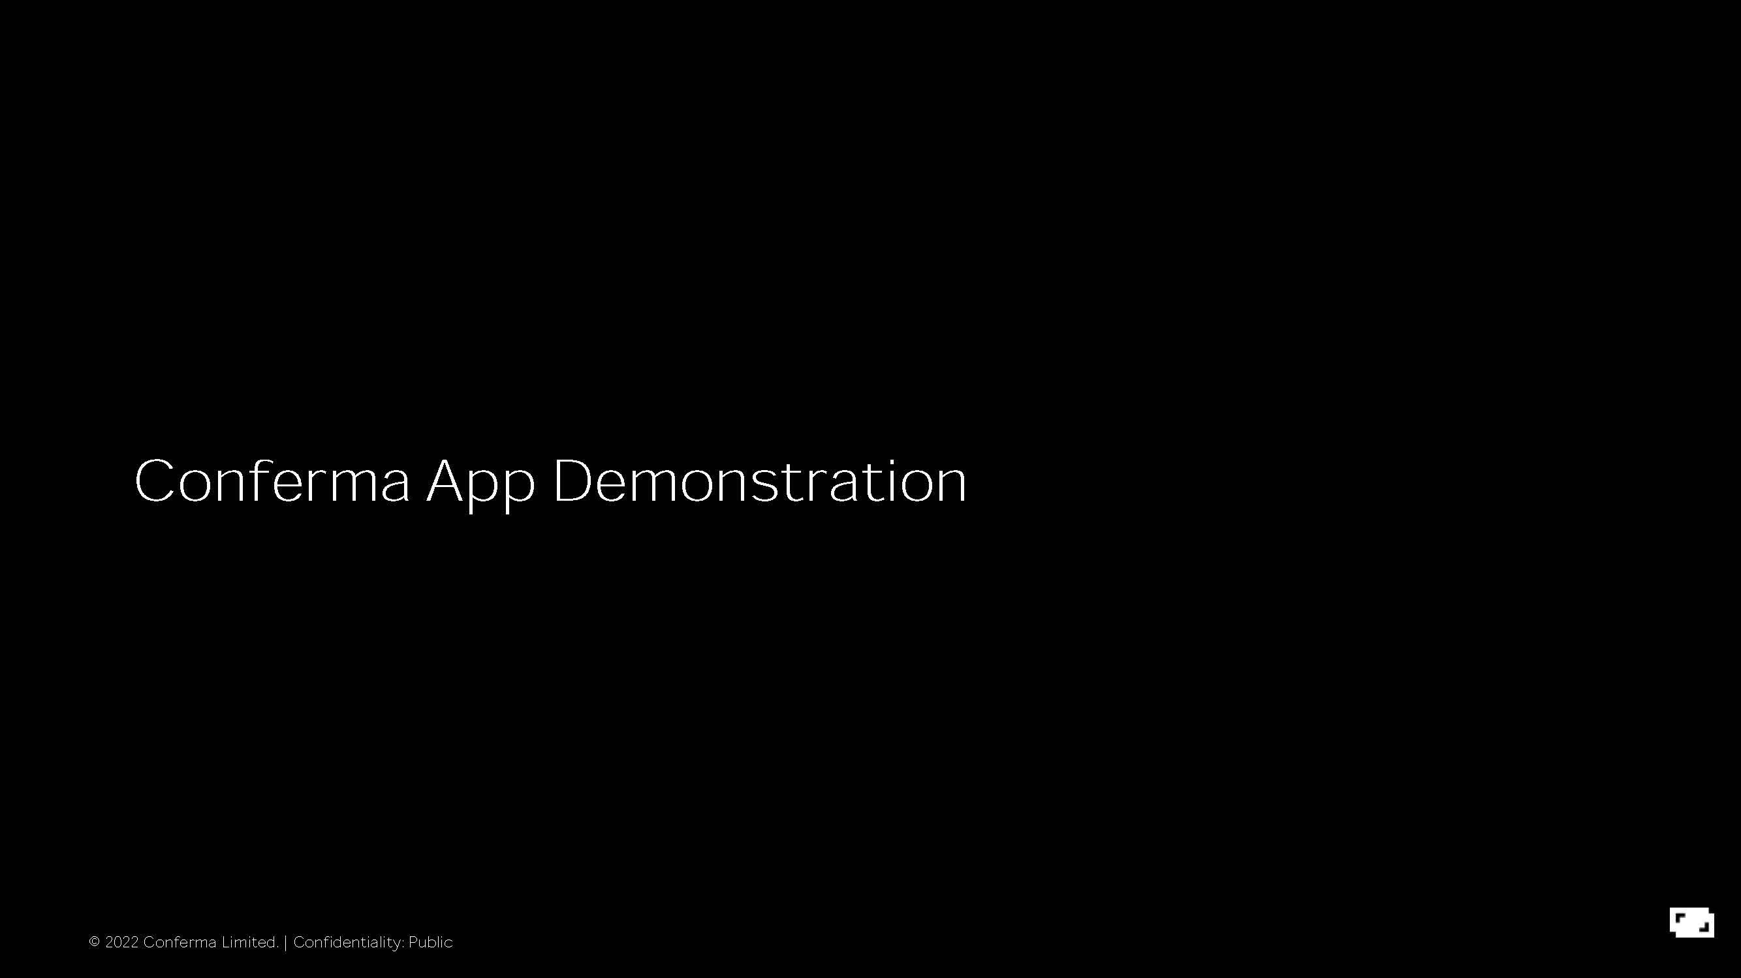

Slide 10
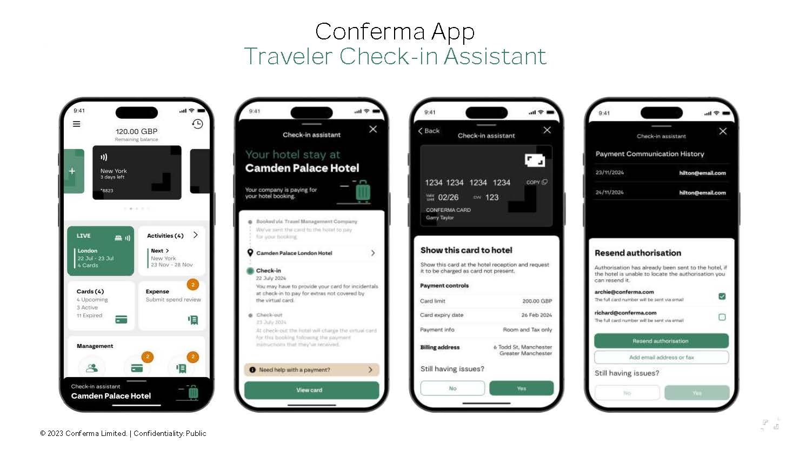

Slide 11
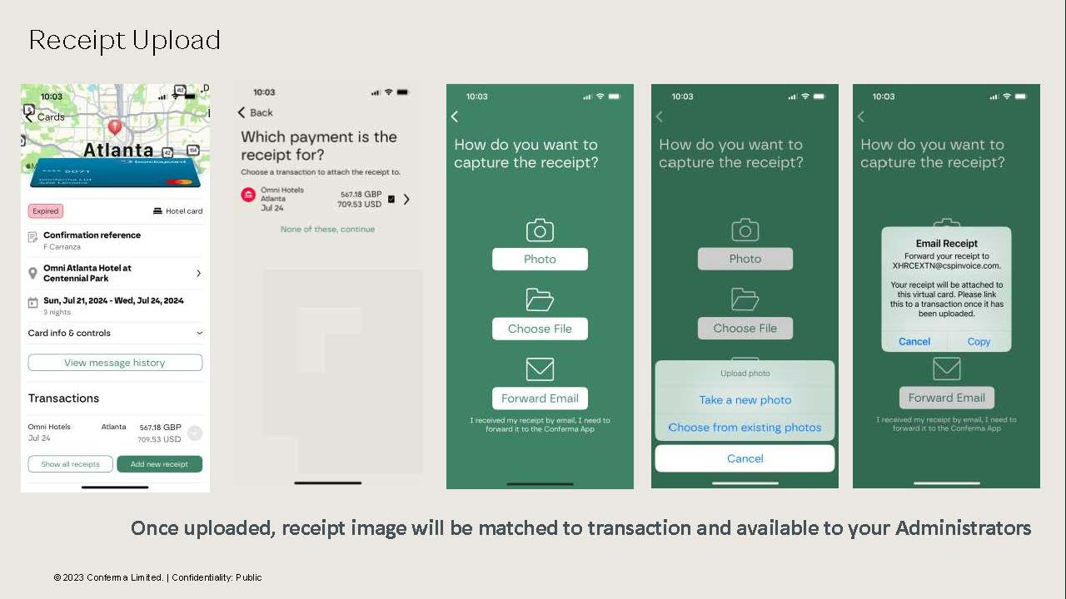

Slide 12
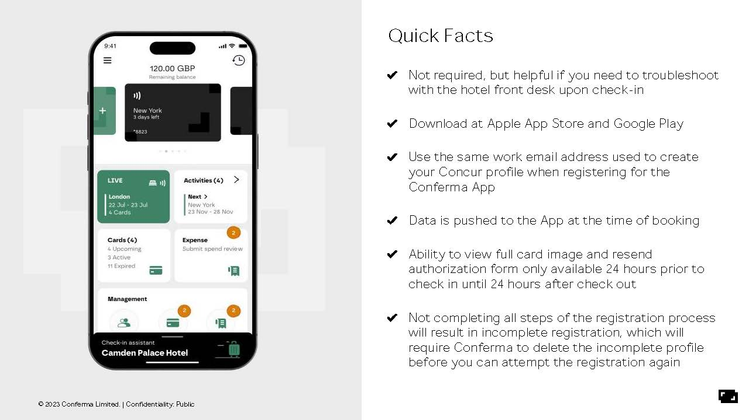

Slide 13
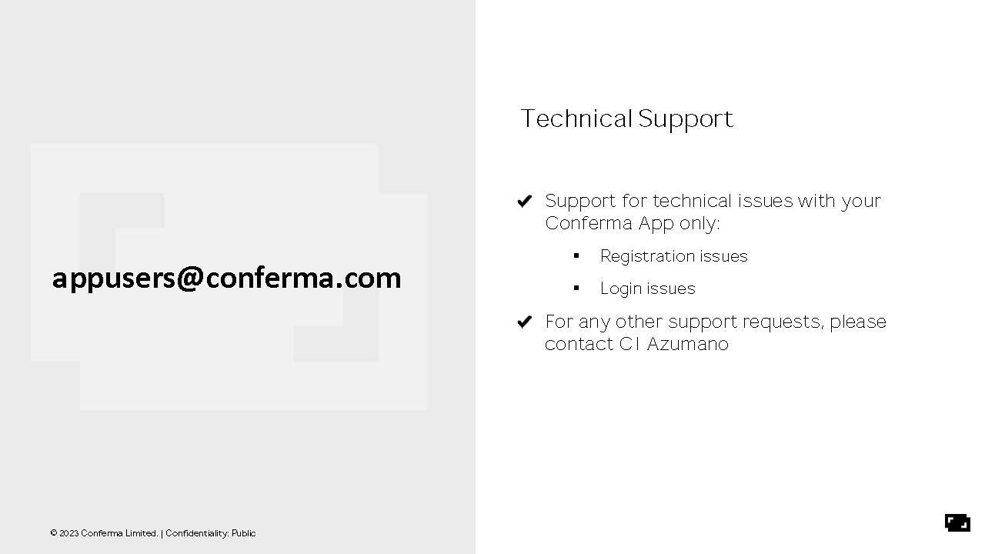

Slide 14


Slide 15
Common Conferma Questions

Slide 16


Do all hotels in Concur accept the Virtual Card Number (VCN)?
Not all hotels in Concur accept the Virtual Card Number.
Hotels labeled as “Preferred” or “Most Preferred” have an agreement with the state to accept virtual cards and will not require a separate credit card authorization form. The hotels that participate in the Preferred Hotel Program are noted in Concur as shown below:
Hotels that we know do not accept the virtual card have a note (shown below) within Concur letting travelers know that they will need to provide a personal form of payment and seek reimbursement.
Hotels that do not participate in the Preferred Hotel Program may require their own credit card authorization form.

Slide 17
What if the hotel does not have my Conferma credit card authorization form?
I have the Conferma app (recommended)
Pull up the virtual card on the Conferma app and provide it to the front desk.
Use Conferma to update the email address and resend the card information to the hotel (See slide 10 for instructions).
Ask the hotel for their credit card authorization form (if required by the hotel). ​
Use Conferma to complete the form.​
I don’t have the Conferma app
During regular business hours, contact your agency Travel Coordinator(s) to assist.
Before or after regular business hours, call CI Azumano at (877) 454-8785 to assist.
Use a personal credit card to check-in while the Travel Coordinator(s)/CI Azumano resolve the issue.
The virtual card will remain active 5 days after the check-out date for the hotel to reverse any charges made to the personal card.
In either situation: request your agency Travel Coordinator(s) contact the Statewide Travel Program for situational awareness.

Slide 18
What if the Virtual Card Number declines?
I have the Conferma app (recommended)
Use the Conferma app to update the email address and resend the card information to the hotel (See slide 10 for instructions).
During regular business hours, contact your agency Travel Coordinator(s) to call U.S. Bank so they can advise on how to resolve the declines.
Before or after regular business hours, call CI Azumano at (877) 454-8785 to troubleshoot.
Use a personal credit card to check-in while the Travel Coordinator(s)/CI Azumano resolve the issue.
The virtual card will remain active 5 days after the check-out date for the hotel to reverse any charges made to the personal card.
I don’t have the Conferma app
During regular business hours, contact your agency Travel Coordinator(s) to assist.
Before or after regular business hours, call CI Azumano at (877) 454-8785 to assist.
Use a personal credit card to check-in while the Travel Coordinator(s)/CI Azumano resolve the issue.
The virtual card will remain active 5 days after the check-out date for the hotel to reverse any charges made to the personal card.

Slide 19
Do travelers have to use the Conferma mobile app to use the Virtual Card Number Program?
The Conferma mobile app helps manage all virtual card reservations.
The Conferma mobile app is not required when using the virtual card program but strongly recommended.
Without the Conferma mobile app, any payment issue experienced at check-in would need to be called in to your agency’s Travel Coordinator(s) or to CI Azumano.
With the app downloaded and an account registered, travelers will have little to no delay in resolution.

Slide 20
Do travelers need to have a state-issued cell phone to use Conferma?
No, the Conferma mobile app may be used on a personal smart phone or tablet as well.
This mobile app is available through both Android and Apple app stores and is completely free.
The only two requirements for using the Conferma mobile app are:
The traveler needs to have a Concur profile.
The traveler needs to register for the Conferma mobile app using the same work email address used to create your Concur profile.
If you have a state-issued cell phone, please make sure to reach out to your agency’s Information Technology office to allow the Conferma mobile app to be downloaded.

Slide 21
Virtual Card Best Practices
Check-In
Tell the front desk staff you are using a virtual card to pay for the stay.
Confirm the hotel has received the card information.
If necessary, resend the card information through the Conferma app.
Give the front desk staff a personal credit card for deposit/incidentals.
Check-Out
Allow enough time to check-out in person.
Ensure the hotel charged the room, tax, parking, and applicable fees to the virtual card.
Ensure the hotel charged any other incidental charges to your personal credit card.
Request 2 folios (receipts): one for the virtual card-paid room + tax, and one for any personal or incidental expenses charged to your personal credit card.
Upload the folios in Conferma app for reconciliation purposes or send to your travel/accounting unit.

Slide 22
Resources
CI Azumano
CI Azumano Website
Concur Website
Call: 1 (877) 454-8785
Email: CalTravel@ciazumano.com
Statewide Travel Program
As a traveler, your first point of contact is your agency Travel Coordinator(s).
Concur Travel Demonstration Training (Video)
Conferma App Guide
Conferma Quick Guide for Travelers
Lodging Resources
SAM 4117.3 (Applies to executive branch agencies only)
Virtual Payment and Virtual Card Number Resources
State Traveler 101
Statewide Travel Program Training, Guides
Traveler Resources on STP Website (Video)
Notes:
Thank you, Nhan. Before our live Q&A, I wanted to point out several resources that are helpful. Under Statewide Travel Program, you can find links to resource pages and guides from our website. You can also find the Conferma Quick Guide for Travelers, which is a one-page guide to using Conferma. We have also linked DGS State Administrative Manual Section 4117.3, which applies to executive branch agencies only.

