Slide 1
DSA: CHANGING CULTURE & CHANGING PROCESSES
CONSTRUCTION OVERSIGHT PROCESS

Slide 2
CHANGING CULTURE & CHANGING PROCESSES

Slide 3
OVERVIEW
Accessibility
Prop. 39
Certification
Inspection Card Process
Design/Construction Oversight Communication
DSA Fee Structure

Slide 4
NEW CALIFORNIA ACCESSIBILITY CODE
New ADA Requirements: 3/15/12
Alignment of ADA and CBC
Most Accessible
Dimensions: Fixed vs. Ranges
Published Date: 7/1/13
Alternative Use: 7/1/13
Effective Date: 1/1/14

Slide 5
PROP. 39
Exempted Work
Expedited Projects

Slide 6
CERTIFICATION
Uncertified Projects as of 1/1/11: 16,386
Uncertified Projects as of 3/1/13: 13,483

Slide 7
ALTERNATIVE APPROACH TO CERTIFICATION (Legacy Projects)
Statute
Death, Default, or Incapacitation
District’s Responsibility to Request
Form 310 and Fees

Slide 8
ALTERNATIVE REQUIREMENTS
IOR’s Verified Report (Form 6)
A/E Verified Report (Form 6)
No Uncorrected Deviations
DSA Approved Construction Documents

Slide 9
STOP THE BLEEDING
3/31/13: 2,271 additional uncertified projects
Change the way we do business

Slide 10
REVISE PROCESS
5/1/12: Eliminate cost review of individual Change Orders

Slide 11
REVISE PROCESS
11/1/12: Initiate Construction Change Documents (CCDs)
Eliminate Field Construction Directives (FCDs)
Eliminate Change Orders (COs)
DSA reviews only Structural, FLS and Access

Slide 12
REVISE PROCESS
1/1/13: Single Signature for Special Inspections

Slide 13
REVISE THE CONSTRUCTION OVERSIGHT PROCESS
Initiate the Inspection Card process
Utilized by all municipal agencies
Approval of construction and documents at milestones
Certification concurrent with construction

Slide 14
INSPECTION CARD
Verified Reports for each milestone
IOR
A/E
Currently required by Statute or Regulation
Each Individual Building or Portion
Site work

Slide 15
MILESTONE APPROVALS
All documents submitted and approved
at each milestone
Equivalency to certification
Order to Comply
Stop Work Order

Slide 16
CONSTRUCTION SCHEDULE
Flexibility
Coordinated: IOR and Builder
Sign-off portions

Slide 17
ACCESSIBILITY REQUIREMENTS
Extended time for access elements

Slide 18
TEMPORARY CERTIFICATION FOR ACCESS
Temporary Certification for Access
Structural and FLS certification equivalency
Temporary equal access facilitation
Posted on DSA’s website
Listing of Elements to be completed
All work completed within 90 days DSA
Posting until completed

Slide 19
TEAM RESPONSIBILITIES
District
IOR
A/E
Laboratory Manager
Conflict of interest changes

Slide 20
CONSTRUCTION OVERSIGHT COMMUNICATION

Slide 21
COMMUNICATION
Change Culture of Project Team
Change Process of Team Communication
Stop Lost Documents
Rapid Response

Slide 22
COMMUNICATION SYSTEM CRITERIA
Immediately Available
Efficient
Simple to Use
Easily Accessible to Entire Team
BOX

Slide 23
DSAbox
Free to all Team Members
Cloud Based: Accessible
Transparent
“Filing Cabinet”
Sends E-Mail to All Team Members
Maintains Response and Version Control

Slide 24
INVITATION TO DSAbox
DSAbox

Slide 25
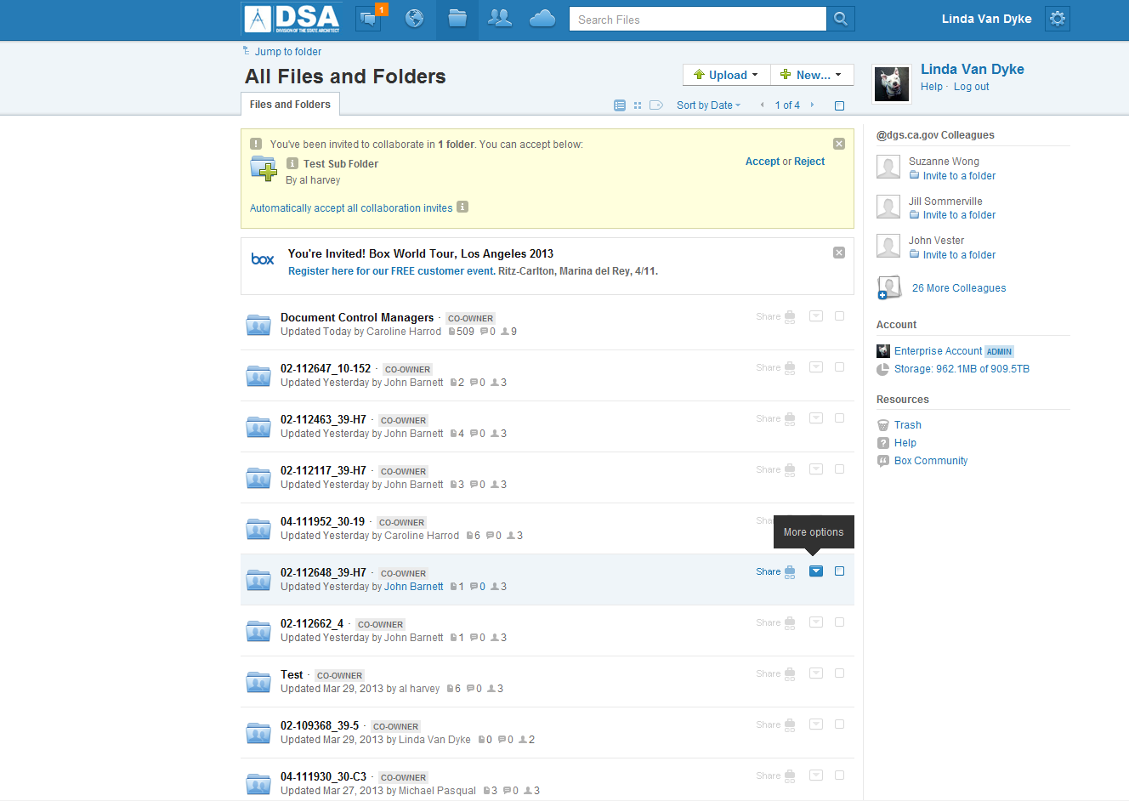
PROJECT LIST
DSAbox

Slide 26
DSAbox
District (Program Manager)
Sort by:
All campuses with active projects
Specific campus with all active projects
Specific project

Slide 27
DSAbox
Campus (Construction Manager)
Sort by:
All active projects
Specific active project

Slide 28
DSAbox
A/E, IOR, Lab, Builder(s)
Sort by:
All contracted active projects in state
All contracted active projects in District
All contracted active projects on specific campus
Specific contracted project

Slide 29
DSAbox
FOLDER SYSTEM
Track
FIELD ENGINEER
IOR
DOCUMENT
ANALYST
A/E
LAB
BUILDER
GEOTECH

Slide 30
DSAbox
FOLDER SYSTEM
Track
FIELD ENGINEER
IOR
DOCUMENT
ANALYST
A/E
LAB
BUILDER
GEOTECH
SEMI-MONTHLY REPORTS
INSPECTION CARDS
DEFICIENCY NOTICES
VERIFIED REPORTS
Sub-folders

Slide 31
DSAbox
FOLDER SYSTEM
Track
FIELD ENGINEER
IOR
DOCUMENT
ANALYST
A/E
LAB
BUILDER
GEOTECH
CONSTRUCTION CHANGE DOCUMENTS
Sub-folders
SUBMITTED
APPROVED

Slide 32
DSAbox
DSA ESTABLISHES FOLDERS (Tracks)
Field Engineer
IOR
Document Analyst
A/E
Lab
Builder
Geo Tech.

Slide 33
DSAbox
DSA ESTABLISHES SUB-FOLDERS
Engineer’s Trip Notes
IOR Semi-monthly Reports
A/E Verified Reports
Etc.
Naming Conventions

Slide 34
PERMISSION LEVEL
DSAbox
View and download only
Upload ability

Slide 35
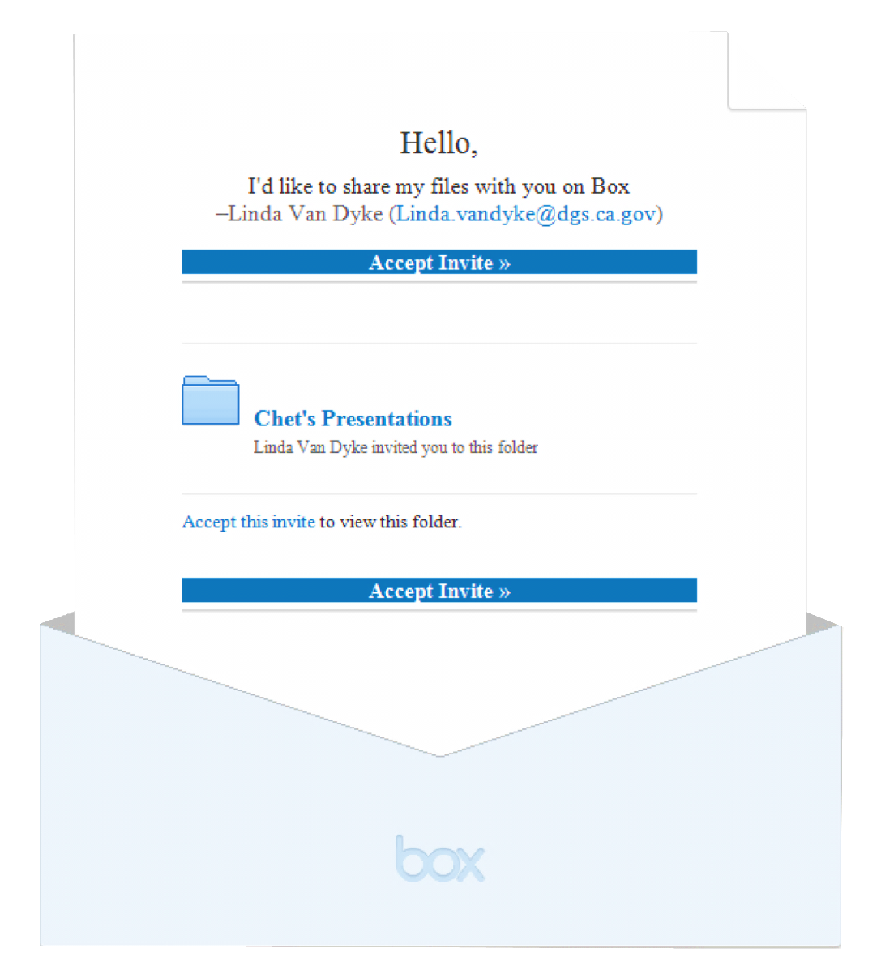
YOU’VE GOT MAIL
DSAbox
E-mail upon deposit to folder
Record all “transactions”

Slide 36
CONSTRUCTION CHANGE DOCUMENTS

Slide 37
DSAbox
Initial Submission

Slide 38
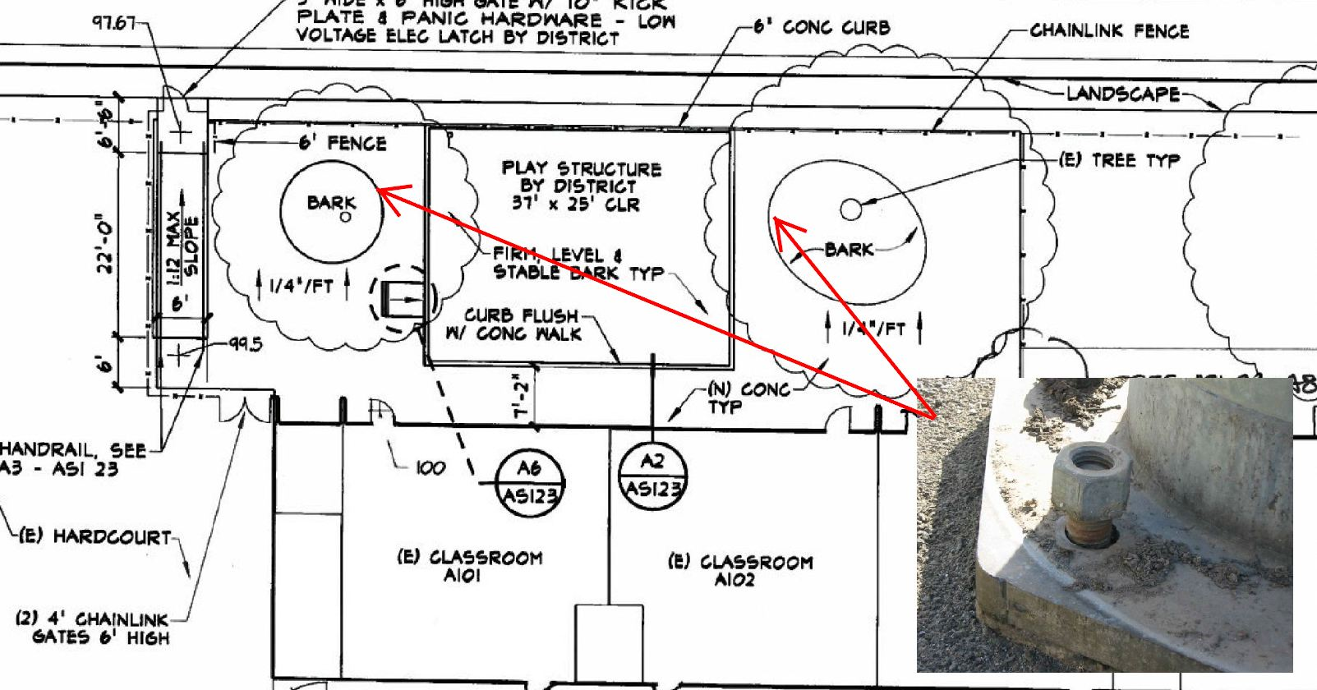
DSAbox
Initial Submission

Slide 39
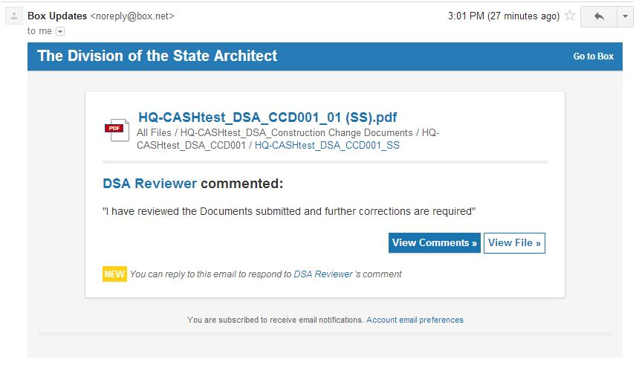
DSA Replies to Initial Submission
DSAbox

Slide 40
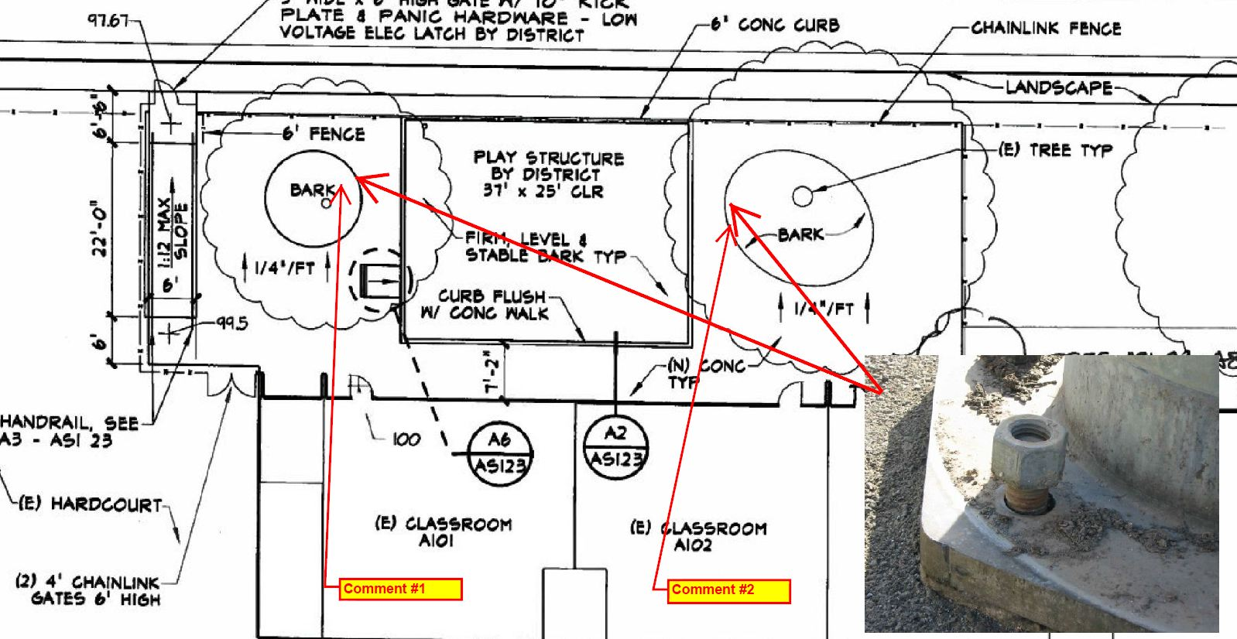
DSA Replies to Initial Submission
DSAbox

Slide 41
DSAbox
Revised Submission

Slide 42
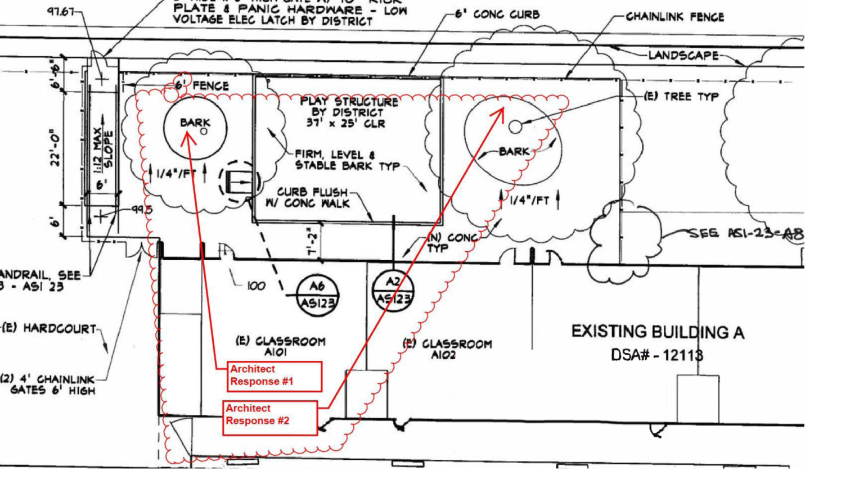
DSAbox
Revised Submission

Slide 43
DSA Approval of Construction Change Document
DSAbox

Slide 44
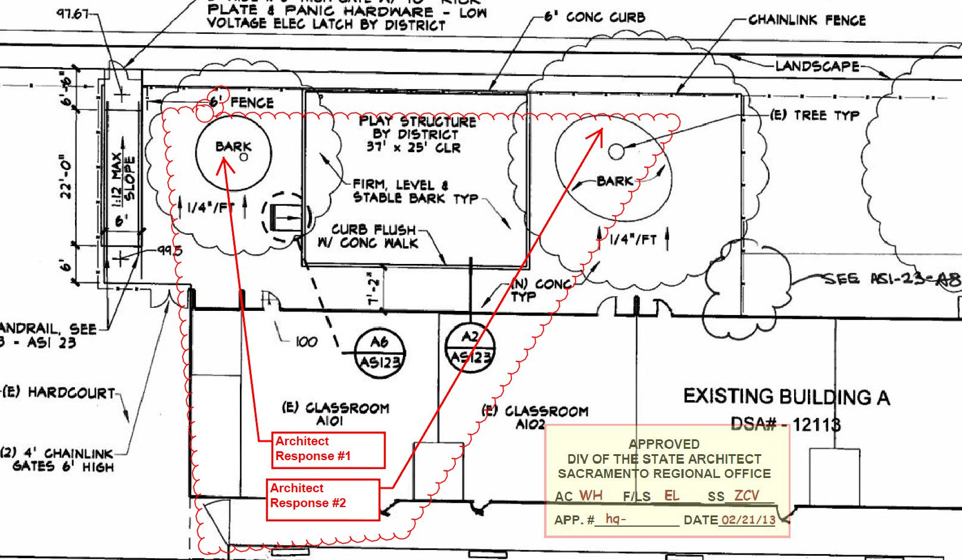
DSA Stamped & Approved Construction Change Document
DSAbox

Slide 45
Record of File Activity
DSAbox
# of updates
Who did what
When they did it

Slide 46
CHANGING CULTURE & CHANGING PROCESSES
Paradigm Shift for Staff
Training
Document Analysts
Tablets

Slide 47
DSA FEE STRUCTURE FOR REVISIONS
Obligated to recover all costs
Changes to original approved documents
Hourly rates

Slide 48
HOURLY RATES
Under construction prior to 2/28/13: $98
Commence construction after 3/1/13: $170
No Double Dipping

Slide 49
CHANGING CULTURE & CHANGING PROCESSES
Documents posted 5/1/13
All projects commencing construction after 6/1/13
All existing projects phased in by 12/31/13

Slide 50
Inspection Card PR 13-01 Associated Forms

Slide 51
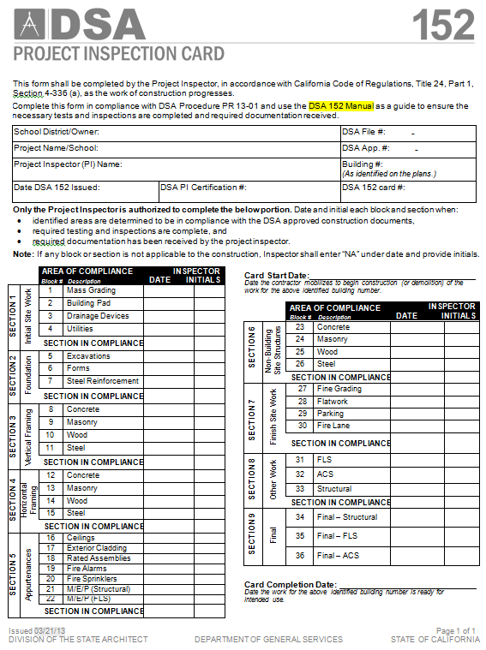
Inspection Card
INSPECTION CARD DSA FORM 152
Similar to that used by virtually every building department in California.
One page document …Interim Verified Report by the Project Inspector.
Comprised 9 sections/36 blocks
Each block and section are signed off by the project inspector as construction proceeds.
Same card is used for all projects regardless of scope but not all blocks and sections may be applicable.
Sections Blocks Descriptions

Slide 52
Inspection Card
INFORMATION ON USING THE INSPECTION CARD
The inspector will use the DSA-152 Manual as a guide to determine the requirements necessary for card sign off. The manual is keyed into the sections and blocks on the inspection card so that the inspector looks up the necessary information using the section and block numbers.
The DSA implementation requirements are published in Procedure PR 13-01.
The number of inspection cards required for projects corresponds with the number of buildings in the project scope. There will be one card issued for each separate building and one card issued for the site work (includes non-building site structures).

Slide 53
Inspection Card
IMPLEMENTATION
DSA Procedure PR 13-01 provides the process requirements
Process Will be Implemented as follows:
Documents posted May 1, 2013
Required Use June 1, 2013
Applicability:
Construction complete before June 1…not applicable
Construction starting after June 1…Process is required
Construction started before June 1 but not complete….phased in process

Slide 54
PR 13-01
PR 13-01: Construction Oversight Process Procedure
Provides required, prescribed methods to achieve code required communication and documentation of the status of construction inspections and material testing.
Implementation Document for the Inspector Card Process
Introduces A Family Of Associated Documents
Form-151: Project Inspector Notifications
Form-152: Project Inspection Card (inspector interim verified report)
Form-154: Notice of Deviations/Resolution of Deviations
Form-155: Project Inspector Semi-monthly Report
Form-156: Commencement/Completion of Work Notification
Form-6 PI: Verified Report – Project Inspector
Form-6 AE: Verified Report – Architect/Engineer
Form-6 C: Verified Report – Contractor
Form DSA 102-IC: Construction Start Notice/ Inspection Card Request
152 Manual: Inspector’s Guide for Completion of the Inspection Card

Slide 55
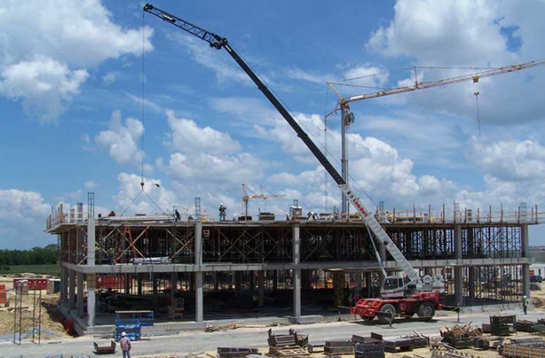
Inspection Card and Manual

Slide 56
DSA: CHANGING CULTURE & CHANGING PROCESSES
DSA 152 PROJECT INSPECTION CARD & MANUAL
Notes:
This presentation covers DSA 152 and accompanying manual
Provide direction for how to fill out DSA 152 through use of manual

Slide 57
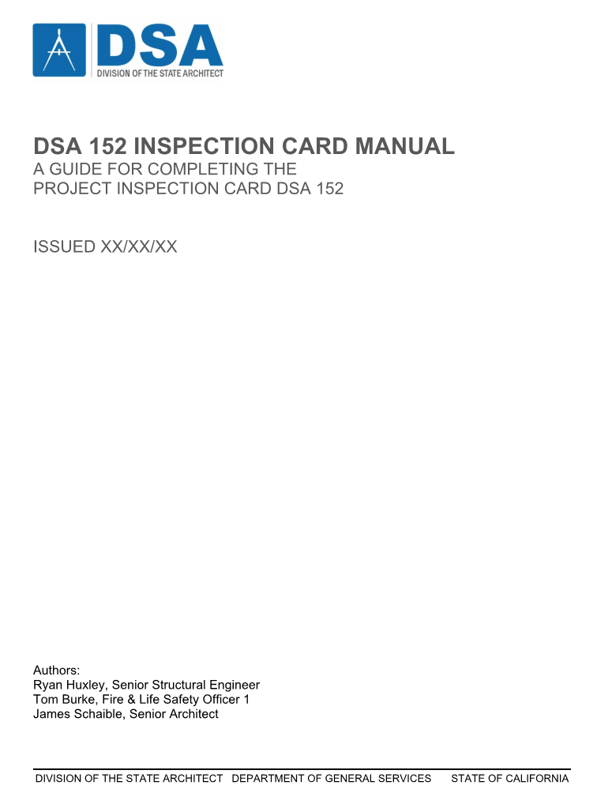
OUTLINE
DSA 152 Project Inspection Card
What is it?
How to fill out?
DSA 152 Inspection Card Manual
Intended Users
What is the manual?
How to use the manual
Notes:
Outline for presentation
(CLICK) DSA 152 Project Inspection Card
(Read sub-bullets)
(CLICK) DSA 152 Inspection Card Manual
(Read sub-bullets)

Slide 58
Form DSA 152
Similar to city/county permit card
Simpler high-level view of construction inspection
PI to fill out to report status of compliant construction per Title 24, Part 1
Use PR 13-01
Use manual (more later)
1st input area by DSA
Notes:
This is the DSA-152 form
New form, conceptually similar to city/county permit card
Much simpler than permit cards - provides very high-level view of construction inspection
Let’s go through each section of the card. (CLICK)
Let’s zoom in on this area (CLICK)
Primary purpose for card based on Title 24, Part 1: PI to fill out to document key stages of compliant construction
PR 13-01 provides a prescribed method for compliance with the applicable sections of Title 24, Part 1 (CAC)
Manual provides detailed descriptions of required documents and inspections to fill out card – more later (CLICK)
Let’s zoom in on this area (CLICK)
1st area filled out by DSA upon issuance of project inspection card
Provides basic information for the project, building OR (CLICK) sitework (CLICK), inspector and other inspection cards

Slide 59
Form DSA 152
Only PI to fill out 2nd area of card
2nd Area
Primary focus
Use of manual
Notes:
Only PI to fill out the 2nd area of card (CLICK)
(CLICK) 2nd area filled out by Project Inspection
Primary focus for remainder of presentation in conjunction with manual

Slide 60
FILLING OUT DSA 152 FORM
Card Start Date
DSA 151 PI Notifications to DSA
Form Organization
Headings
Sections
Provide broad overview of key construction stages
Card Completion Date
Notes:
(CLICK) Provide card start date for each building & site work for project
Submit DSA-151 PI Notifications to DSA
(CLICK) Form Organization
Headings for columns
(READ HEADINGS)
(CLICK) Sections
Section number, block number, and description
These provide a broad overview of the key stages/portions of the construction process for a given building or sitework. More detail next slide.
(CLICK) Card Completion Date

Slide 61
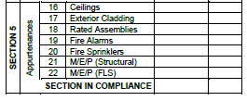
FILLING OUT DSA 152 FORM
Section 1
Section 2
Section 3
Section 4
Section 5
Section 6
Section 7
Section 8
Section 9
Notes:
Go briefly through each section – generally follows sequence of new construction.
(CLICK) Section 1 (CLICK) covers Initial Site Work related items. (CLICK)
(CLICK) Section 2 (CLICK) covers Foundation related items. (CLICK)
(CLICK) Section 3 (CLICK) covers Vertical Framing related items. (CLICK)
(CLICK) Section 4 (CLICK) covers Horizontal Framing related items. (CLICK)
(CLICK) Section 5 (CLICK) covers Appurtenances. (CLICK)
(CLICK) Section 6 (CLICK) covers Non-Building Site Structures. (CLICK)
(CLICK) Section 7 (CLICK) covers Finish Site Work related items. (CLICK)
(CLICK) Section 8 (CLICK) covers Other Work related items. (CLICK)
(CLICK) Section 9 (CLICK) covers Final related items. (CLICK)

Slide 62
DSA 152 Inspection Card Manual
Intended Users
Project Inspectors
Special Inspectors
Design Professionals
Laboratories
What is it?
Guide to fill out DSA 152 Project Inspection Card
Contains information about testing, inspections and resulting documentation necessary to fill out the inspection card
VERY LARGE document
Only reference needed sections
Notes:
(CLICK) While Ryan compiled the manual, (CLICK) FLS and ACS material generated mainly by others (CLICK)
Intended audience
(CLICK) (READ THROUGH LIST)
Design Prof’s – AOR/SEOR/GEOTECH – all listed on DSA-1 application
(CLICK) What is it? - Due to brevity of Project Inspection Card, Manual provides detailed requirements
Provides required documentation and inspection to fill out DSA-152
LARGE - ~350 pages
Only refer to sections applicable – don’t need to go through entire manual – example later

Slide 63
DSA 152 Inspection Card Manual
Overview of Contents
5 Chapters & 2 Appendices
Ch. 1 Administration
Inspection Card Correlation Matrix
Ch. 2 Structural Safety
Ch. 3 Fire/Life Safety
Ch. 4 Access Compliance
Ch. 5 Other Building Components and Systems
Appendix A – DSA 103 Correlation Matrix
Appendix B – Referenced DSA Forms
Notes:
High level view of contents
(CLICK through each bullet)
(Last CLICK underlines Correlation Matrix for DSA 152 & 103) Next slides describe correlation matrices (152 & 103) in more detail.

Slide 64
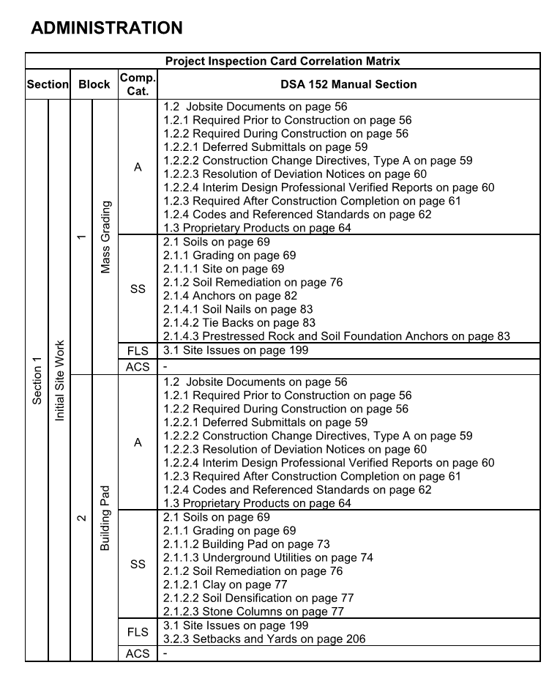
DSA-152 Correlation Matrix
Key link between inspection card and Manual
Same Block # as IC
Same Section # as IC
Same Block # as IC
Notes:
Correlation Matrix provides detailed reference guide for rest of manual
(CLICK) Broad Overview List of DSA-152 Sections and corresponding Manual Section.
Doesn’t cover all – may be individual subsections beyond broad sections noted
Example (CLICK), the FLS Section 3.2.3 is in 3.2, not 3.1. (CLICK)
Correlation matrix provides comprehensive exhaustive list of applicable sections and subsections.
All items hyperlinked within PDF version of manual.
Only refer to sections applicable – don’t need to go through entire manual

Slide 65
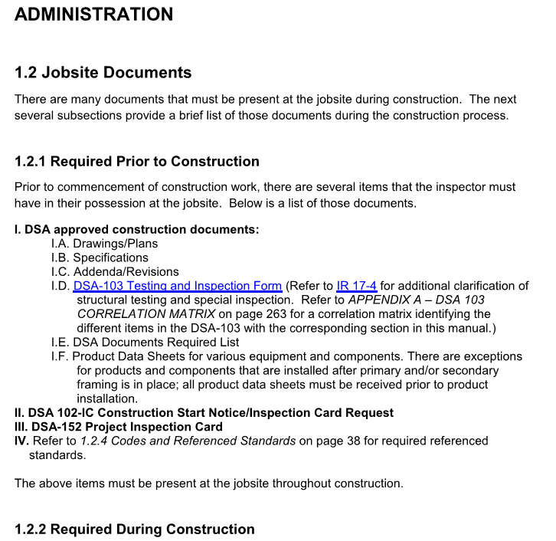
Notes:
Now we’ll go through remaining Administration portion of manual
Next sections deal with Jobsite Documents
Recall these include documents before, during, and after construction
Items Required Prior to Construction
(READ THROUGH LIST)

Slide 66
Notes:
The next section deals with documents required during construction
First subsection deals with Material and Structural Test Documentation
Applies to all the other chapters in which Material/Structural Test Documentation is required
Provides information on LEA Labs, test report forms, and IR’s
Test report forms provide suggested format, but required information
Appendix B has these referenced forms for easier reference by PI

Slide 67
Notes:
Next subsection covers Special Inspection Documentation
Has information for various types of special inspectors approved by DSA
Shotcrete
Masonry
Wood/Glulam
Steel/Welding
In-plant

Slide 68
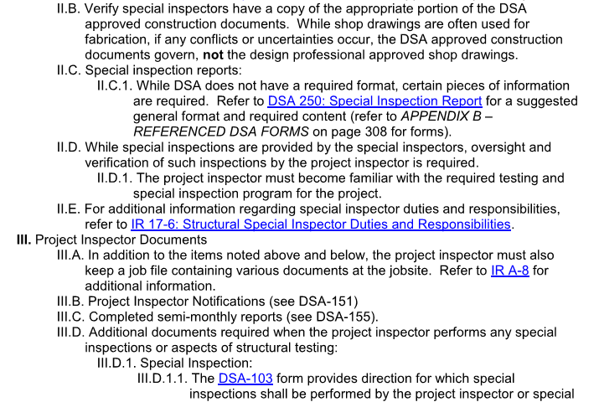
Notes:
Not all types of special inspectors required on all projects – depends on project/building characteristics which apply
For applicable special inspectors, verify their certification is current prior to such work requiring special inspection is begun.
Form DSA 250 provides suggested format, but required information for special inspection reports
PI must be familiar with special inspection program
PI provides oversight of special inspector and testing
See IR 17-6 for special inspector duties and responsibilities
PI Documents
IR A-8 has information required to be kept by PI, including job file
PI Notifications to DSA via DSA 151
PI Semimonthly reports now mush use DSA 155
Additional documents when PI performs special inspection
DSA 103 “Testing & Inspection” or “T&I” form dictates special inspection requirements

Slide 69
Notes:
Structural Testing performed by PI must be indicated in DSA 6-PI
Other Documents
Contractor submittals (READ A FEW)
Notification to PI for construction completion – DSA 156
Later sections will go into more detail for:
Deferred Submittals
Construction Change Documents
Notice of Deviations/Resolution of Deviations
Interim Verified Reports
Proprietary Product Documents
Some projects may require documents normally required at construction completion, but while construction is ongoing
More to be discussed about these in a later section

Slide 70
Notes:
Documents required during construction
Deferred Submittals
Refer to cover page of approved plans for listing of deferred approvals; tracker also has information
Construction Change Documents, Type A
Notice of Deviations/Resolution of Deviations
Interim Verified Reports
Required as noted from several different individuals as indicated in PR 13-01 at completion of each section of inspection card DSA 152

Slide 71
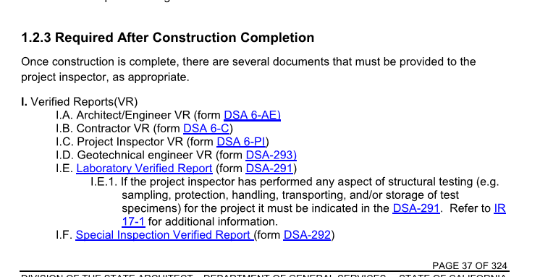
Notes:
Next section on documents required after construction completion
Verified Reports
Many individuals listed, similar to the interim verified reports
Next section lists the codes and referenced standards applicable to a given project
Many must be on-hand at the jobsite, while others may need to be available depending on the type of construction

Slide 72
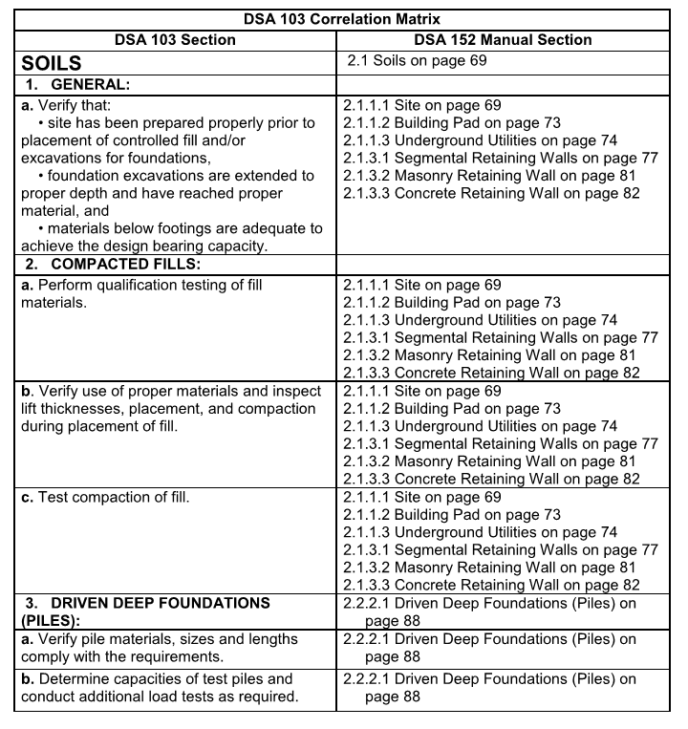
App. A – DSA 103 Correlation Matrix
Key link between DSA 103 (T&I list) and DSA 152 Manual
Same Numbering as T& I
Notes:
Correlation Matrix provides detailed reference guide for rest of manual
(CLICK) Broad Overview List of DSA-103 Sections and corresponding Manual Section.
Only refer to sections applicable – don’t need to go through entire manual

Slide 73
Using DSA 152 Inspection Manual
Example Project:
Scope of work: Alteration to (1) Classroom Building A, Construction of (1) Classroom Building B.
3 DSA 152 cards
1 for Building A
1 for Building B
1 for Sitework
Notes:
(READ EXAMPLE)
(CLICK) Based on PR 13-01, 3 cards required (READ BULLETS)

Slide 74
Using DSA 152 Inspection Manual
Review DSA Approved Plans
Building A:
Removing bearing wall between 2 classrooms
Installing new sliding partition with supporting steel beam and column, new foundation
Building B:
1 story light wood frame
Sitework:
Accessible features to new construction & alteration
Notes:
Review approved plans, additional information regarding construction becomes clear
(CLICK) Building A (READ bullets)
(CLICK) Building B (READ bullet)
(CLICK) Sitework
Accessible features – stairs, ramps, etc.

Slide 75
Using DSA 152 Inspection Manual
Building ‘A’ DSA 152 – Applicable Sections & Blocks:
Section 2 (blocks 5-7)
Section 3 (block 11)
Section 4 (block 15)
Section 5 (block 16)
Section 8 (blocks 31-33)
Section 9 (blocks 34-36)
All other items NA
Use manual correlation matrix
Notes:
Applicable Sections & Blocks

Slide 76
Using DSA 152 Inspection Manual
NA
RPH
NA
RPH
Building ‘B’ DSA 152 – Applicable blocks:
Nearly all sections and blocks
Blocks NA in Sections 3, 4, & 6:
Concrete
Masonry
Steel
All Section 6 - NA
Use Correlation Matrix
NA
RPH
NA
RPH
NA
RPH
NA
RPH
NA
RPH
NA
RPH
NA
RPH
NA
RPH

Slide 77
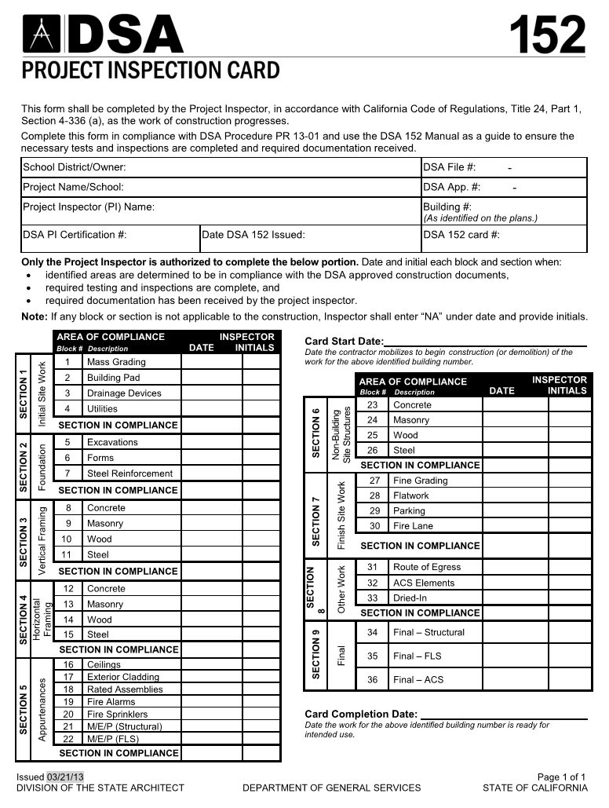
Using DSA 152 Inspection Manual
Building ‘B’ DSA 152
Completing Section 2 blocks:
5 – Excavations
6 – Forms
7 – Steel Reinforcement
Need IVR prior to initialing overall section
AOR/EOR - DSA 6 A/E
Geotech - DSA 293
Lab – DSA 291
Sp. Insp. – DSA 292
6/1/2013
RPH
6/1/2013
RPH
6/1/2013
RPH
6/1/2013
RPH

Slide 78
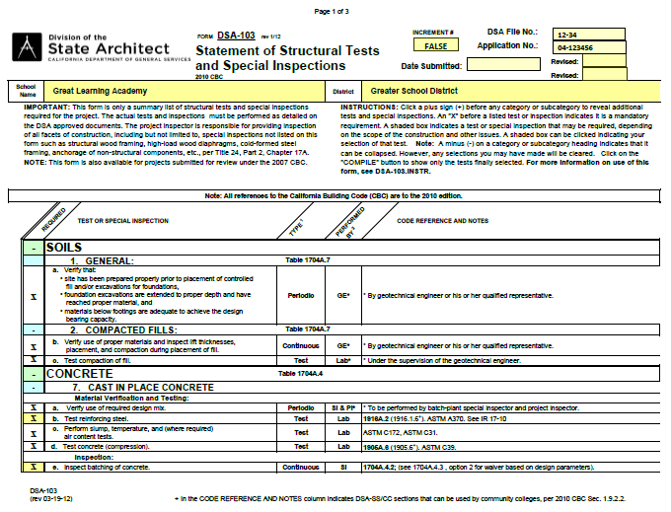
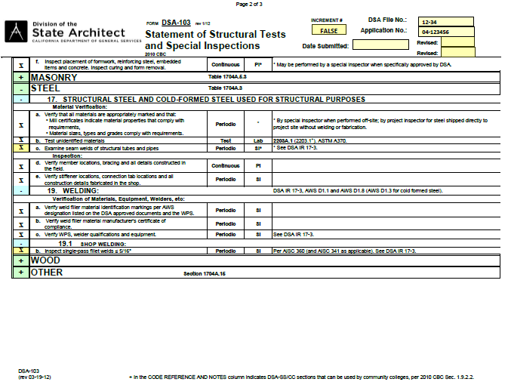
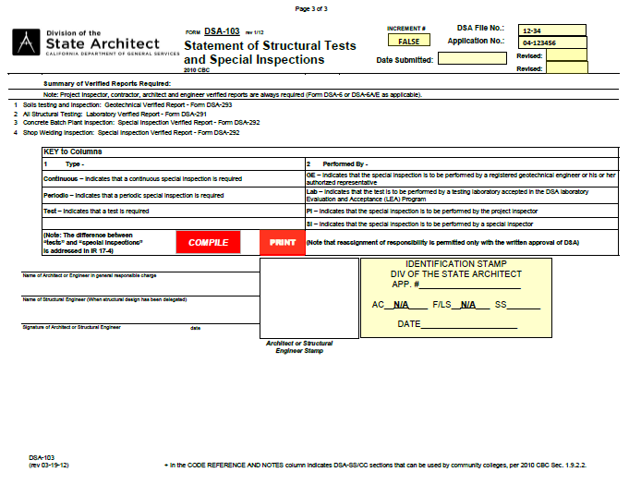
Using DSA 152 Inspection Manual
Review DSA Approved DSA 103
Soils
Concrete
Steel
Summary of Verified Reports
Notes:
Review approved T & I for items
Soils
Concrete
(CLICK) Steel
(CLICK) Summary of Verified Reports

Slide 79
Using DSA 152 Inspection Manual
Refer to App. A – DSA 103 Correlation Matrix
Identify corresponding manual sections based on specific T & I items
Viewing PDF files
Hyperlinks
Bookmarks
Word Search
Notes:
Referring to DSA 103 Correlation Matrix in App. A lists corresponding manual section.
When viewing manual as PDF, take advantage of hyperlinks & previous view – Similar to “back” in internet browser.

Slide 80
