Slide 1
Common Errors and Omissions
Presenter: U.S. Access Boardmember, Scott J. Windley

Slide 2
Session agenda
Scoping
Building Blocks
Accessible Routes
General Site & Building Elements
Plumbing Elements & Facilities
Communication Elements & Features
Special Rooms, Spaces, & Elements
Built-in Elements
Maintenance & Policy
Questions?

Slide 3
introduction
The errors and omissions presented today are by no means definitive.
What is presented here are common errors that we have experienced in:
Technical Assistance questions
Questions during training sessions

Slide 4
Chapter 2: Scoping Chapter 3: Building Blocks

Slide 5
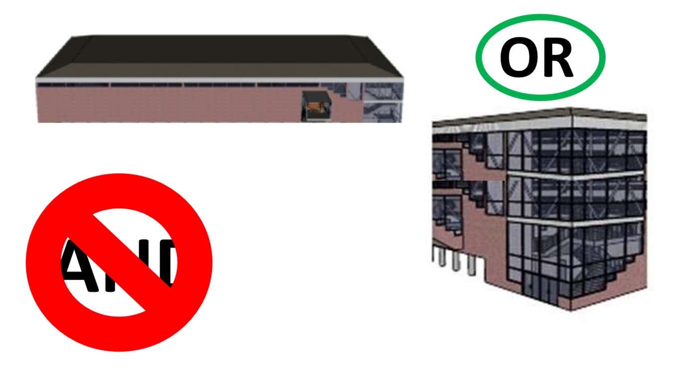
Elevator Exception § 206.2.3
The elevator exception is mistakenly thought to be an AND condition instead of and OR condition.

Slide 6
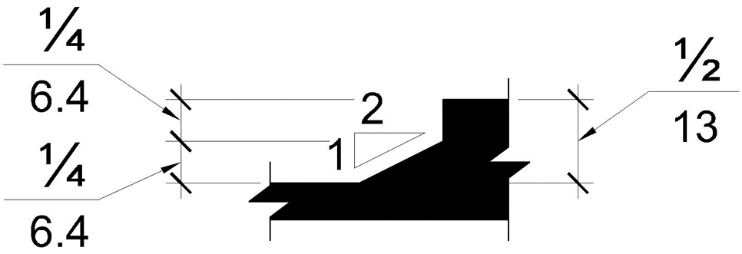
Level of changes § 303
One of the threshold configurations is not correct.

Slide 7
Level Changes § 303
The one with the abrupt edge at the top is incorrect.

Slide 8
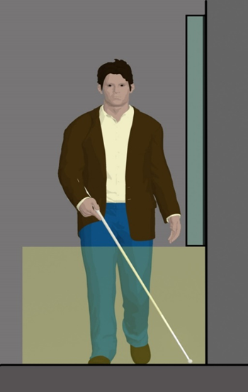
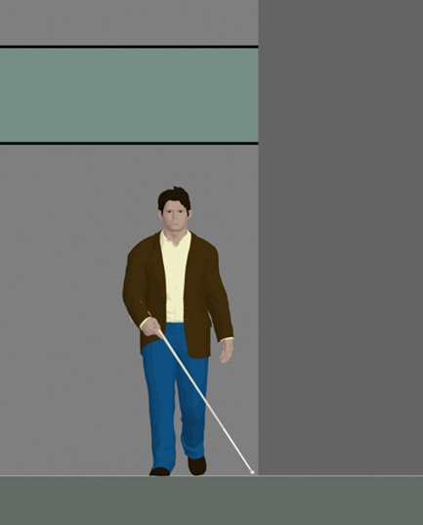
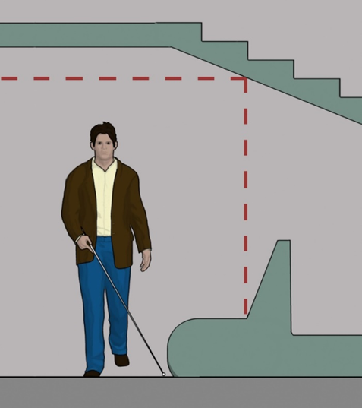
Protruding Objects § 307 (1 of 2)
Overhead Objects and Wall Mounted Objects
80 inches above head
0 to 27 inches are within can sweep

Slide 9
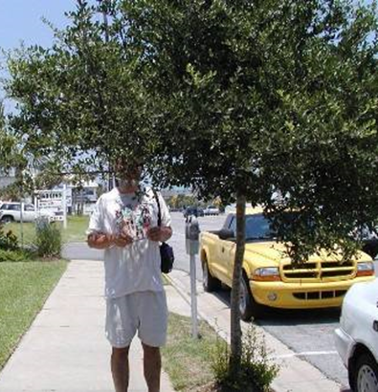
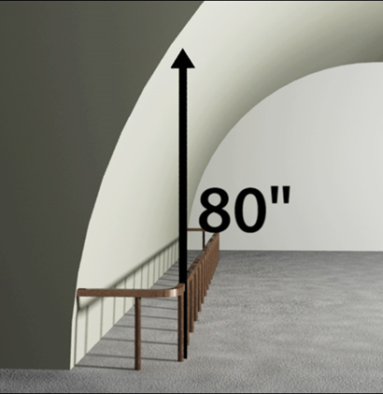
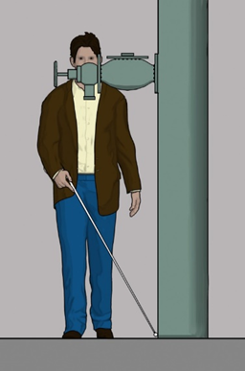
Protruding Objects § 307 (2 of 2)
Many things can become protruding objects that were not intended to be; or were not when first installed.

Slide 10
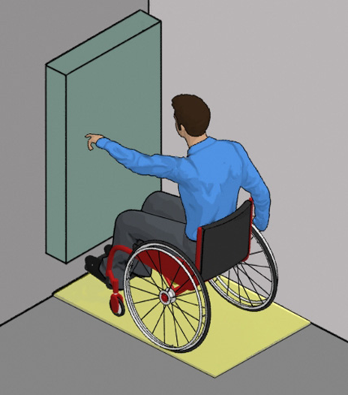
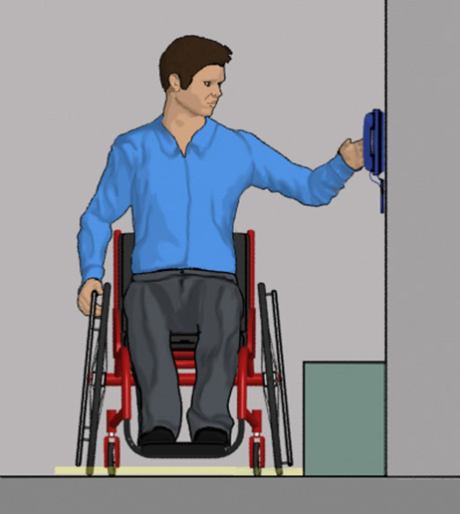
Reach Ranges § 308 (1 of 3)
The thing to remember with reach is to think about it from a seated position by someone who is not able to bend their body into strange angles.

Slide 11
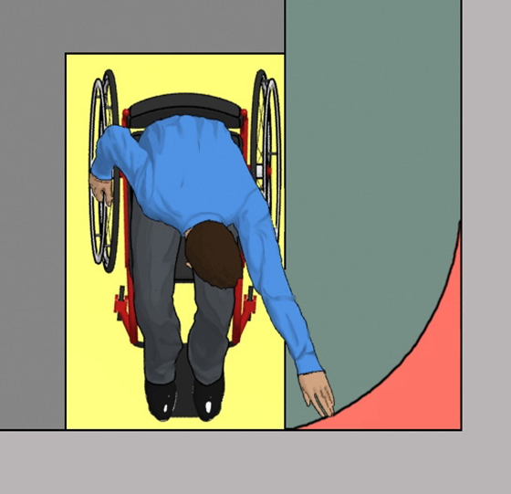
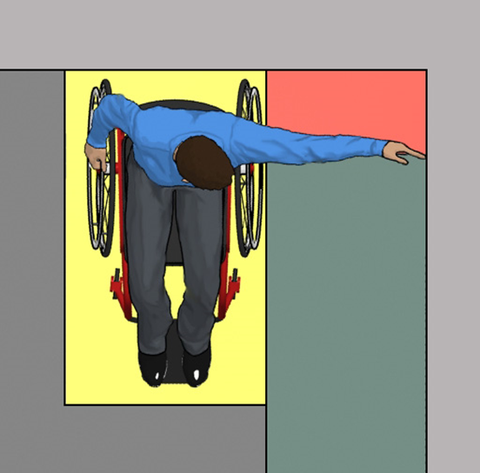
Reach Ranges § 308 (2 of 3)
Many designers are not aware of the horizontal aspect of reach limits (which can be even more limited depending on an individual persons abilities).

Slide 12
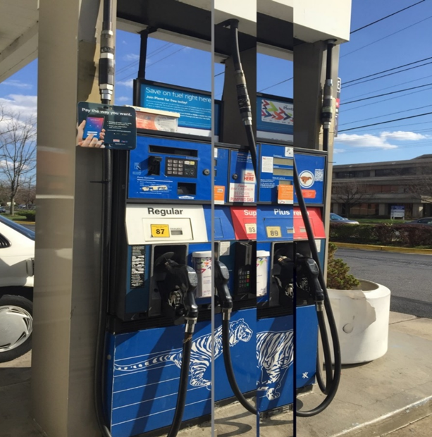
Reach Ranges § 308 (3 of 3)
Many times reach ranges for accessibility are not thought of when some equipment or devices are installed. Example: gas pumps

Slide 13
Chapter 4: Accessible Routes

Slide 14
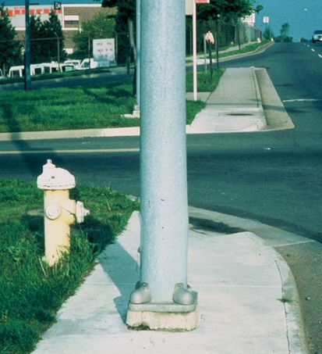
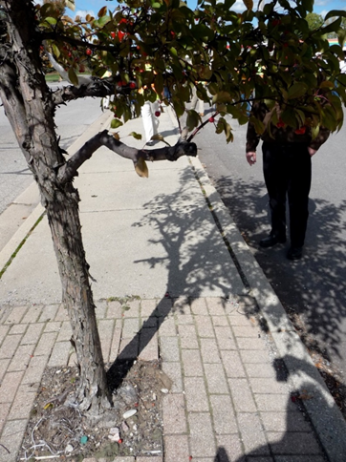
Accessible Routes § 403.5.1
Items impeding the accessible route: signs, utility poles, street trees, structural columns etc.

Slide 15
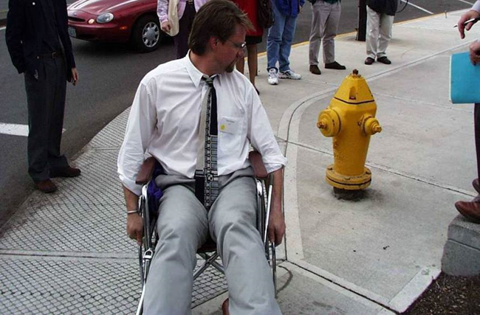
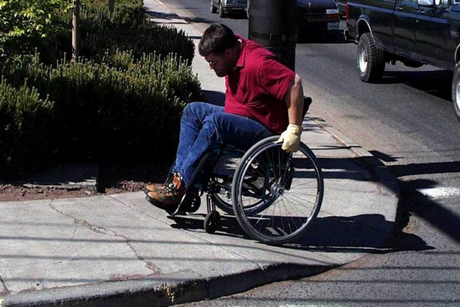
Curb Ramp Landing § 406.4
No landing at the top of perpendicular curb ramps
No space available (grass or a building)
Object at top of ramp (fire hydrant, utility, etc.)

Slide 16
Or how to make your curb ramp completely unusable

Slide 17
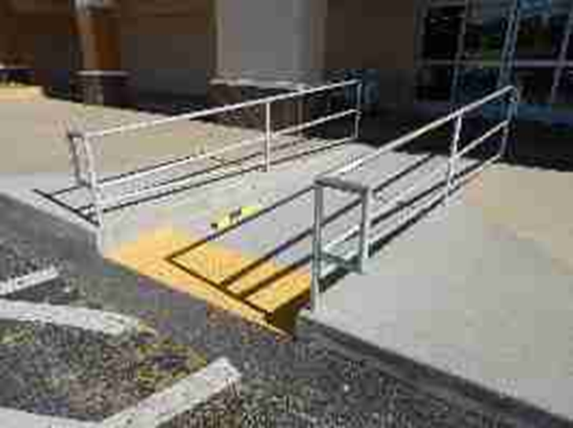
Curb Ramps with Handrails?
Curb ramps should never need handrails (nor are they required) even when they are longer than 6 feet.

Slide 18
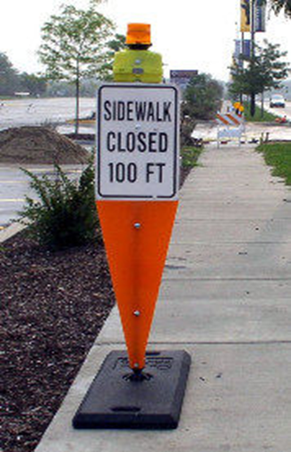
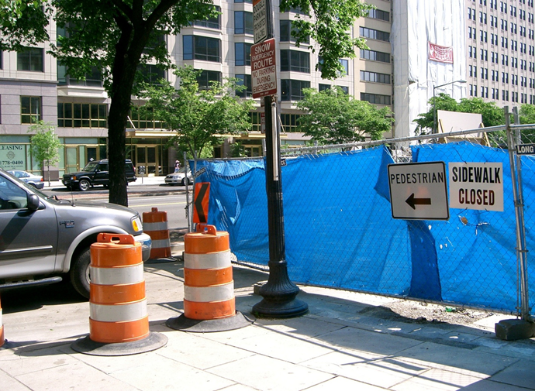
Temporary Routes
Many temporary routes do not provide for the needs of all users like:
No curb ramp on or off sidewalk
No delineated route or accessible signage

Slide 19
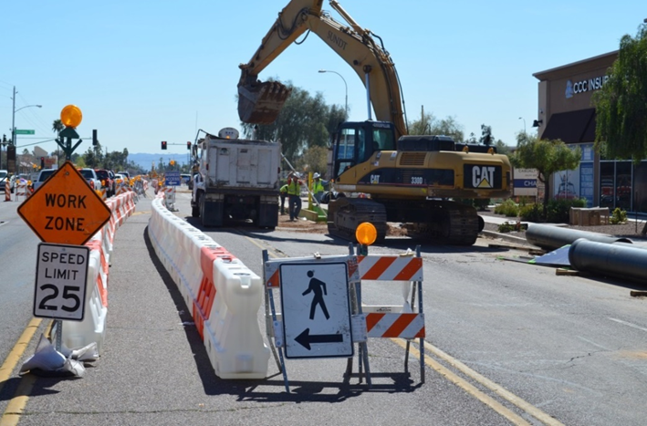
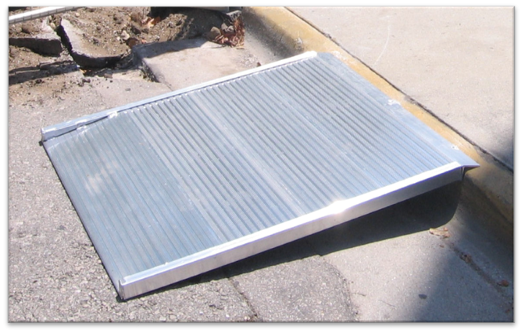
Temporary routes
Examples of temporary curb ramp and good delineation of a temporary route

Slide 20
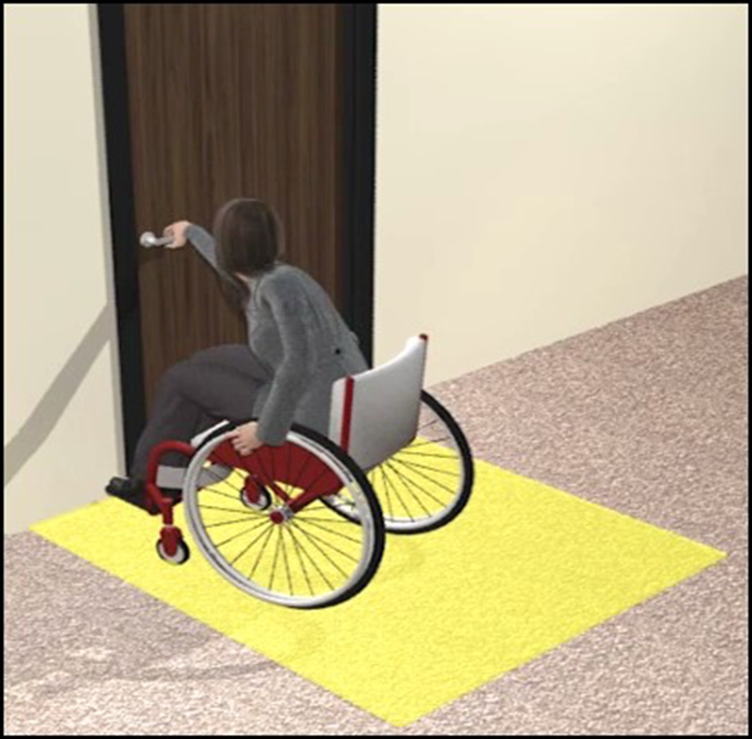
Door Opening Force § 404.2.9
Interior door closers must be adjustable to 5 pounds of force or less.

Slide 21
Chapter 5: general site and building elements

Slide 22
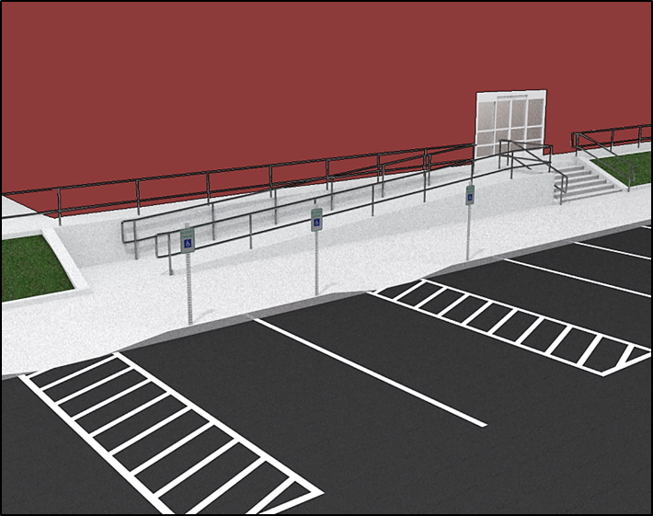
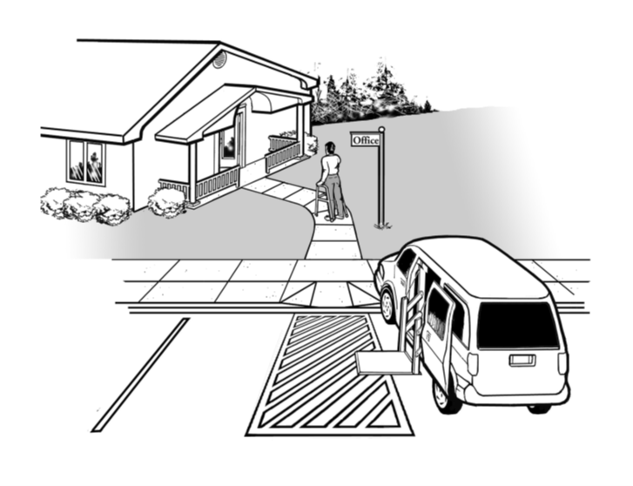
Accessible Parking on Shortest Accessible Route § 208.3.1
There may be shorter pedestrian routes that are not accessible

Slide 23
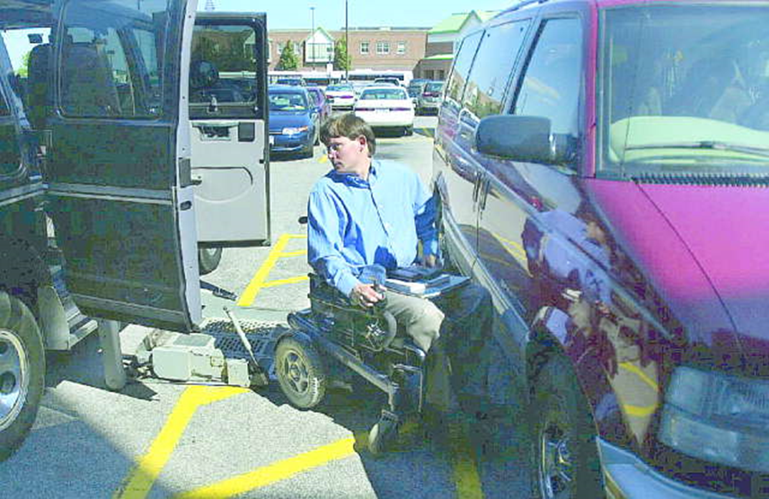
Van Parking Spaces § 208.2.4
Insufficient space to deploy lift at car only space

Slide 24
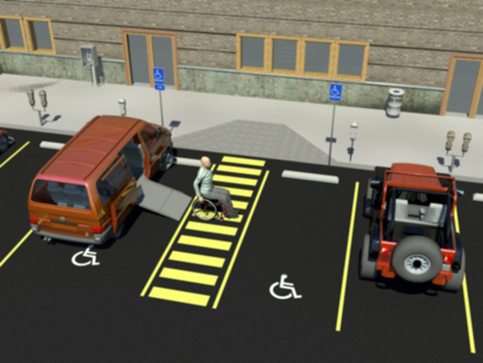
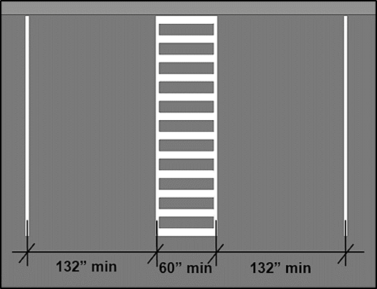
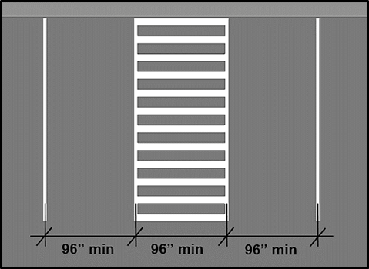
Van Parking Spaces § 208.2.4
One for every six accessible spaces or fraction thereof.

Slide 25
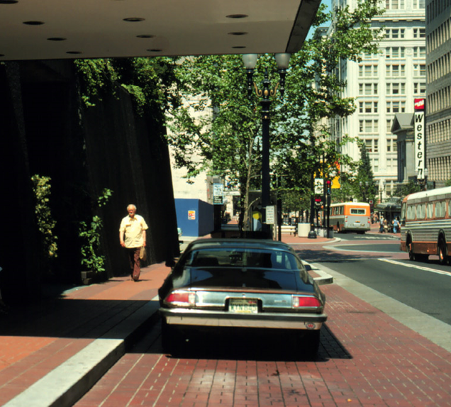
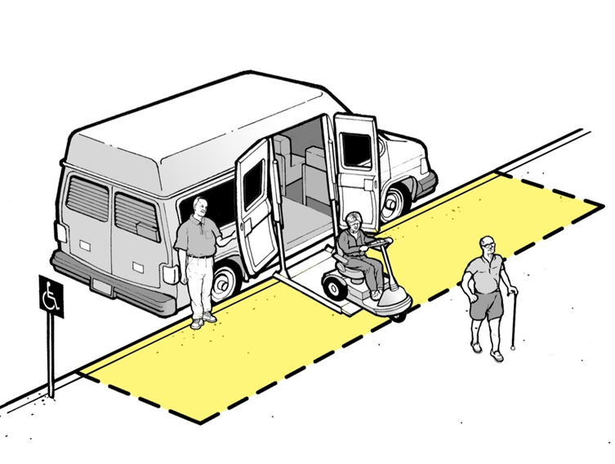
Passenger Loading Zone § 503.4
Loading zone not at same level as vehicle pull-up space.

Slide 26
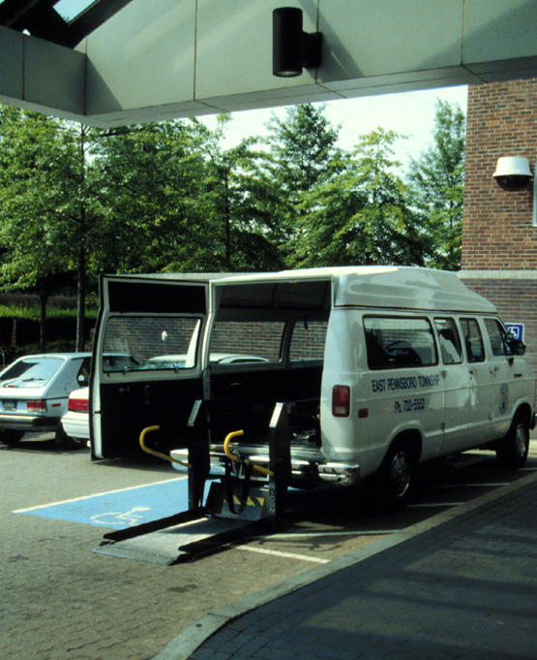
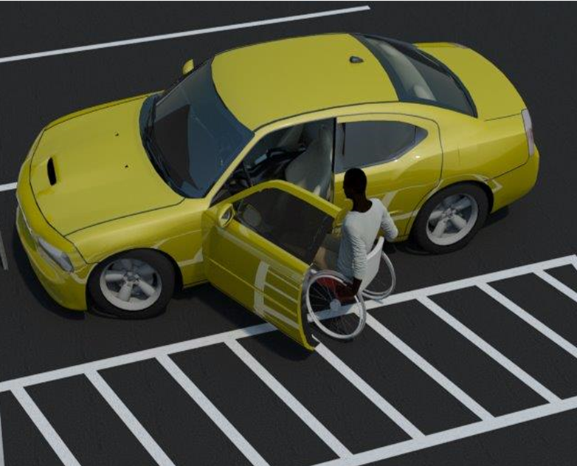
Passenger Loading Zone § 503.4
Rear lift gates.
Transfers to and from cars.

Slide 27
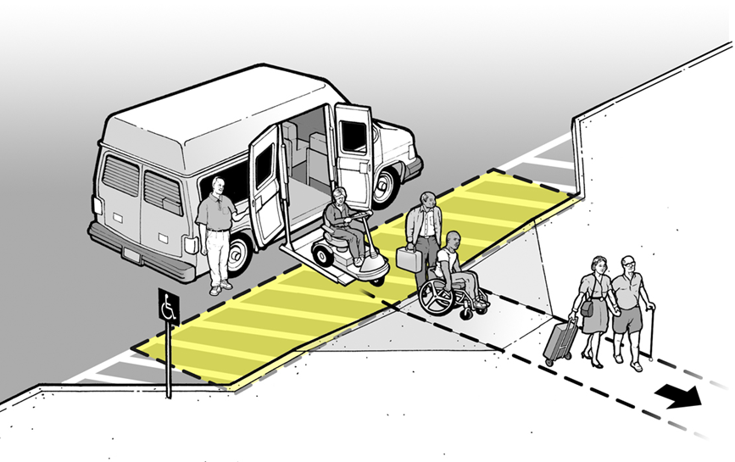
Passenger Loading Zone § 503.4
Loading zone at SAME level as vehicle pull-up space

Slide 28
Chapter 6: plumbing elements and facilities

Slide 29
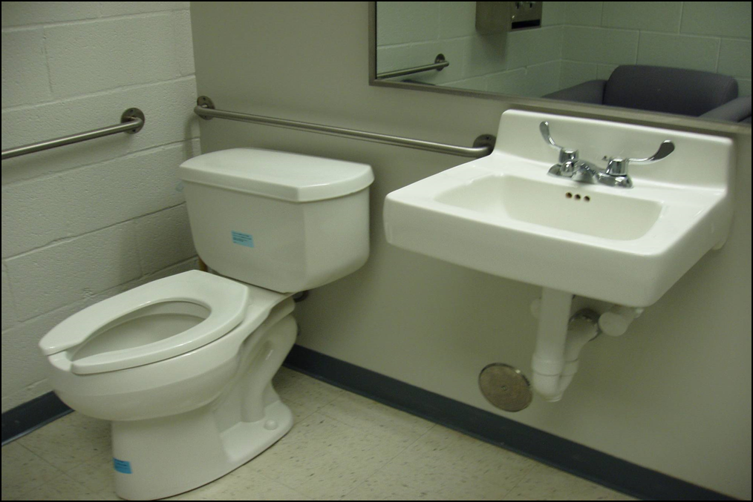
Insufficient Space Beside Accessible Water Closet
Lavatory overlap no longer permitted §604.3

Slide 30
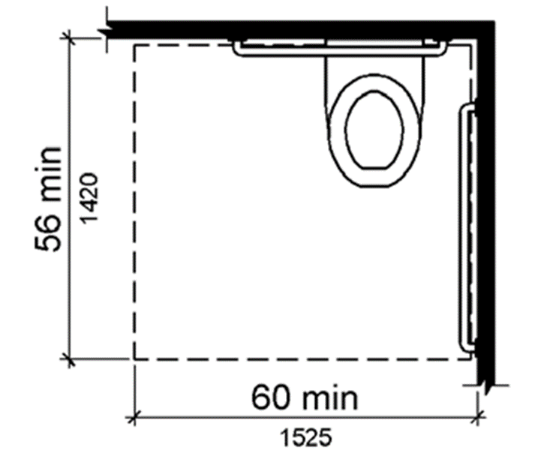
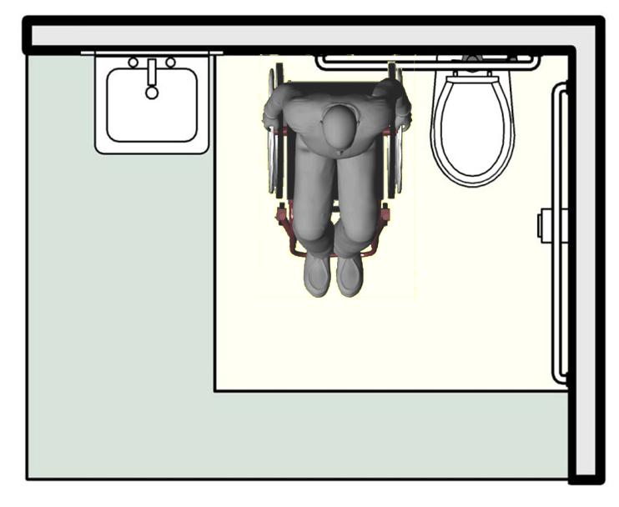
Water Closet Clearance § 604.2
Allows space for side transfers.

Slide 31
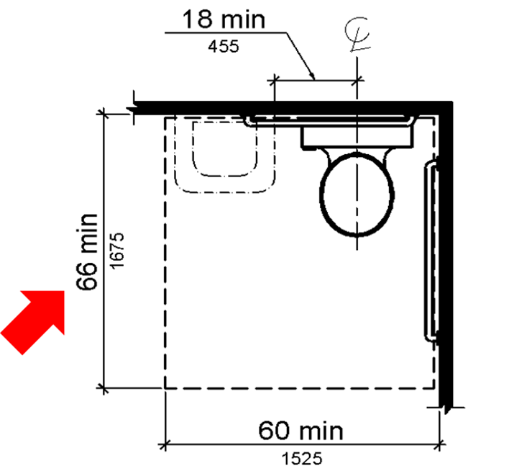
Water Closet Clearance § 604.3.2
Exception for residential units still permits encroachment

Slide 32
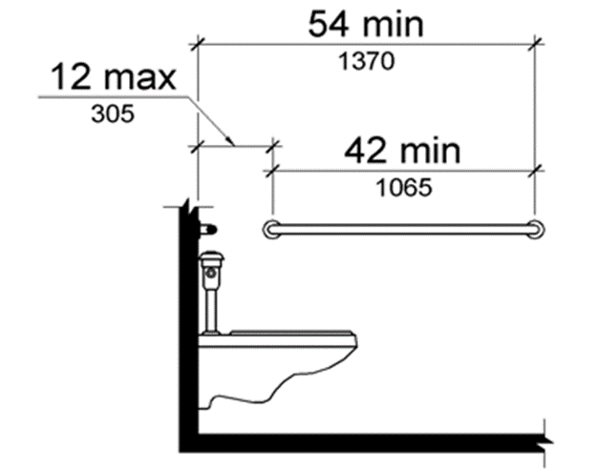
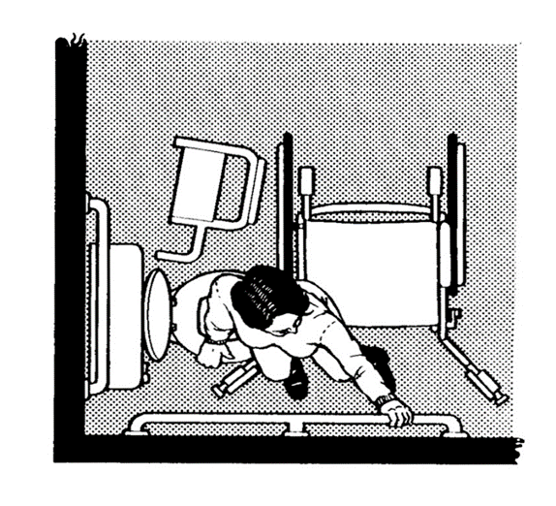
Side Wall Grab Bar at Water Closets § 604.5.1
Both dimensions from rear wall are critical.

Slide 33
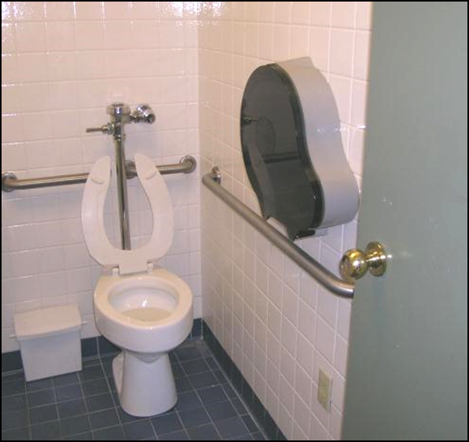
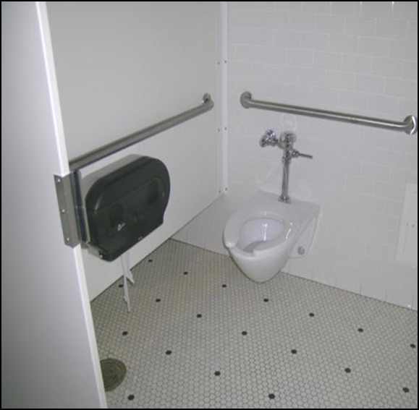
Large Roll Toilet Dispensers Obstruct Use § 604.7 & § 609.3
They just don’t fit!

Slide 34
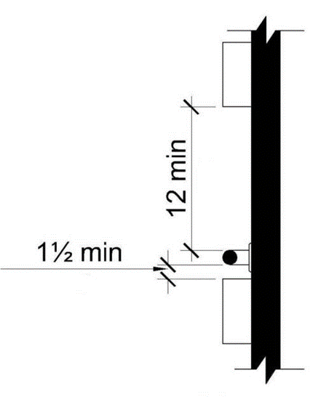
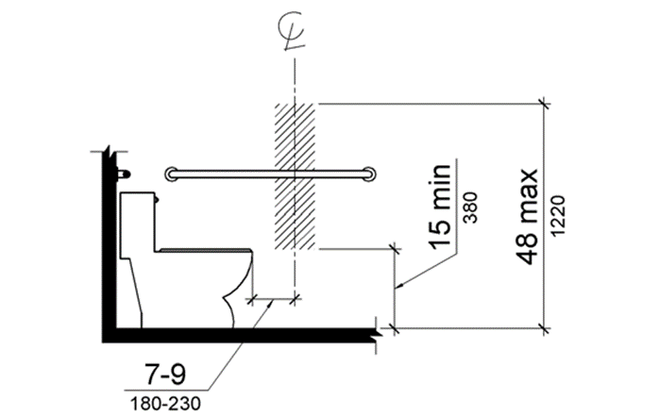
Provisions Affecting Dispensers Locations
Dispenser Outlet Location for Recessed Dispensers § 604.7
Spacing of Grab Bars § 609.3

Slide 35
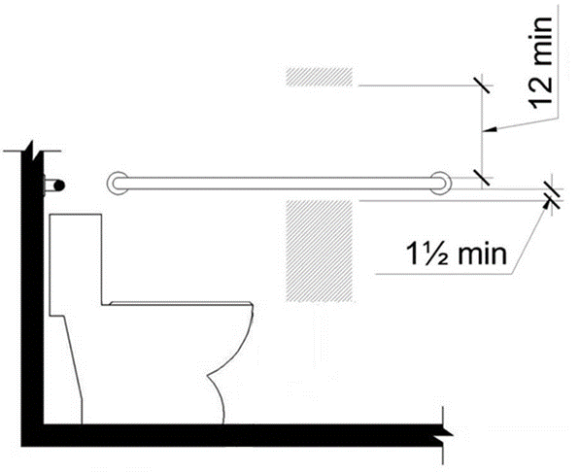
TP Dispenser Location
Grab bar height (33”-36”) and clearances further limit location of non-recessed dispensers.

Slide 36
Diaper Changing Table Location § 604.3.2

Slide 37
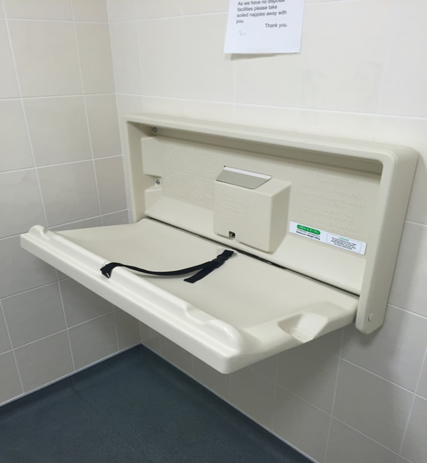
Diaper Changing Table Location
Strongly encourage and recommend locating the baby changing table outside of the accessible toilet compartment.

Slide 38
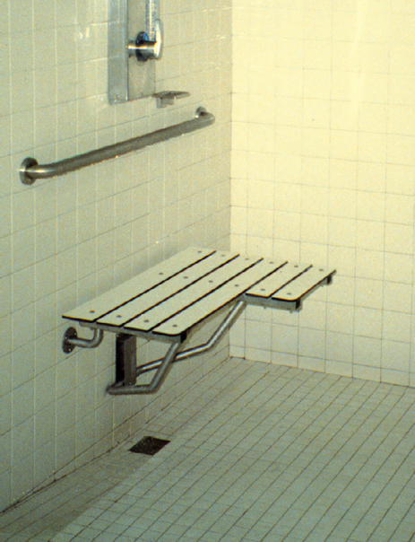
Seats § 607.3 & § 608.3
Bars cannot obstruct seat use

Slide 39
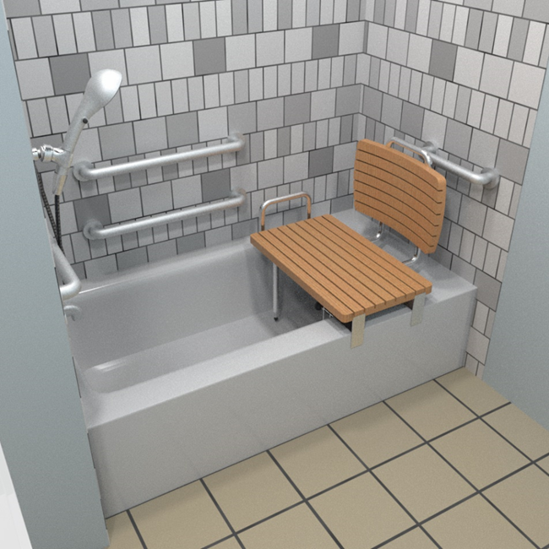
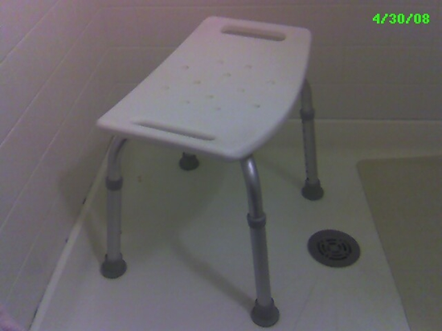
Tub Seat in Bathtub § 610.2
Free standing – does NOT meet Standards
Fastens to rim of tub - meets Standards

Slide 40
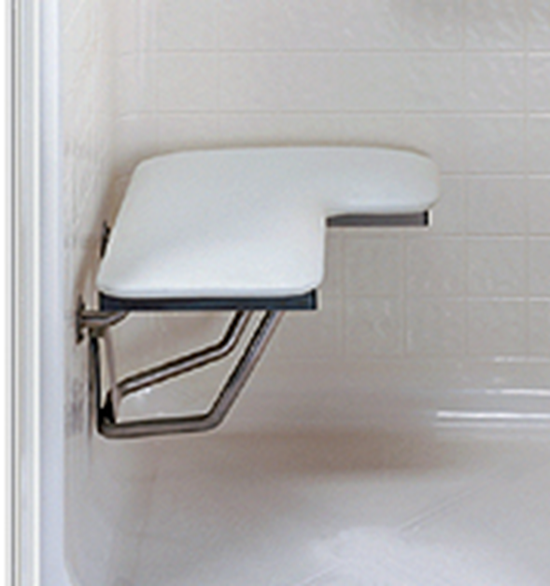
Shower Seats § 610.3
Folding seat securely fixed to wall.

Slide 41
Shower Seats § 610
Adequate reinforcing must be provided § 610.4

Slide 42
Shower Seats § 610.3
Seat placement more than 3 inches from entry § 610.3

Slide 43
Shower Seats § 610.3.2
Seat installed incorrectly § 610.3.2

Slide 44
Parallel Approach to a Sink
§ 606.2 Clear Floor Space
EXCEPTION: A parallel approach permitted to a kitchen sink where cook top or conventional range is NOT provided.

Slide 45
Five percent of non-kitchen Sinks Must Have Forward Approach § 212.3
Knee and Toe Clearance § 606.2

Slide 46
Sinks § 212.3
Mop or Service Sink Exception

Slide 47
Chapter 7: Communication elements and features

Slide 48
Directional Sign to the Accessible Entrance § 216.6

Slide 49
Directional Signs to Accessible Entrances § 216.6
ISA label at accessible locations
Directional signs at inaccessible locations

Slide 50
Directional Signs to Accessible Entrances § 216.6
Strategic placement of directional sign.

Slide 51
Designations § 216.2
1991 Standards – 60” to centerline of sign
Where to Measure the Room Sign Height?

Slide 52
Tactile Signs
Cane detection of doorways consistent location needed.

Slide 53
Installation Height§ 703.4
Figure 703.4.1 Height of tactile character above finish floor or ground.

Slide 54
“Access” Blue and White is Not Required by Standards
On pavement ISA painted white with blue back ground.
picture of paint cans and a brush

Slide 55
Symbols§ 703.7.2
Contrast - light-on-dark or dark-on-light §703.7.1
Non-glare finish § 703.7.1
Text (where provided): visual access § 703.5

Slide 56
§ 703.7.2 Symbols
Any contrasting colors permitted check state and local code for additional requirements.

Slide 57
Chapter 8: SPECIAL ROOMS, SPACES AND ELEMENTS

Slide 58
FEATURES § 222 & § 803
Bench is not provided or lacks the required features.

Slide 59
Dressing Benches § 903
Clear floor or ground space at both the end and parallel to bench §803.4/§903

Slide 60
Dressing Benches § 903
Adequate back support must be provided §803.4/§903.

Slide 61
Communication Features for Transient Lodging Guest Rooms § 224.4
MUST be Permanent room features.
NO. Kits do not meet requirements of 2010 Standard.

Slide 62
Notification Devices § 806.3.1
“Where emergency warning systems are provided, alarms complying with 702 shall be provided.”

Slide 63
Chapter 9: BUILT-IN ELEMENTS

Slide 64
Dining and Work Surfaces § 902.3
The height of dining and work surfaces shall not exceed 34 inches and provide forward approach with knee clearance.
Commonly not provided at Bars.

Slide 65
Benches § 903
Benches at bus stops and other non-bathing or dressing locations are NOT required to meet 903 requirements

Slide 66
Sales and Service Counter § 904.4
The height of sales and service counters shall provide a parallel or forward approach and shall not exceed 36 inches.

Slide 67
maintenance

Slide 68
Maintenance / Policy (1OF 3)
Accessibility elements can be misused if no one is diligent about keeping them available.

Slide 69
Maintenance / PolIcY (2 OF 3)
Snow removal IS a maintenance obligation of Title II and Title III entities.

Slide 70
Maintenance / PolIcY (3 OF 3)
Free standing objects impeding the necessary width of an accessible route.

Slide 71
Technical Guides on the Standards
Available on the Board’s website.

Slide 72
U.S Access Board
(800) 872-2253 (voice)
(800) 993-2822 (TTY)
E-mail: ta@access-board.gov
www.access-board.gov

