Slide 1

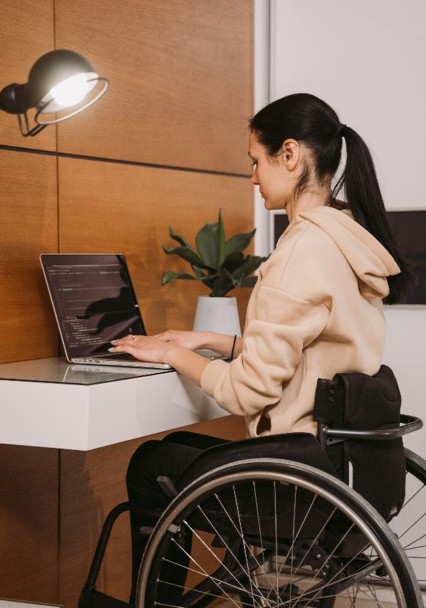

ADA Opportunities for Small Businesses:
Accessibility & Customer Service
October 2, 2023
Notes:
Jan

Slide 2
Housekeeping: Zoom
If comfortable, please turn on your camera when speaking.
Please keep your audio muted when you are not speaking.
Please use the Q&A feature to post questions.
  Chat feature is distracting for people with vision disabilities who use screen reading software.
Notes:
Suzanne
Enter name in chat for an attendance list.

Slide 3
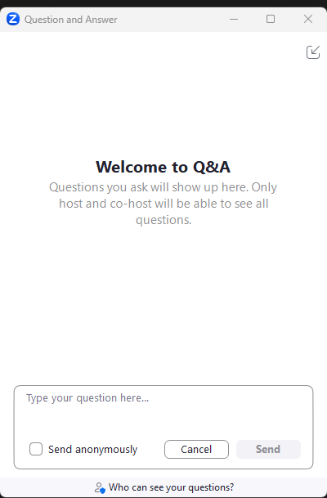
Q&A Session
  To Ask a Question:
  Select “Q&A” at the bottom of your screen
  A box shown to the right will pop up, input your questions throughout the webinar
  Q&A Session:
  Will be at the end of the presentation
  Selected questions will be answered

Slide 4
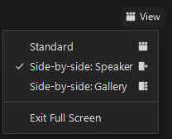
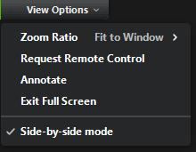
Zoom Viewing Options
View options:
  Upper right-hand corner, select “View” for “Speaker” or “Gallery” views and with screen share: Standard and Side-by-side options.
  During PowerPoint: “View Options” menu at top of screen to adjust zoom ratio and other features.
  During PowerPoint: use the slider between the shared screen and participants and slide to your preference.

Slide 5
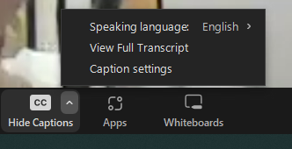

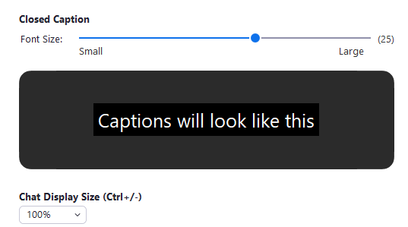
Zoom Live Captions
Turn on captions by selecting the CC icon (show captions) on the menu bar.
Change the size of captions by selecting the up arrow next to the CC and choose the “Caption settings”.
Move captions by hovering over captions and dragging them to the preferred location.
Turn off captions by selecting the CC icon (hide captions) on the menu bar.
Notes:
Suzanne - Had a request
Turned on to cater to different situations and different learning styles

Slide 6


What the Pacific ADA Center Offers
Technical Assistance
Trainings
Webinars
Materials
Conferences
Notes:
Jerri

Slide 7
What the California Commission on
Disability Access Offers
Small Business Education and Outreach
Technical Materials and Trainings
Listening Forums and Webinars
Disability Access Litigation Data Tracking
Annual Report to State Legislature
Notes:
Jerri

Slide 8


Types of Disabilities
People have many types of disabilities – not all are physical.
Some disabilities are obvious, and some are not.
People with disabilities:
  Are more likely to experience a lack of services and accessibility
  Have $21 billion in discretionary income to spend
  (Yin, Shaewitz, Overton & Smith, 2018)
Notes:
Jan

Slide 9

Disability & Intersectionality
People with disabilities are:
  All races and ethnicities
  All gender identities
  All ages
  All national origins
Disability is the only minority you can join!
Notes:
Jan

Slide 10
Use Inclusive & Respectful Language
People First - Examples: person who is blind, people who use wheelchairs
A person is not their disability (retarded, a quadriplegic, an epileptic)
Emphasis on ability rather than limitations
Disability is not a tragedy or challenge to “overcome”
Notes:
Jan

Slide 11
Terms to Avoid
Wheelchair Bound
Special Needs
Differently Abled
Physically Challenged
Inspirational
Some people don’t even like “people first” language!
  Not sure? Just ask!
Notes:
Jan

Slide 12
Provide Assistance When Asked
People with disabilities will generally ask when they need assistance.
It’s fine to say, “May I assist you?”
But then, if the person says “yes,” ask “How” to provide the assistance.
If the person doesn’t want your assistance, don’t be offended.
Notes:
Jan

Slide 13
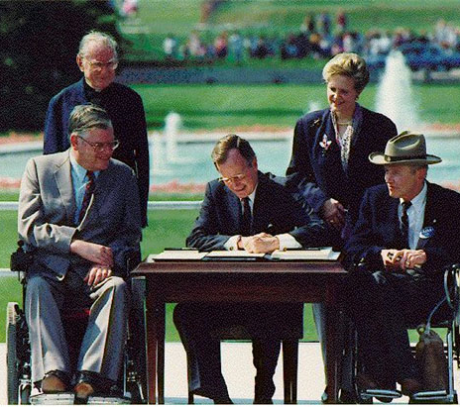
The Americans with Disabilities Act
Considered the major Civil Rights Law for people with disabilities
Signed by President George H.W. Bush on July 26, 1990
Protects people with disabilities from discrimination, promotes integration, and provides equal opportunity
Goal: The full inclusion of people with disabilities in all aspects of American society
Notes:
Jan

Slide 14


Slide 15
What is a disability?
Disability is defined very broadly under the ADA.
It can include physical, developmental, psychiatric, cognitive, intellectual, learning, vision, hearing, speech, addiction (in recovery), and health disabilities
- There is no all-inclusive list
Many people don’t know they fit under the definition
According to the CDC, 1 in 4 Americans have a disability.
Notes:
Jan

Slide 16

Americans with Disabilities Act Titles
Title I. Employment
Title II. Public Entities
Part A - State and Local Government
Part B - Public Transportation
Title III. Public Accommodations
Title IV. Telecommunications
Title V. Miscellaneous
Notes:
Jan

Slide 17
What ADA Title III Covers Small Businesses Serving the Public
ADA Title III covers places of public accommodation (open to the public).
  Includes all types of private businesses and nonprofit organizations, no matter how many employees they have:
    Social service organizations
    Retail stores
    Restaurants
Notes:
Jan

Slide 18

Effective Communication:
Communication Disabilities
State and local government agencies, as well as public accommodations, must provide effective communication to people with communication-related disabilities:
  Hearing
  Vision and/or
  Speech
Notes:
Jan

Slide 19

Effective Communication:
Vision Disabilities
Alternative formats:
Electronic
Large print
Braille
Websites accessible to screen readers
Qualified readers to convey technical information
Assistance with reading menus, etc.
Notes:
Jan

Slide 20
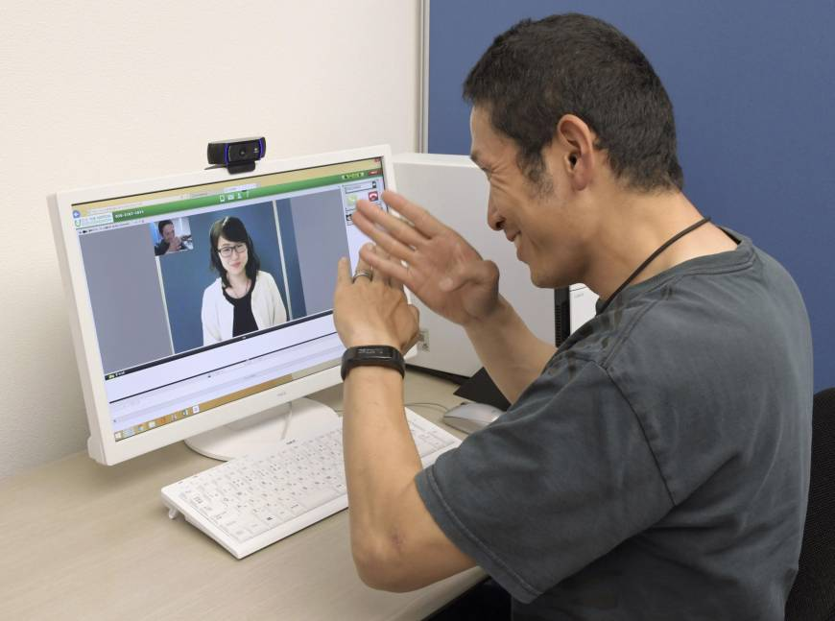
Effective Communication:
Hearing Disabilities
Sign language interpreters
  In-person
  Video remote interpreting
Real-time captioning
Relay service
Writing notes (for simple, brief conversations)
Notes:
Jan

Slide 21
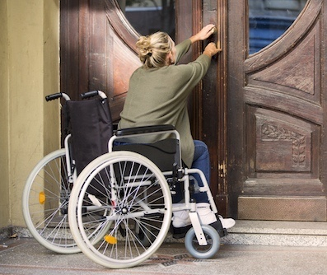
Accessibility for People with Mobility Disabilities
Accessible parking
No-step entrances with wide, easy-open doors
  Door opening force 5 lbs. or less in CA
Interior accessible paths
Lowered portions of counters and bars
Accessible restrooms
Notes:
Jan

Slide 22
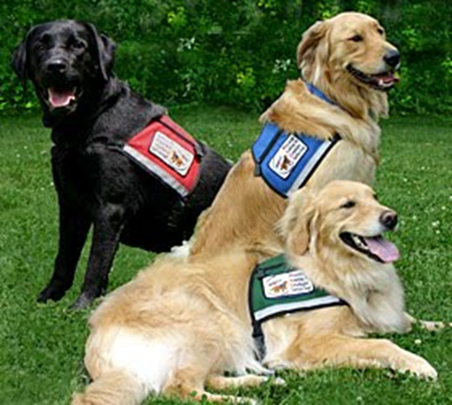
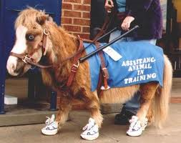
Service Animals: The Basics
Service animals are dogs that must be:
  Trained to do one or more physical tasks for their handlers
    Emotional support is not a task
  Under control
    Housebroken
    Well behaved
    Leash, tether, or voice control
Miniature horses may be allowed
Notes:
Jan

Slide 23
Service Animals: Two Questions
Government or Businesses Can Ask
  1. Is the animal required because of a disability?
      - Don’t ask this if the disability is obvious
  2. What work or task(s) has the animal been trained to perform?
  Do not ask about the handler’s disability or to see the task performed.
Notes:
Jan

Slide 24
Service Animal Training & Proof
Service animal handlers can train their own animals.
Service animals in training are allowed in California.
No certificates, vests, ID cards, etc. necessary to prove an animal is a service animal.
  If the handler answers the 2 questions, don’t ask for proof.
Notes:
Jan

Slide 25
Planning for the Accessibility of
Your Business
Designate responsible staff person – Site ADA Coordinator
Create checklists, duty sheets, etc.
Post “service animals allowed” notification
Consider additional signage
Evaluate facilities for future uses
Budget for facility and communication access
Notes:
Jan

Slide 26

Questions
Notes:
Jan

Slide 27
Resources I
ADA Update: A Primer for Small Business - https://www.ada.gov/resources/title-iii-primer/
ADA Requirements: Effective Communication – https://www.ada.gov/resources/effective-communication/
Service Animals & the ADA Frequently Asked Questions –https://www.ada.gov/resources/service-animals-faqs/
Notes:
Jan

Slide 28
Resources II
ADA Quick Tips: Tax Incentives – https://adata.org/factsheet/quicktips-tax
Certified Access Specialist (CASp) Inspection - https://www.dgs.ca.gov/DSA/Resources/Page-Content/Resources-List-Folder/Certified-Access-Specialist-Property-Inspection
Notes:
Jan

Slide 29

Stay Connected with the California Commission on Disability Access
Department of General Services
California Commission on Disability Access
400 R Street, Suite 310
Sacramento, CA 95811
Email: ccda@dgs.ca.gov
Phone: (916) 319-9974
eFax: (916) 376-4216
Website: https://www.dgs.ca.gov/CCDA
Notes:
Jan

Slide 30

Stay Connected with Pacific ADA Center!
Subscribe to our newsletter: www.adapacific.org
Pacific ADA Center
P.O. Box 665
Concord, CA 94522
Phone: (800) 949-4232 (Voice/Relay)
Email: adatech@adapacific.org
Website: https://adapacific.org
Notes:
Jan

