Slide 1



Nothing About Us Without Us:
Disability Awareness & Etiquette
Sarah Harris, Program Manager
Resources for Independence Central Valley (RICV)
Sharris@ricv.org 559-221-2330
Shannon M. Mulhall, NIC, ADAC, CASp
SR HR Analyst, Former ADA Coordinator, City of Fresno
Special Programs Chair, Certified Access Specialist Institute
Shannon.Mulhall@fresno.gov

Slide 2
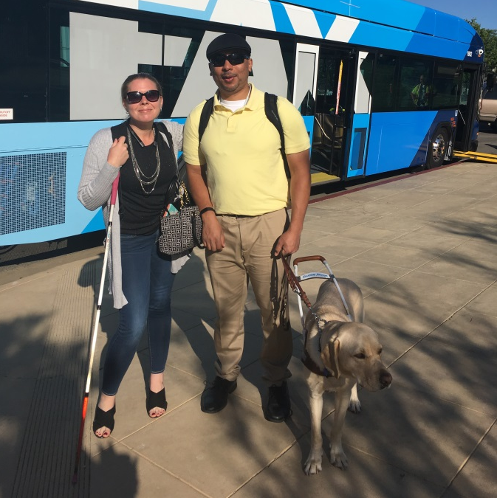
Sarah Harris
Resources for Independence Central Valley (RICV) Director of Programs
B.A. Advocate
California Council of the Blind

Slide 3
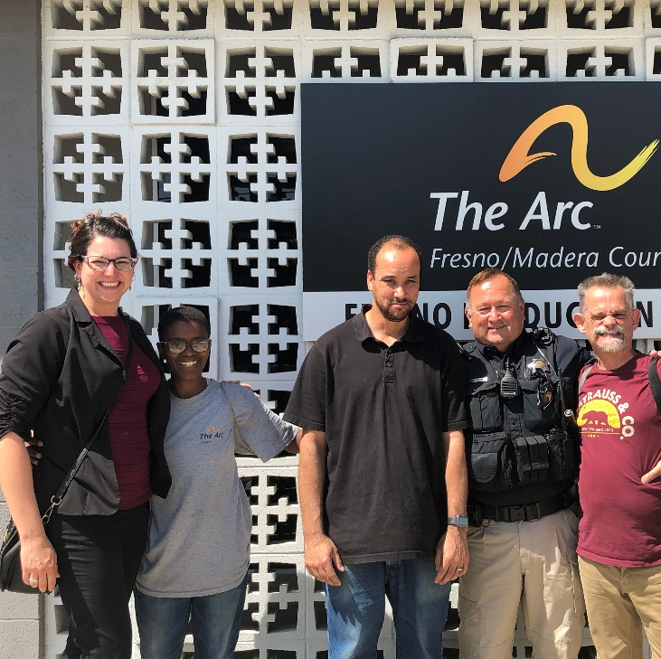
Shannon M. Mulhall
ADA Nerd & life-long learner
Certified Access Specialist (CASp)
Certified ADA Coordinator (ADAC)
Certified ASL interpreter (NIC)
Special Programs Chair, Certified Access Specialist Institute (CASI)

Slide 4
Topics
Disability Discrimination - Attitudinal Barriers
How we:
  Interact with people with disabilities
  Talk about disability
  Write about disability
  Recover when we mess up

Slide 5
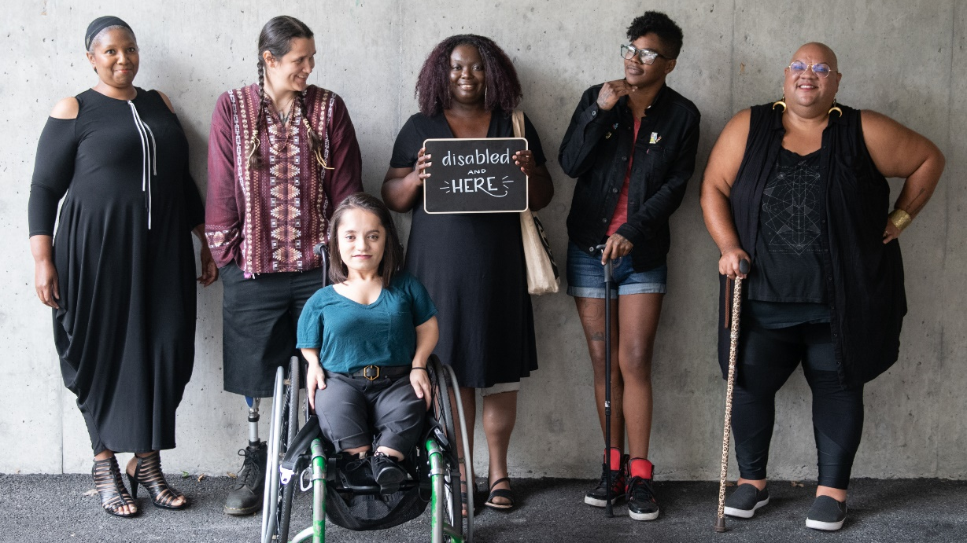

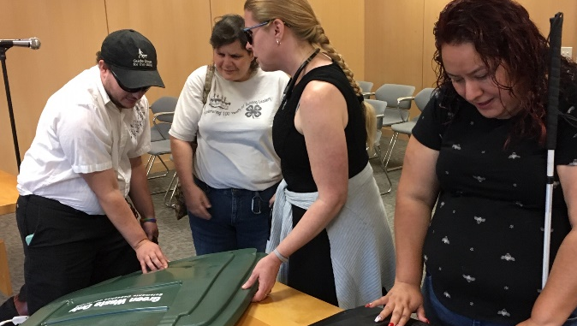

People First

Slide 6
Quote 1
“Disability and aging extends across race, ethnicity, level of education and socioeconomic status. All of us have experienced the effects of disability or the aging process.”
Lex Frieden

Slide 7
Disability Discrimination Looks Like:
Outright or intentional exclusion
Isolation or segregation
Architectural, transportation, and communication barriers
Exclusionary qualification standards or criteria
Overprotective rules and policies
Attitudinal barriers (Ableism)
Notes:
Disability discrimination can come in many different forms. Today we’re going to talk a bit about attitudinal barriers and ways that each of us can make small shifts to address our own internal biases and improve outcomes for people with disabilities.

Slide 8
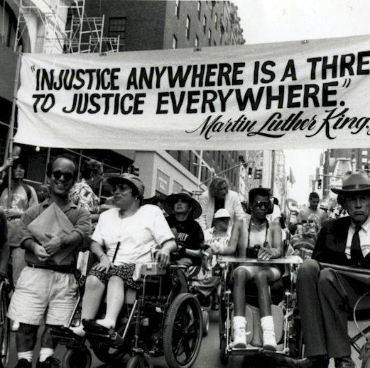
Independent Living Movement
Advocacy
Inclusion
Autonomy
Independence
Equity

Slide 9
Disability Rights Laws
Americans with Disabilities Act
Telecommunications Act
Fair Housing Act
Air Carrier Access Act
Voting Accessibility for the Elderly and Handicapped Act
National Voter Registration Act
Civil Rights of Institutionalized Persons Act
Individuals with Disabilities Education Act
Rehabilitation Act
Architectural Barriers Act
CA Disabled Persons Act
CA Lanterman Act
Notes:
We’re not going to go into the law, but want to show the context that there are many disability rights laws on the books now, but we are still battling when it comes to attitudinal barriers
https://www.ada.gov/cguide.htm

Slide 10
Disability Rights Are Civil Rights

Slide 11
Quote 2
“How we define, think about, and treat those who currently have marked disabilities is how we ourselves may well be perceived if and when we become less abled than we are now: by age, degeneration, or some sudden change in our physical or mental capacities.”
Sara Hendren

Slide 12
Quote 3
“Disability is just a part of life. Anyone can join our group at any point in life.”
Ed Roberts
“Father of the Independent Living Movement”
Notes:
Or put more succinctly by the great Ed Roberts….

Slide 13
Ableism
“Ableism is the discrimination of and social prejudice against people with disabilities based on the belief that typical abilities are superior. At its heart, ableism is rooted in the assumption that disabled people require ‘fixing’ and defines people by their disability. Like racism and sexism, ableism classifies entire groups of people as ‘less than,’ and includes harmful stereotypes, misconceptions, and generalizations of people with disabilities.”
Access Living, Center for Independent Living
Notes:
accessliving.org/newsroom/blog/ableism-101/

Slide 14

Deficit Lens vs. Capacities Lens
Capacities:
Strengths
Abilities
Unique Skills
Interests
Perspectives
Growth Opportunities
Presumed Competence
Notes:
The first thing you need to do is examine your own biases. How are you viewing people with disabilities? Do you only see people from a medical model, focused on the “can’t” or can you make internal shifts to how you view disability, focusing on strengths and opportunities?
It turns out, people are more than their disability.
Capacity or Deficit? Examining the Lens Educators Use to View Student Disability
https://www.peakparent.org/blog/capacity-or-deficit-examination-lens-educators-use-view-student-disability
By Emily A. Nusbaum, University of Colorado at Colorado Springs, Julie Maier, San Francisco State University, and Jeanne M. Rodriguez, California State University, East Bay. Using a capacity-building lens, the basic premise is that the student possesses an innate ability and desire to express, grow, and learn in unique ways.

Slide 15
Person First or
Identity First?
Person First: disability is one aspect of identity; considered a neutral choice. Examples:
  Person on the Autism Spectrum
  Person with hearing loss
  Person who uses a wheelchair
Identity First: may integrate the disability experience, pride, and/or culture into their identity. Examples:
  Autistic
  Deaf
  Wheelchair user
Use the language people use for themselves.

Slide 16
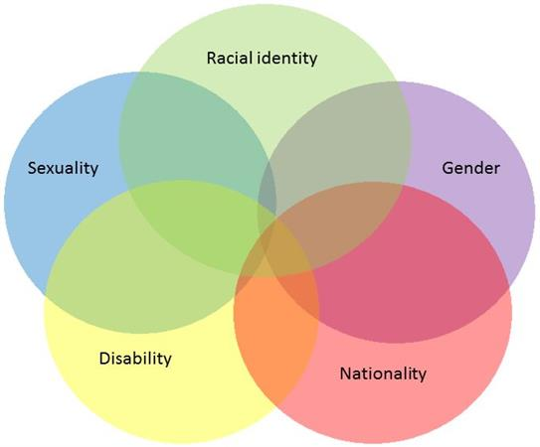
Intersectionality
“The interconnected nature of social categorizations such as race, class, and gender as they apply to a given individual or group, regarded as creating overlapping and interdependent systems of discrimination or disadvantage.”
Notes:
Coined in 1989 by professor Kimberlé Crenshaw to describe how race, class, gender, and other individual characteristics “intersect” with one another and overlap.

Slide 17
Written Communications
Instead of:
Handicapped
Special Needs
Disabled people
Disability organizations
Seniors/Senior citizens
Hearing Impaired
Retarded
“Suffers from…”
Use:
Disability
Accessible
People/Individuals with disabilities
Agencies serving people with disabilities
Older adults/aging population
D/deaf or hard of hearing
Intellectual/Developmental Disabilities
“Lives with…”

Slide 18
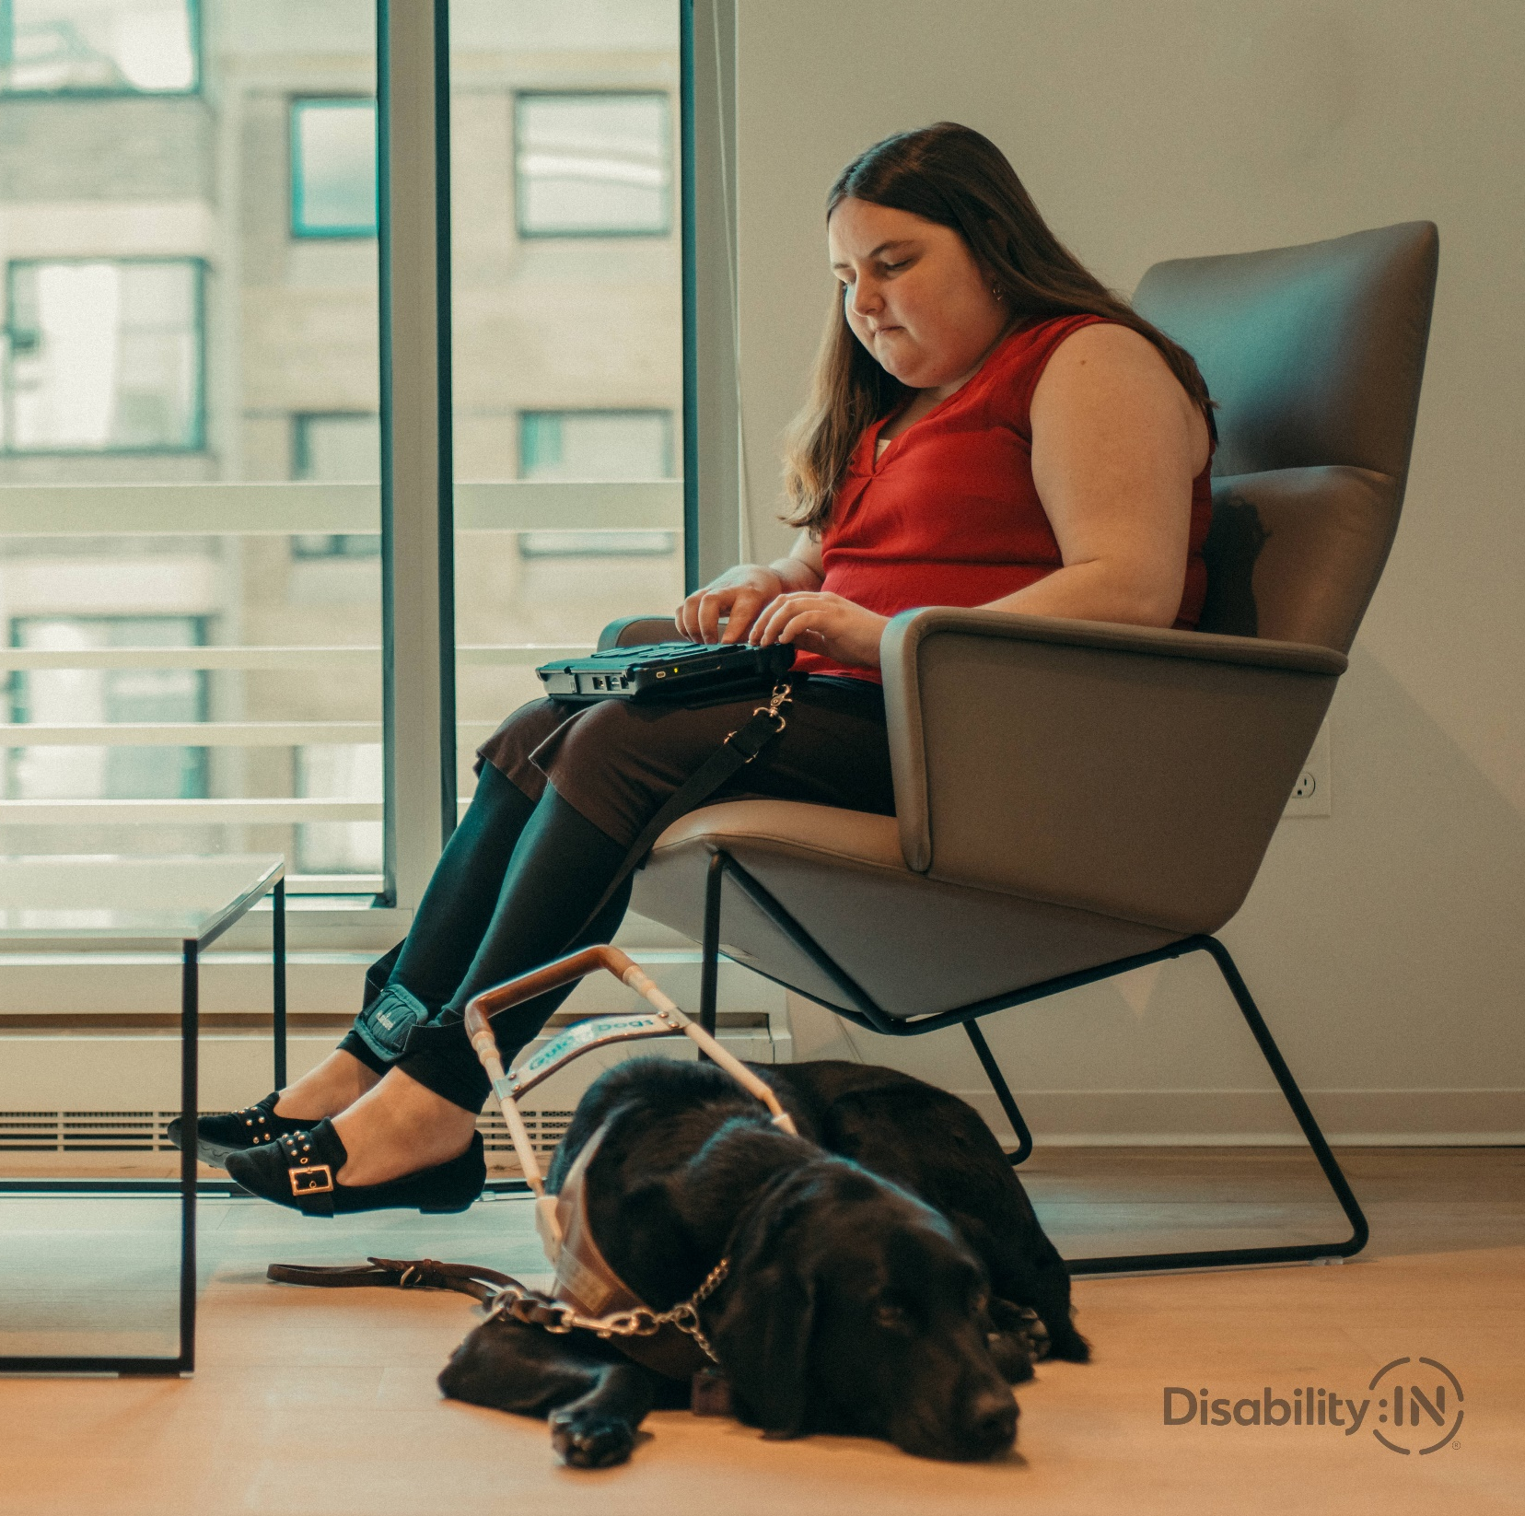
Visual/Graphic Representation
https://disabilityin.org/resource/disability-stock-photography/
https://affecttheverb.com/collection/
https://www.gettyimages.com/collections/thedisabilitycollection

Slide 19
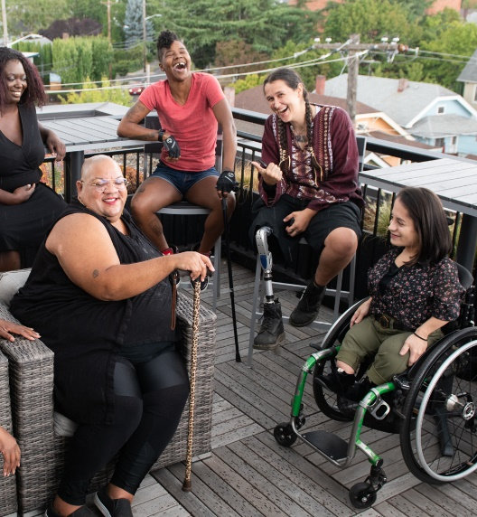
Simple Steps for Interactions
Work directly with the person
Give time and space
One step at a time
Plain language (no slang)
Use calm body language
Age appropriate
Touch only with consent
  Guiding people who are blind/visually impaired/vision loss
  Wheelchair as extension of person
Seek resources to help you
Remember: People are unique, behaviors and needs vary.

Slide 20
Everyday Ableism & Microaggressions
Choosing inaccessible venues/locations for events
Inaccessible meeting materials/documents
Framing disability as inspirational or tragic
Invasive questions/statements
  “How disabled are you?”
  “How did you become disabled?”
  “I don’t even think of you as disabled”
Terms/phrases like: “retarded” “that’s so lame” “I’m super OCD” “the blind leading the blind”
Notes:
Microaggression: indirect, subtle, or unintentional discrimination against members of a marginalized group. (accidentally being a jerk – intent versus impact)

Slide 21
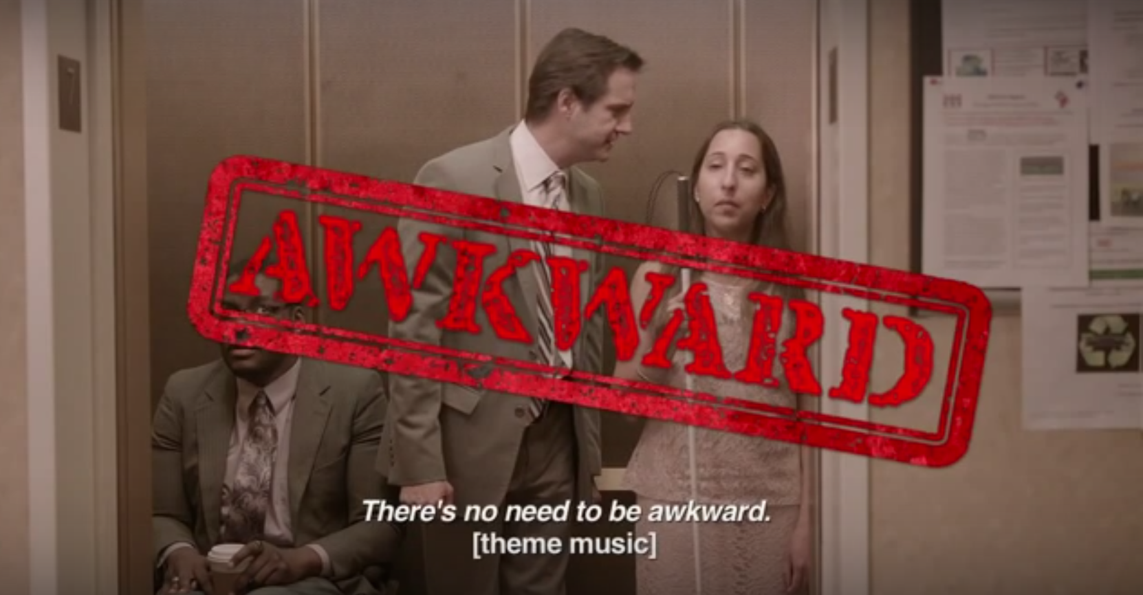
DC Office of Disability Rights
Notes:
https://youtu.be/Gv1aDEFlXq8?list=PLbFKGFkIKL21ureNznAlzeQmeB4zECsOc

Slide 22
We All Make Mistakes
Own it – Apologize – Make it Right – Move On
Three Fs
It’s not personal, no need to defend
Reactions/Responses vary

Slide 23
What Can You Do?
Make room at the table
Invite new voices to contribute
Acknowledge disability without judgement
Avoid assumptions
Follow the person’s lead
Recognize that disability is just one aspect of a person’s identity
Notes:
“If there’s not a seat at the table, bring a folding chair” Shirley Chisholm

Slide 24
It’s All About People

Slide 25
Resources
ADA Website www.ada.gov
Pacific ADA Center www.adapacific.org
Job Accommodation Network http://askjan.org/
California Commission on Disability Access www.ccda.ca.gov
Resources for Independence, Central Valley www.ricv.org

Slide 26
Nothing About Us Without Us:
Disability Awareness & Etiquette
Sarah Harris, Program Manager
Resources for Independence Central Valley
Sharris@ricv.org 559-221-2330
Shannon M. Mulhall, NIC, ADAC, CASp
SR HR Analyst, Former ADA Coordinator, City of Fresno
Special Programs Chair, Certified Access Specialist Institute
Shannon.Mulhall@fresno.gov

