Slide 1
Ada Coordination Survey Results
CCDA
Legislative Committee Meeting
January 15, 2020

Slide 2
CCDA FIVE-YEAR STRATEGIC GOAL #6
GOAL:
Explore the development of a state-level Americans with Disabilities Act (ADA) Access Office
PURPOSE:
To address the disparate levels of resources and information at various state offices by providing a single point of contact.

Slide 3
ONE-YEAR IMPLEMENTATION OF STRATEGIC GOAL #6
2019 Goal: Conduct research study on state accessibility compliance and coordination efforts.
Explanation: To further its mission, CCDA will partner with a research university to develop and conduct a survey of state government operations and effectiveness of ADA coordinators with regard to disability access.
Deliverables:
  Organize study participants at different agencies in state government
  Publish a roster of statewide ADA Coordinators
  Publish a report of survey findings

Slide 4
Background on Researchers
Deliverables and research are provided by the Mount Saint Mary’s University Graduate Students the Health Policy and Management Program.
Mount Saint Mary’s University is dedicated to inculcating leadership skills and nurturing characteristics of serving others.
The Master of Science in Health Policy and Management program aims to foster leaders who will comprehend today’s healthcare, endorse successful care systems, support effective health policies, and use evidence-based knowledge to advance the health of people and communities by emphasizing on medical humanities and liberal arts.

Slide 5
Methodology
The research was administered using the “Qualtrics Survey”.
Qualtrics is a program where one can open the survey, respond to a series of questions and generate a report to the administrator with outcomes.
The students used free response questions, one open-ended question, and multiple choice questions to present accurate data
The survey was delivered to ADA Coordinators within the state of California.
*Survey did not include any other ADA Coordinators outside of state service.

Slide 6
Survey questions

Slide 7
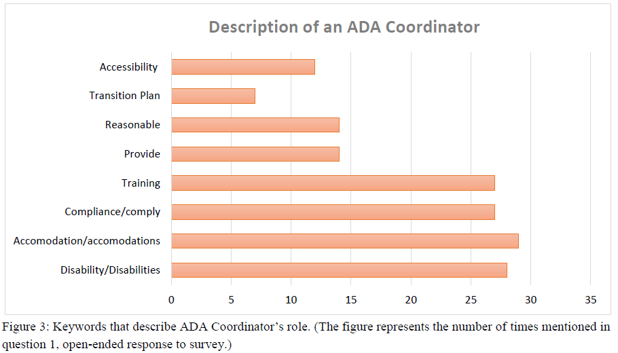
Question #1
Question: What are your specific duties as the ADA Coordinator for your agency/department/unit?
The answer was and open-ended response field.

Slide 8
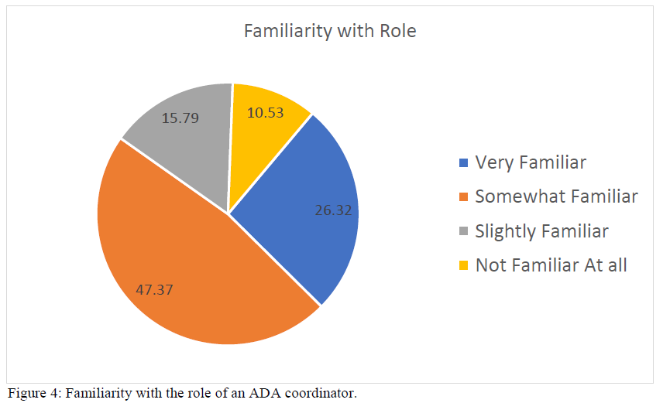
Question #2
Question: The Federal regulations require state and local governments with 50 or more employees to designate an employee responsible for coordinating compliance with ADA requirements. How familiar were you to the role of an ADA Coordinator upon assuming the position?

Slide 9
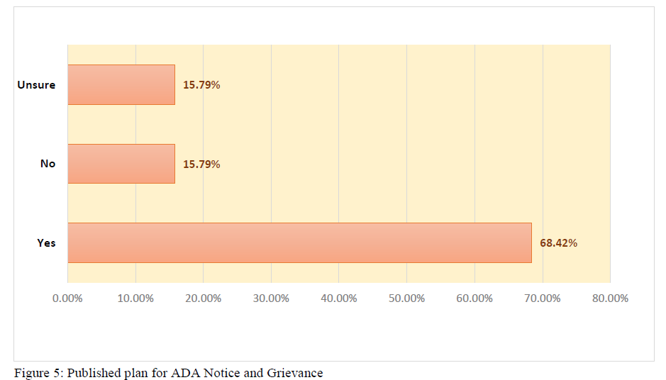
Question #3
  Question: Does your agency have a published plan for ADA Notice and Grievance for resolving complaints of disability discrimination?

Slide 10
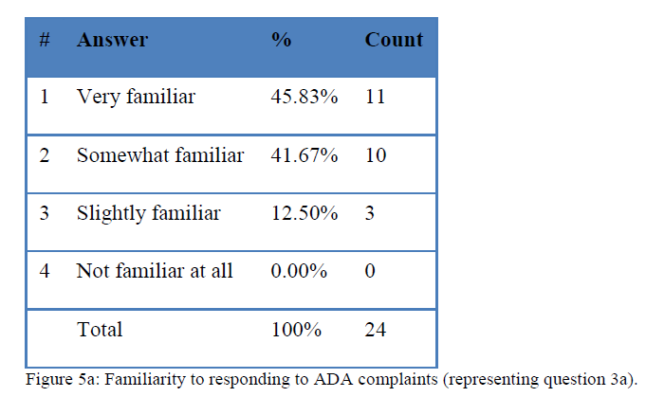
Question #3A
IF yes to Question #3, how familiar are you with the process of responding to ADA complaints?

Slide 11
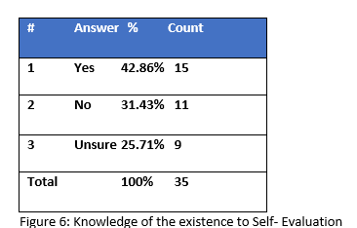
Question #4
Question: Are you aware of the existence within your agency/department/unit of a Self-Evaluation of its current services, policies, and practices, and the effects thereof, to determine necessary modifications to achieve program accessibility?

Slide 12
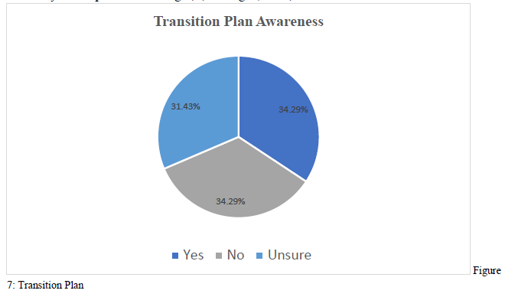
Questions #5
Question: Are you aware of the existence within your agency/department/unit the implementation of a Transition Plan?

Slide 13
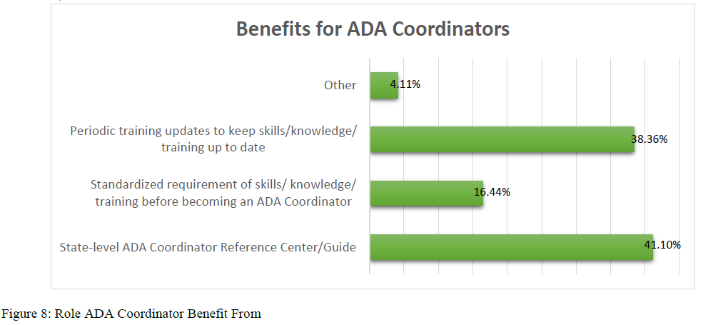
Questions #6
Question: What type of tools/policies/training would you recommend to better prepare future ADA Coordinators?

Slide 14
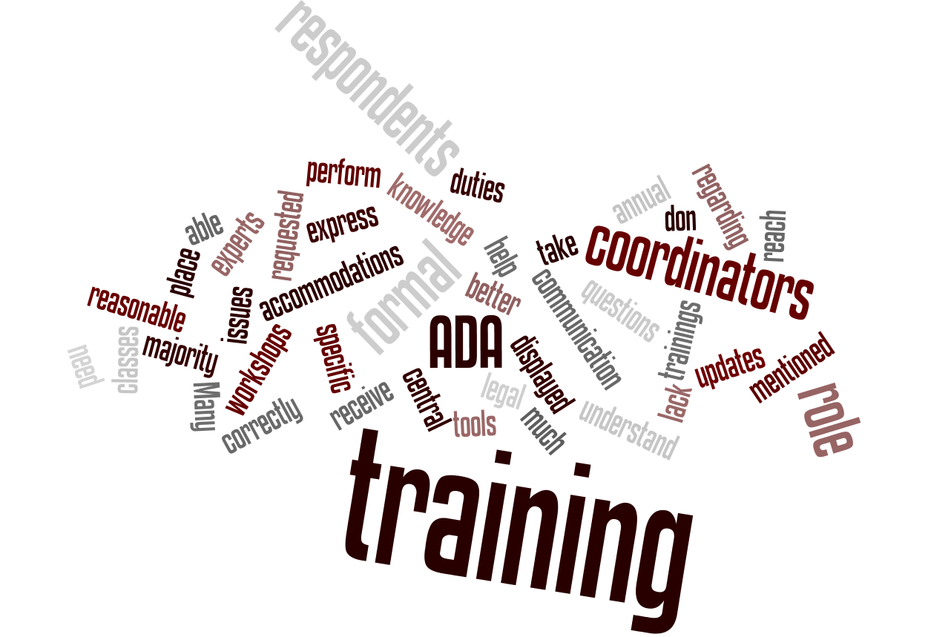
Question #7
Question: In your opinion, would your role as an ADA coordinator benefit from (choose all that apply):
  A State-level Ada Coordinator Reference center/guide
  a standardized requirement of skills/knowledge/training before becoming an ADA Coordinator
  Periodic training updates to keep skills/knowledge/training up to date
  Other

Slide 15
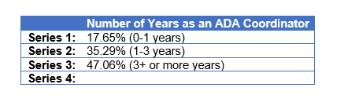
Question #8
Question: Number of Years as an ADA Coordinator:
  0-1yr
  1-3yrs.
  3+yrs.

Slide 16
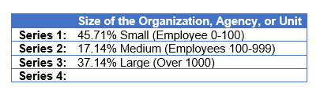
Question #9
Question: Size of the organization within which you work:
  Small (0-100)
  Medium (100-999)
  Large (over 1000)

Slide 17
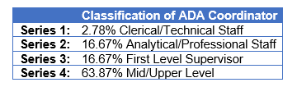
Question #10
Question: Which description best defines your classification?:
  Clerical/Technical Support
  Analytical/professional Staff
  1st Level Supervisor
  Mid/Upper Management

Slide 18
Total Number of Participants
The participants were gathered by going off of the State of California Org Chart.
Each Agency/Division/Unit within state work, was asked who their designated ADA coordinator(s) are.
Once all state service had been verified it list was given to the Graduate students.

Slide 19
Total Number of Respondents

Slide 20
Recommendations from ADA Coordinators
Comfortability of Role
26.3% Very Familiar
47.8% Somewhat Familiar
15.8% Slightly Familiar
10.5% not Familiar at all
Benefits
State Level – ADA Reference Center – 41.10%
Standardized requirement of skills – 38.36%
Trainings and Continual Education -16.44%
Other – 4.11%

Slide 21
Recommendations for CCDA
Future ADA coordinators receive formal training for their role for at least 1-2 days with training manual that guides them to better perform their roles.
Coordinators should be given resources and contacts in case they have questions or difficulty with any of their duties.
Provide a job description of someone who enters the role of an ADA coordinator to provide guidelines that can be followed.

Slide 22
Q & A / Discussion

Slide 23

CCDA Contact Information
PHONE: (916) 319-9974
EMAIL: CCDA@DGS.CA.GOV
WEBSITE: WWW.DGS.CA.GOV/CCDA

